Slide 1
Becoming an Inventor

Slide 2
Can anyone share something they know about Innovation or Invention?
Notes:
Ask the group if there is something they know about innovation.

Slide 3
Can anyone share something they know about Innovation or Invention?
What | Why | When | How | Who
Notes:
To help organize the discussion and encourage the group to see themselves as inventors/innovators, direct the group discussion to fill out the table on slide 4. Some general/possible entries for the five categories are below.

Slide 4
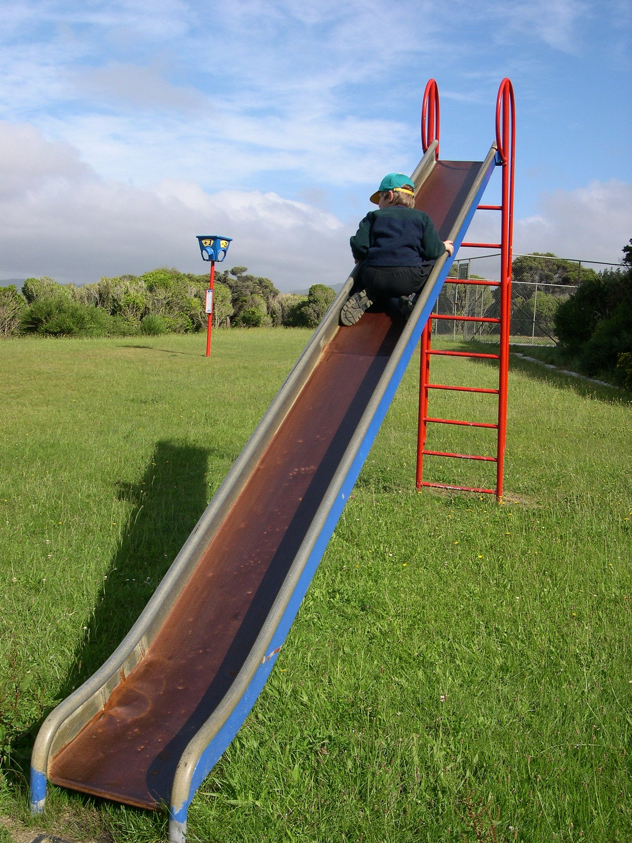
Can you think of some ways to make this slide better?
Notes:
Use this slide to collect ideas from the group. The ideas can come around fun or safety

Slide 5
Describe the slides you see in this picture

Slide 6
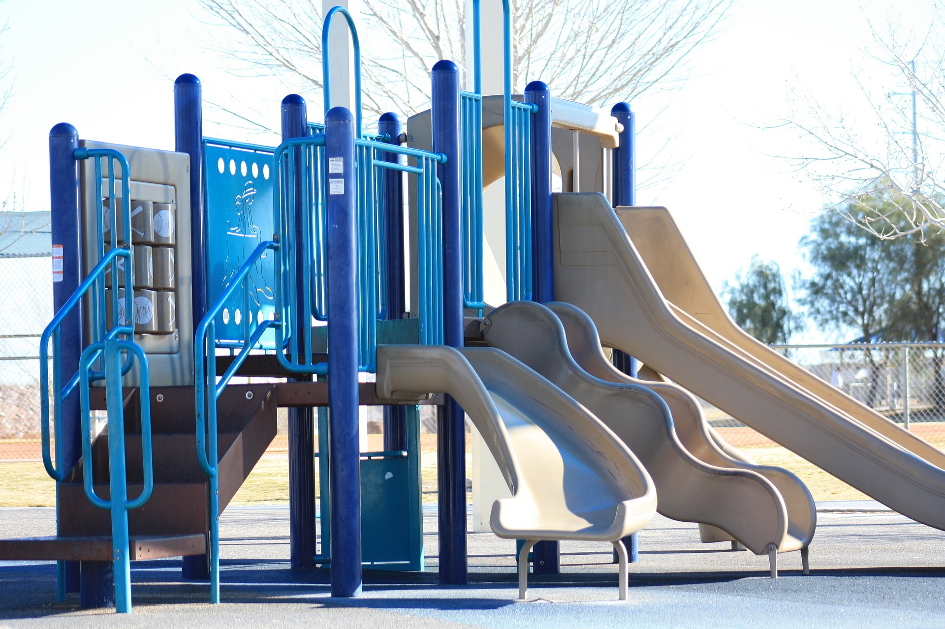
Describe the slides you see in this picture

Slide 7
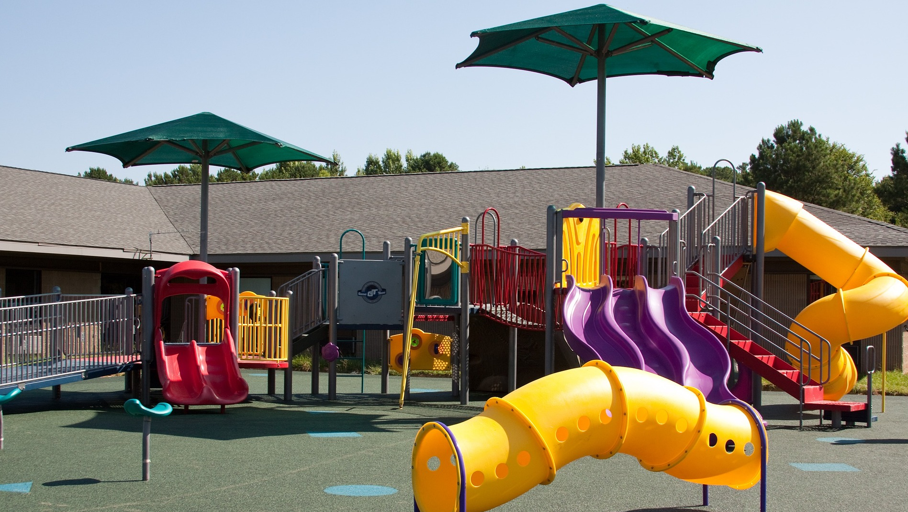
Describe the slides you see in this picture

Slide 8
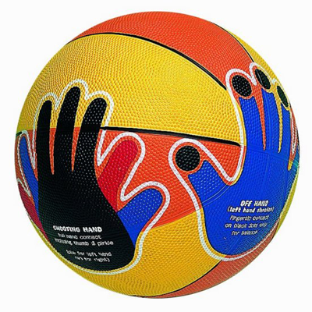
Innovator Profile – Chris Haas
CHRIS HAAS
Age at time of invention: 9 years old
Invention: Hands On basketball is a basketball that shows kids where to put their hands to make a given shot.
Notes:
Click on the picture to load the YouTube video - https://www.youtube.com/watch?v=Px1v20R7Dgo
After the video reflect with the group by having them answer the following things:
What object was being improved?
What was the improvement?
What help and tools did they use to come up with their solution?

Slide 9
Innovator Profile - Andrea Sreshta & Anna Stork
ANDREA SRESHTA AND ANNA STORK
From: New York City
Age at time of invention: Early 20’s
Invention: An inflatable solar powered lantern that can be used in emergencies or in areas without reliable electricity.
Photo curtesy of luminAID
Notes:
Click on the picture to load the YouTube video https://www.youtube.com/watch?v=8RR6shO-FHg
After the video reflect with the group by having them answer the following things:
What object was being improved?
What was the improvement?
What help and tools did they use to come up with their solution?

Slide 10
Lesson 2

Slide 11
Can anyone share something they know about Innovation?
What | Why | When | How | Who
Notes:
Have a quick (2 – 3 minute) recap discussion about what innovation is.

Slide 12
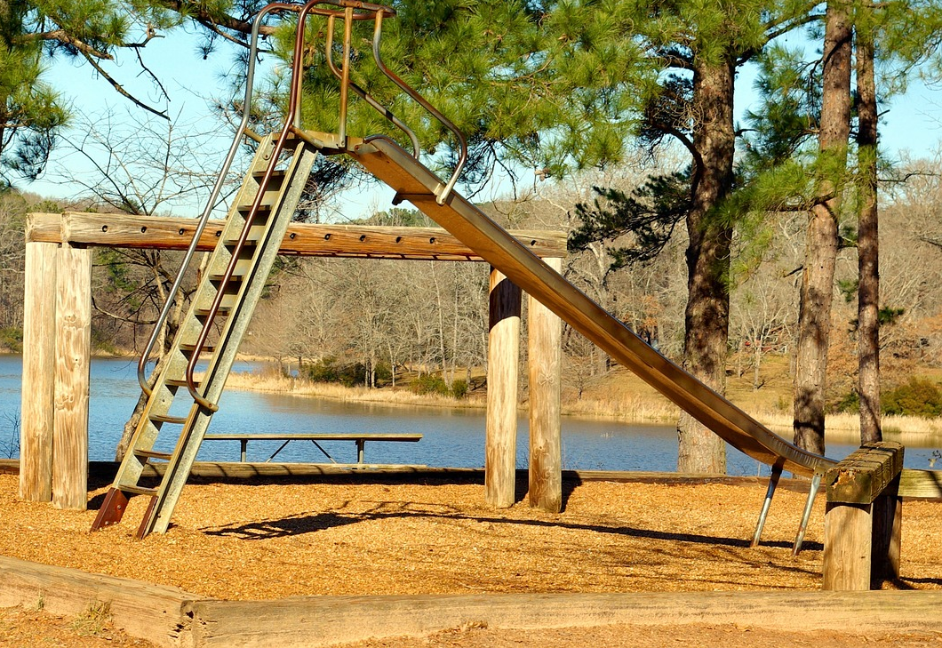
What might be a part of a better piece of playground equipment?
Notes:
Use this slide to collect ideas from the group. The ideas can come around fun or safety

Slide 13
Describe the equipment you see in this picture

Slide 14
Describe the equipment you see in this picture

Slide 15
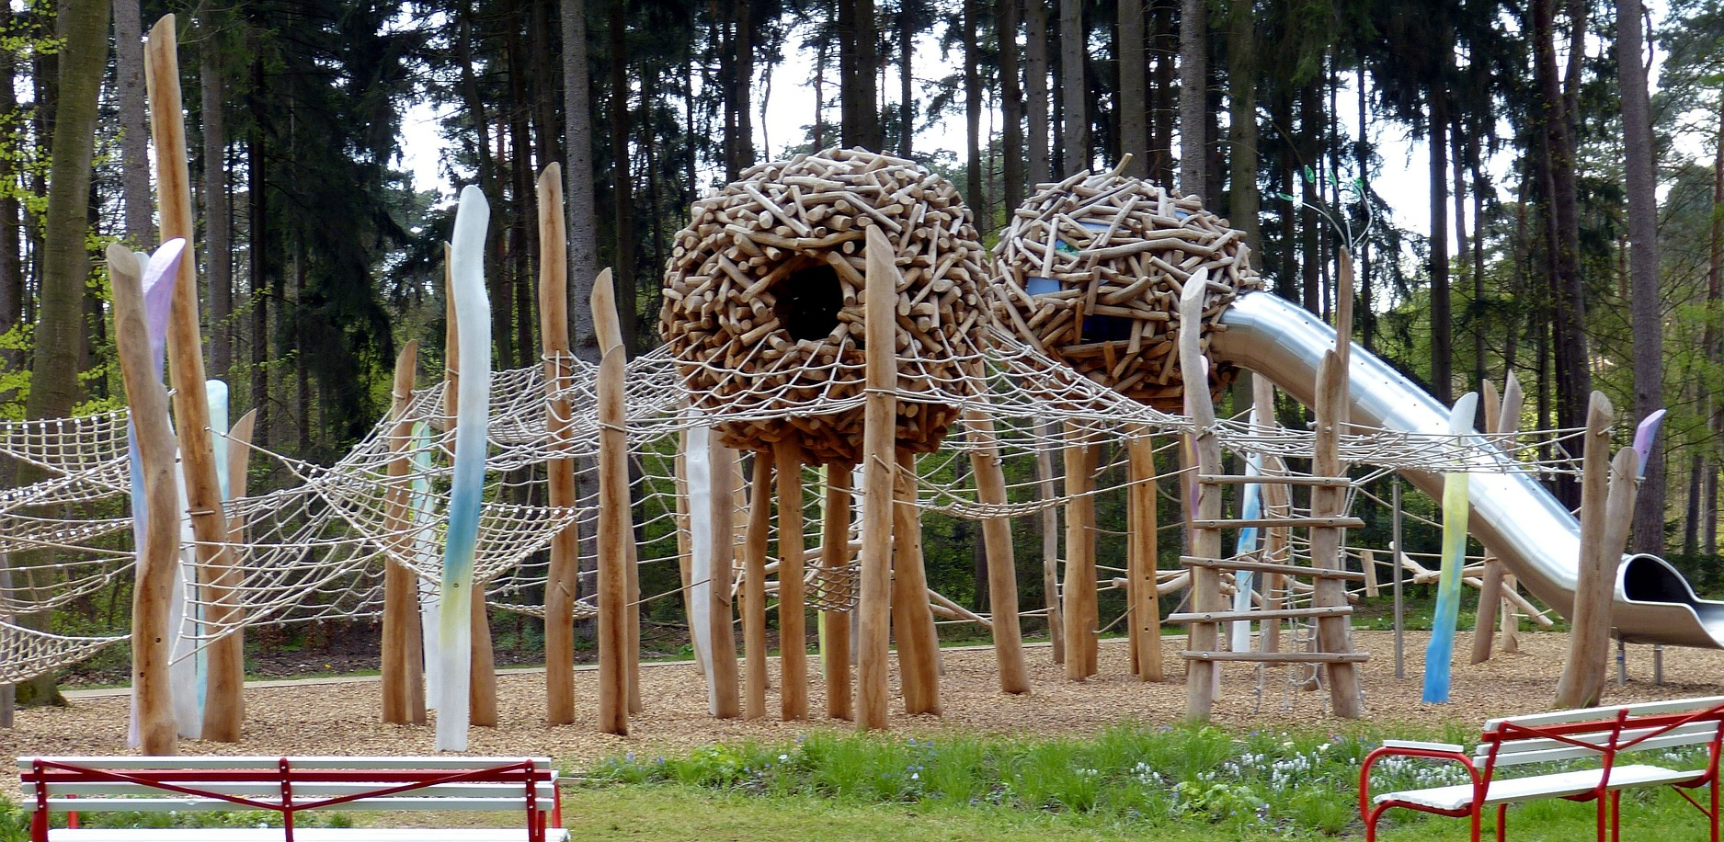
Describe the equipment you see in this picture

Slide 16
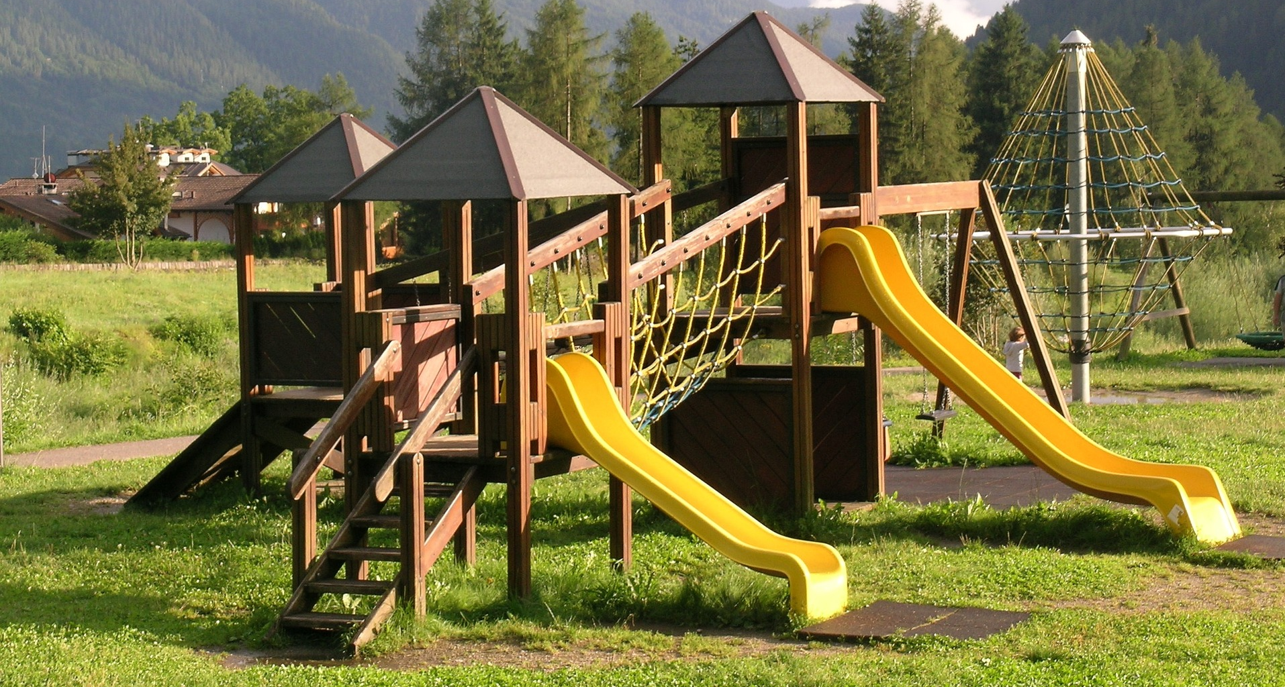
Describe the equipment you see in this picture

Slide 17
Day 3

Slide 18
Can anyone share something they know about Innovation?
What | Why | When | How | Who
Notes:
Have a quick (2 – 3 minute) recap discussion about what innovation is.

Slide 19
Giving and receiving feedback
What is feedback?
Notes:
To begin with, make sure students know what the word feedback means and when you might get or give it?

Slide 20
Giving and receiving feedback
Feedback is the HELPFUL information on things you like or things you think should be changed or modified that you give to someone so they can improve a performance, product, etc.
Notes:
To begin with, make sure students know what the word feedback means and when you might get or give it?

Slide 21
Giving and receiving feedback
What are some things to think about when giving and receiving feedback?
Notes:
To begin with, make sure students know what the word feedback means and when you might get or give it?

Slide 22
Giving and receiving feedback
Useful Phrases for Having Constructive Discussions
Asking Clarifying Questions
Can you give an example?
Can you please explain your thinking?
Could you say that one more time?
Adding to an Idea
I agree, and I have an addition: .
I believe this is true because .
Yes, that makes sense, and I would also like to add .
Respectfully Disagreeing with an Idea
Could you explain, because I have a different idea?
I disagree with that idea because .
Notes:
Go over the useful phrases with the group.
If possible, hand out a printed list of useful phrases.

Slide 23
Feedback Round 1
Put a picture of your invention here
Notes:
Have the students each find someone with a different innovation prompt.
Have them take turns explaining their innovation and then have the other person give feedback. Encourage everyone to say something nice then also say something constructive using one of the phrases. This should take about 2 – 4 min each person.
After 1 round of feedback, let the students work on their inventions for the rest of the session.

Slide 24
Feedback Round 2
Notes:
Have them take turns explaining their designand then have the other person give feedback. Encourage everyone to say something nice then also say something constructive using one of the phrases.

