Slide 1
Welcome

Slide 2
What things around you do you find frustrating or not fun to do?
Clean my room
Notes:
Use this slide to list out the frustrations the group comes up with.

Slide 3
Can anyone share something they know about INNOVATION?
Notes:
Ask the group if there is something they know about innovation.

Slide 4
Can anyone share something they know about INNOVATION?
What | Why | When | How | Who
Notes:
To help organize the discussion and encourage the group to see themselves as inventors/innovators, direct the group discussion to fill out the table on slide 4. Some general/possible entries for the five categories are below.

Slide 5
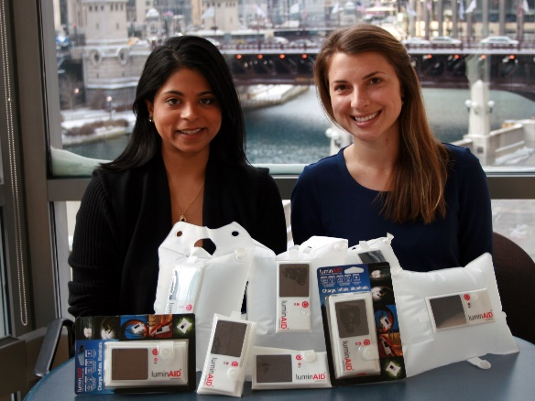
Innovator Profile - Andrea Sreshta & Anna Stork
ANDREA SRESHTA AND ANNA STORK
From: New York City
Age at time of invention: Early 20’s
Invention: An inflatable solar powered lantern that can be used in emergencies or in areas without reliable electricity.
Photo curtesy of luminAID
Notes:
Click on the picture to load the YouTube video https://www.youtube.com/watch?v=8RR6shO-FHg
After the video reflect with the group by having them answer the following things:
What is the problem that was being solved?
What is the solution?
What resources did they use to come up with their solution?

Slide 6
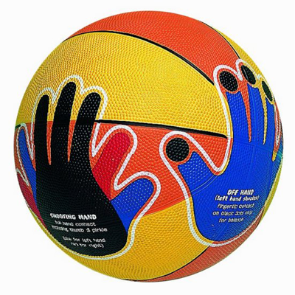
Innovator Profile – Chris Haas
CHRIS HAAS
Age at time of invention: 9 years old
Invention: Hands On basketball is a basketball that shows kids where to put their hands to make a given shot.
Notes:
Click on the picture to load the YouTube video - https://www.youtube.com/watch?v=Px1v20R7Dgo
After the video reflect with the group by having them answer the following things:
What is the problem that was being solved?
What is the solution?
What resources did they use to come up with their solution?

Slide 7
What things around you do you find frustrating or not fun to do?
Notes:
Copy the frustration list from slide 2 to slide 7.
Have the group pick one or two of their frustrations and recast as a challenge that is actionable (it might already be this way, but if not take a couple of minutes to do this).
Example – I hate feeding the dog → The dog’s food gets everywhere when he/she eats, and I wish it didn’t.

Slide 8
Brainstorming
Notes:
Ask the group if someone can tell you what brainstorming is – coming up with as many ideas around a challenge or topic or problem as possible. Remind the group that we don’t judge ideas as good or bad in brainstorming, we’re just trying to come up with as many ideas as possible.
Pick one of the frustrations from the previous page and have the group work on coming up with as many ideas around that frustration as possible.

Slide 9
Plan for the next few days – you become the inventors!
Day 1 (today) – Introduction to invention
Days 2 & 3 – Distribute the Book of Ideas, work on your inventions, give feedback to and get feedback from your classmates
Day 4 – Finish up your invention and present your idea to the group
Notes:
Show students the Book of Ideas but don’t hand them out yet.

Slide 10
Lightning Round Brainstorming
Today in school I had a great idea...
We should reuse car tires to make...
How cool would it be if we could make electricity from...
This could help keep our oceans clean and safe...
What if we put solar panels on...
I wish we could run airplanes, cars and trucks on...
What if we used heat from the Earth to power...
What if we used heat from the Earth to power...
This would make it easier for people to save energy...
I want to make a difference by…
We should reuse dishwater and shower water to…
What if we could make houses out of...
This would make it easier for people and companies to use less water...
I want to make a difference by...
Notes:
On the slide are all the prompts in the Book of Ideas.
Read through them as a group. While you’re doing this handout 1 – 2 pieces of scratch paper to each student.
After you have read through all the prompts, have the students each pick one and spend 2 -3 minutes INDIVIDUALLY brainstorming all the things they can think about to address that prompt or challenge. They should write either the prompt (ideally) or the prompt number (alternative) on the top of their page. Writing down the full prompt will help them keep focused on it as they brainstorm.
After 2 – 3 minutes have the students share out some of their ideas.
Depending on the time remaining, do a repeat session with a new prompt.

Slide 11
Day 2

Slide 12
Plan for the next few days – you become the inventors!
Day 1 – Introduction to invention
Days 2 (today) & 3 – Distribute the Book of Ideas, work on your inventions, give feedback to and get feedback from your classmates
Day 4 – Finish up your invention and present your idea to the group
Notes:
Remind students of the plan for the week

Slide 13
Can anyone share something they know about Innovation?
What | Why | When | How | Who
Notes:
Then have a quick (2 – 3 minute) recap discussion about what innovation is.

Slide 14
The Engineering Design Process
Step 1: Start with a question, problem, or goal. Step 2: Think about all the possibilities. (brainstorming) Step 3: Decide which ideas from step 2 you want to use. Step 4: Create your first draft/prototype/version. Step 5: Get feedback and improve your design.
Notes:
Go over the steps on the slide and point out to the group that the “Engineering Design Process is just a formal (or fancy) title for something they do all the time.

Slide 15
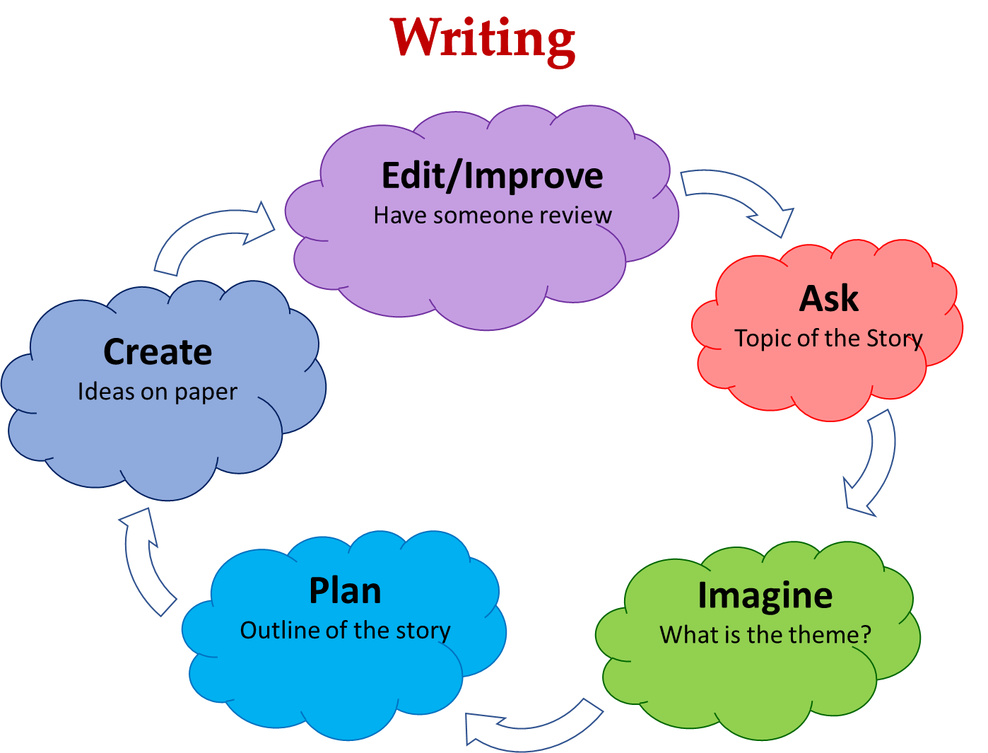
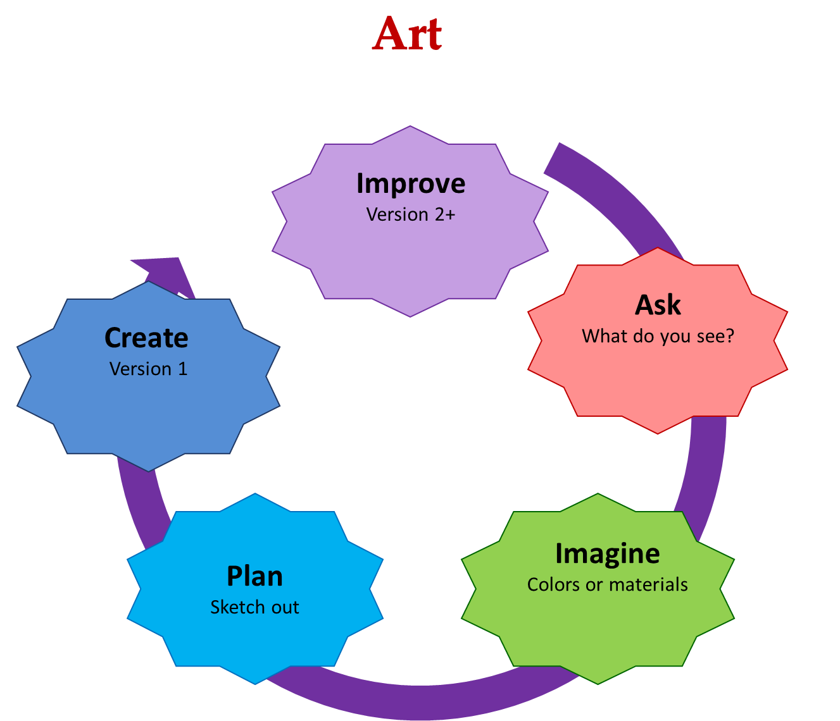
The Engineering Design Process
Notes:
You can show them that is similar to processes they use in art or writing – just with science and engineering.

Slide 16
The Engineering Design Process
Step 1: Start with a question, problem, or goal. Step 2: Think about all the possibilities. (brainstorming) Step 3: Decide which ideas from step 2 you want to use. Step 4: Create your first draft/prototype/version. Step 5: Get feedback and improve your design.
Notes:
Take a minute to point out the final step in the cycle is feedback – we’ll talk a bit more about that later – and that it is a key step in keeping the cycle going.

Slide 17
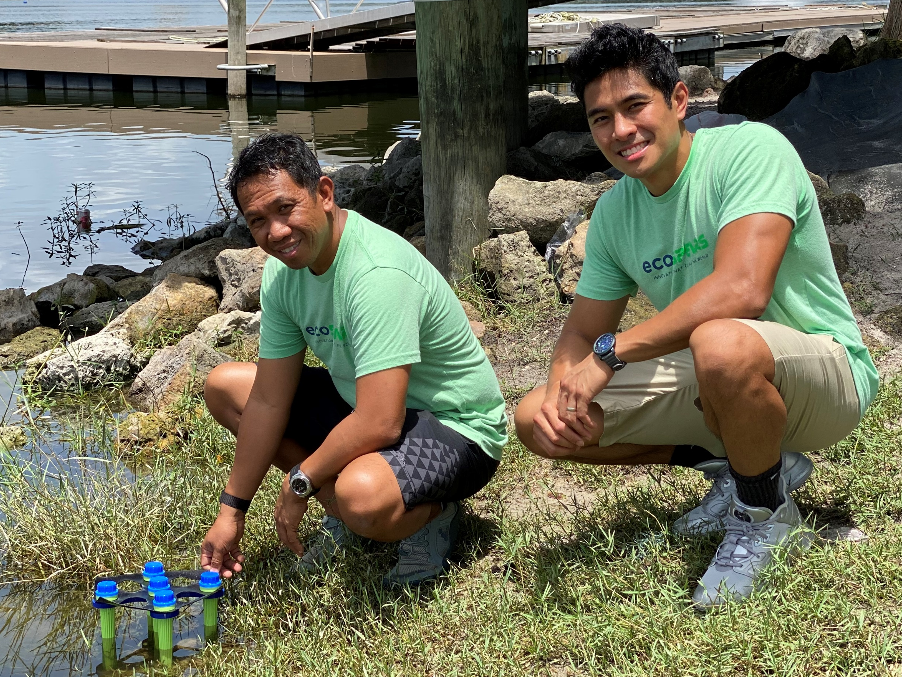
Innovator Profile – ecoSpears
SERG ALBINO & IAN DOROMAL
From: New York and Florida
Age at time of invention: 20 - 30
Invention: A sponge-filled spear that is able to absorb harmful chemicals out of the mud to clean lakes and rivers.
Photo curtesy of ecoSPEARS
Notes:
Click on the picture to load the YouTube video. https://youtu.be/8I3FVFclvss
After the video reflect with the group by having them answer the following things:
What is the problem that was being solved?
What is the solution?
What resources did they use to come up with their solution?

Slide 18
Get Inventing!
Today in school I had a great idea...
We should reuse car tires to make...
How cool would it be if we could make electricity from...
This could help keep our oceans clean and safe...
What if we put solar panels on...
I wish we could run airplanes, cars and trucks on...
What if we used heat from the Earth to power...
Pick one of the 14 challenges in the book and start working on an invention or innovation to address the challenge
What if we used heat from the Earth to power...
This would make it easier for people to save energy...
I want to make a difference by…
We should reuse dishwater and shower water to…
What if we could make houses out of...
This would make it easier for people and companies to use less water...
I want to make a difference by...
Notes:
Hand out the Book of Ideas have the group start working on individual inventions.
It does NOT need to be the one they worked on before. They should try to work solidly for 15 – 20 minutes. They can switch prompts if they want.

Slide 19
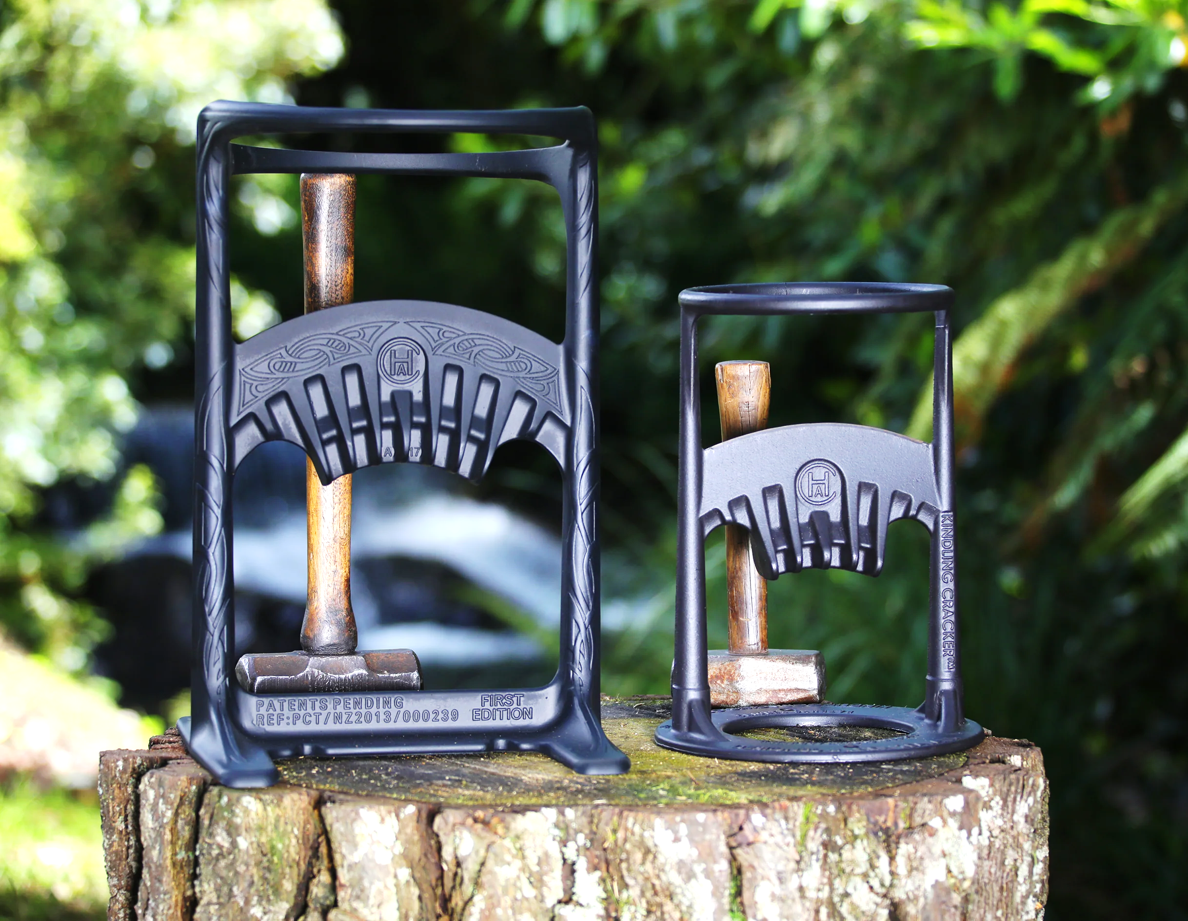
Innovator Profile – Ayla Hutchinson
Ayla Hutchinson
From: New Zealand
Age at time of invention: 13 years old
Invention: Alya invented the Kindling Cracker after her mother cut herself with an ax while chopping firewood.
Product Review
Notes:
Kindling Cracker - https://www.youtube.com/watch?v=LmEbjC0xY60 - Click on the picture to load the YouTube video
This video isn’t the best but it provides enough information to reflect on. You can also check out the product website (https://www.kindlingcracker.com/blogs/about-ayla)
After watching the video, reflect on the following questions
What is the problem that was being solved?
What is the solution?
YouTube is full of great reviews – which are a good intro to the feedback section. Show a video review (https://www.youtube.com/watch?v=4-RhakR3Hg8) and then ask the students:
What did you notice (often both positive observations/experiences and negative experiences were mentioned).
How might these reviews be helpful to Ayla (they could help her make changes to improve her product)

Slide 20
Giving and receiving feedback
What is feedback?
Notes:
To begin with, make sure students know what the word feedback means and when you might get or give it?

Slide 21
Giving and receiving feedback
Feedback is the HELPFUL information on things you like or things you think should be changed or modified that you give to someone so they can improve a performance, product, etc.
Notes:
To begin with, make sure students know what the word feedback means and when you might get or give it?

Slide 22
Giving and receiving feedback
What are some things to think about when giving and receiving feedback?
Notes:
To begin with, make sure students know what the word feedback means and when you might get or give it?
Time and interest permitting, revisit some of the product reviews or product improvements made with the Kindling Cracker (e.g., between version 1 and the XL – which basically got bigger so that larger logs could be used).

Slide 23
Giving and receiving feedback
Useful Phrases for Having Constructive Discussions
Asking Clarifying Questions
Can you be more specific?
Why do you think that happened?
Can you please explain your thinking?
Can you give me another example, so I can understand?
Adding to an Idea
I agree, and I have an addition: .
I believe this is true because .
Yes, that makes sense, and I would also like to add .
Respectfully Disagreeing with an Idea
Could you explain, because I have a different idea?
I respect your opinion and .
I see your reasoning and disagree with some of the idea because .
Notes:
Go over the useful phrases with the group.
If possible, hand out a printed list of useful phrases.

Slide 24
Feedback Round 1
Time to test it out.
Find someone working on a DIFFERENT innovation prompt.
Notes:
Have the students each find someone with a different innovation prompt.
Have them take turns explaining their innovation and then have the other person give feedback. Encourage everyone to say something nice then also say something constructive using one of the phrases. This should take about 2 – 4 min each person.
After 1 round of feedback, let the students work on their inventions for the rest of the session.

Slide 25
Day 3

Slide 26
Plan for the next few days – you become the inventors!
Day 1 – Introduction to invention
Days 2 & 3 (today) – Distribute the Book of Ideas, work on your inventions, give feedback to and get feedback from your classmates
Day 4 – Finish up your invention and present your idea to the group
Notes:
Remind students of the plan for the week

Slide 27
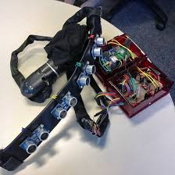
Innovator Profile – Alex Deans
ALEX DEANS
From: Windsor, Ontario, Canada
Age at time of invention: 13 years old
Invention: The iAid device help people who are blind or have trouble seeing get around more easily.
Notes:
Go through the innovator profile and then give students 5 - 10 minutes to get reacquainted with their inventions.
If a lot of students want to start in on a new innovation prompt, then give them up to 20 minutes to work on it before the next round of feedback
Click on the picture to load the YouTube video - https://youtu.be/EGPo7gnvlhE?si=ZVIUkA7hDrugxPz6
After the video reflect with the group by having them answer the following things:
What is the problem that was being solved?
What is the solution?
What resources did they use to come up with their solution? How did they incorporate feedback?

Slide 28
Giving and receiving feedback
Feedback is the HELPFUL information on things you like or things you think should be changed or modified that you give to someone so they can improve a performance, product, etc.
Notes:
If necessary, Give a quick refresher on feedback.

Slide 29
Giving and receiving feedback
Useful Phrases for Having Constructive Discussions
Asking Clarifying Questions
Can you be more specific?
Why do you think that happened?
Can you please explain your thinking?
Can you give me another example, so I can understand?
Adding to an Idea
I agree, and I have an addition: .
I believe this is true because .
Yes, that makes sense, and I would also like to add .
Respectfully Disagreeing with an Idea
Could you explain, because I have a different idea?
I respect your opinion and .
I see your reasoning and disagree with some of the idea because .
Notes:
Remind students of the helpful phrases

Slide 30
Feedback Round 2
Find someone working on the SAME innovation prompt.
Notes:
Have the students each find someone with the same innovation prompt (if possible).
Have them take turns explaining their innovation and then have the other person give feedback. Encourage everyone to say something nice then also say something constructive using one of the phrases. This should take about 2 – 4 min each person.
Keep track of the time and then at the end have them go back to working on their innovations.
After 1 round of feedback, let the students work on their inventions for the rest of the session.

Slide 31
Sneak Peek – Next Session Presentation ☺
Hi, My name is_________. Today I will tell you about the __________________________________________. (enter the name of your invention or solution).
Today I’m going to tell you about __________________________________________ which
(enter the name of your invention or solution)
__________________________________________________________________________.
(describe what the invention does in 1 sentence)
The _________________________________________ has the following features ________________________
(enter the name of your invention or solution) (describe your solution in a bit more detail 1- 3 sentences)
____________________________________________________________________________.
Thank you for your time and attention.

Slide 32
Day 4

Slide 33
Plan for the next few days – you become the inventors!
Day 1 – Introduction to invention
Days 2 & 3 – Distribute the Book of Ideas, work on your inventions, give feedback to and get feedback from your classmates
Day 4 (today) – Finish up your invention and present your idea to the group
Notes:
Remind students of the plan for the week

Slide 34
Presentation
Hi, My name is_________. Today I will tell you about the __________________________________________. (enter the name of your invention or solution).
Today I’m going to tell you about __________________________________________ which
(enter the name of your invention or solution)
__________________________________________________________________________.
(describe what the invention does in 1 sentence)
The _________________________________________ has the following features ________________________
(enter the name of your invention or solution) (describe your solution in a bit more detail 1- 3 sentences)
____________________________________________________________________________.
Thank you for your time and attention.
Notes:
Take the next 20 minutes and finish up your inventions and think about what you want to say to the group. If possible, hand out printouts of the script template so that they can fill it out.

Slide 35
Presentations!

