Slide 1
Collaborative Communities
Presented by

Slide 2
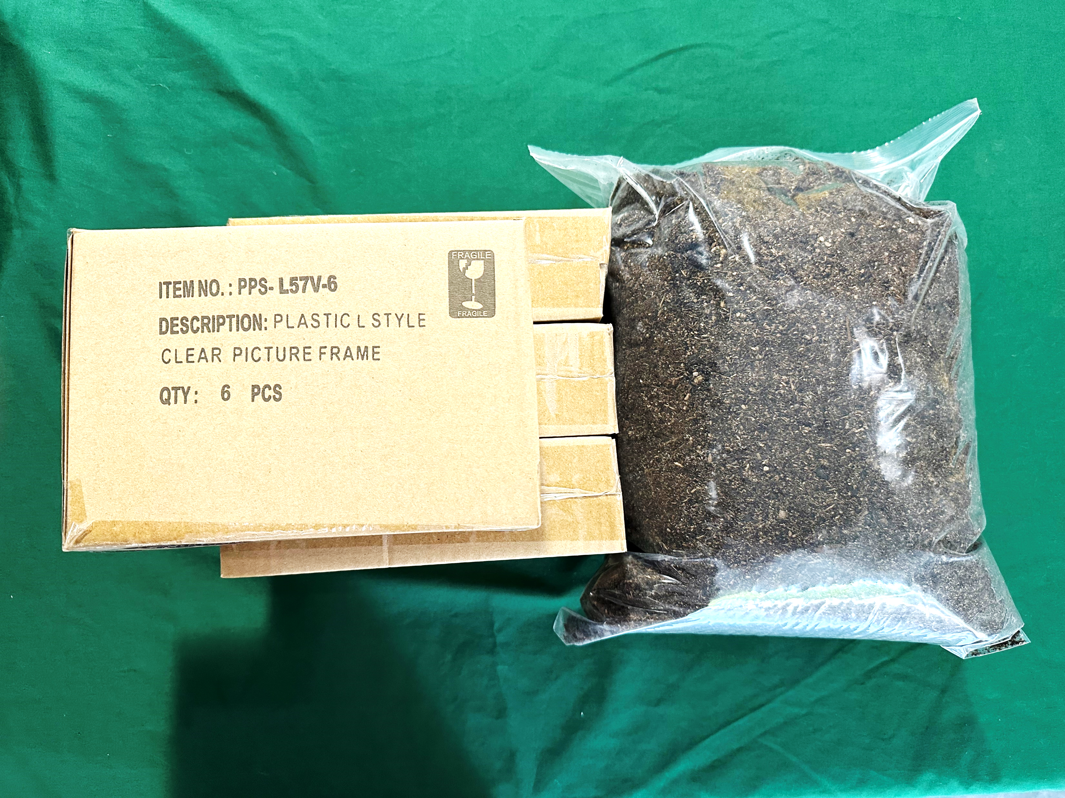
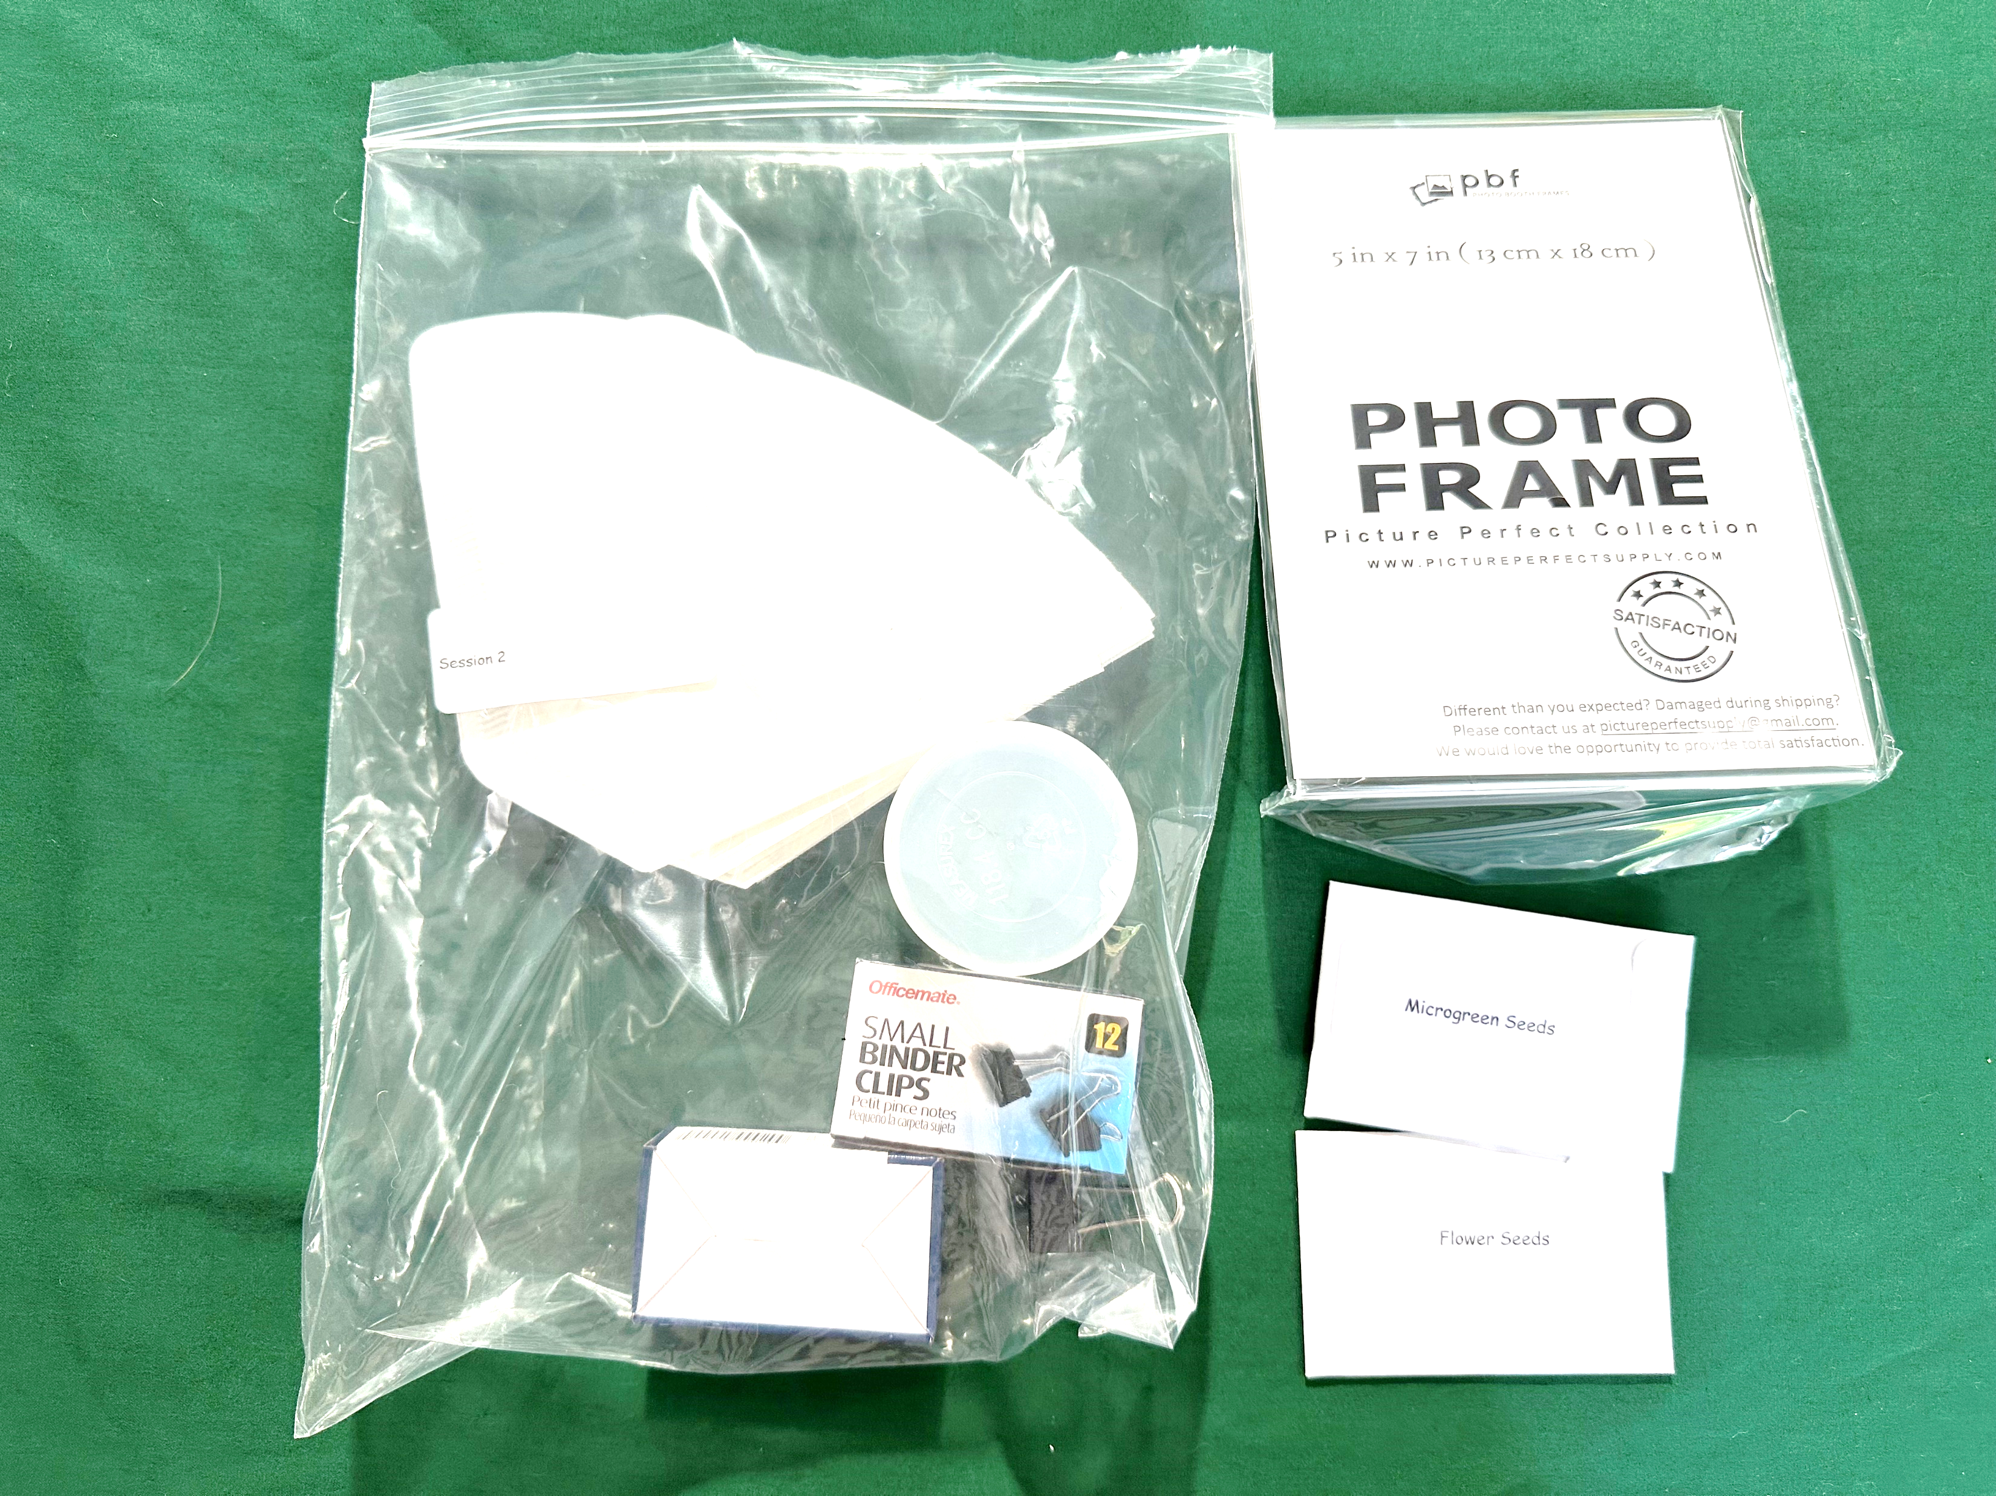
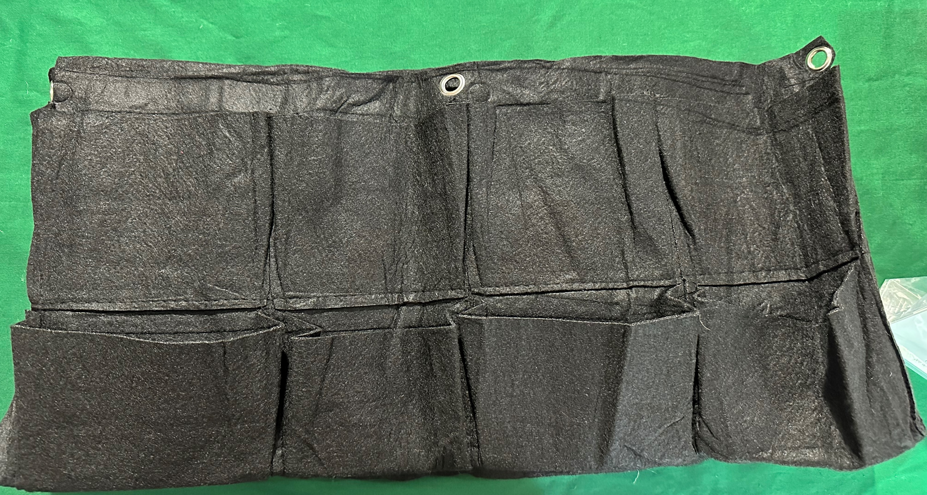
Session 2
Your Natural Neighbors
What you need
Participant notebook Per Participant: Acrylic frame (1) Felt pocket (1) Coffee filter (1) Binder clip (1) Soil (1 scoop) Foil (1 sheet) Seeds (4 – 5) Adhesive dots ½ cup scoop Additional Supplies Needed Pens/pencil Water (tap) Adult Scissors
Session Flow | Session Flow
5 min | Welcome. Topic introduction via discussion prompt
5 min | Initial discussion on living walls.
25 min | Initial living wall assembly Reflection on living walls and seed selection Completion of living walls
10 min | Reflection and technology discussion
Final 10 minutes | Cleanup and share out on final reflection
Session 2 Materials
Participant Notebook

Slide 3
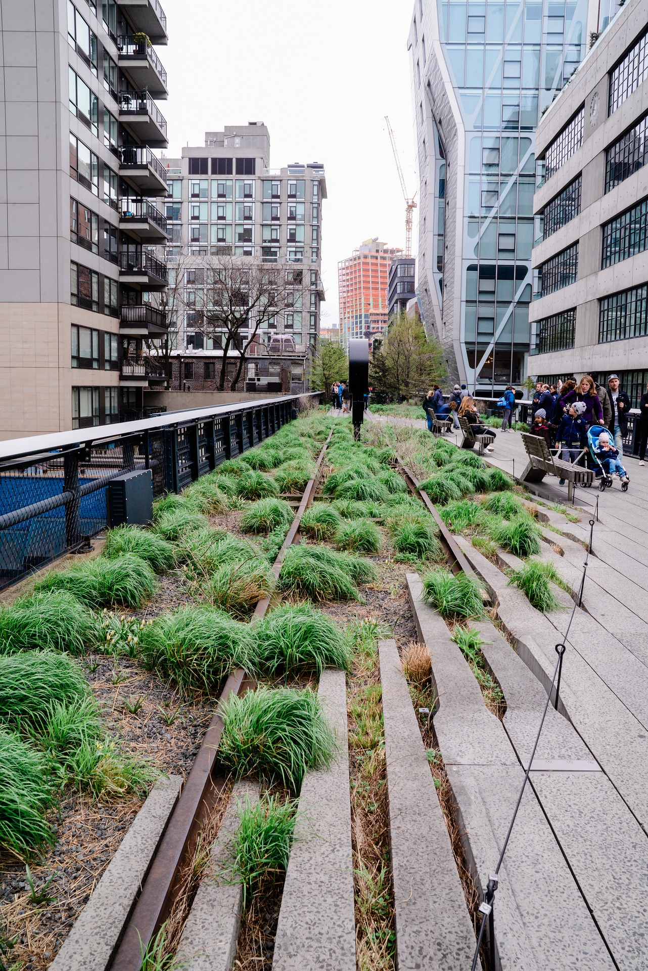
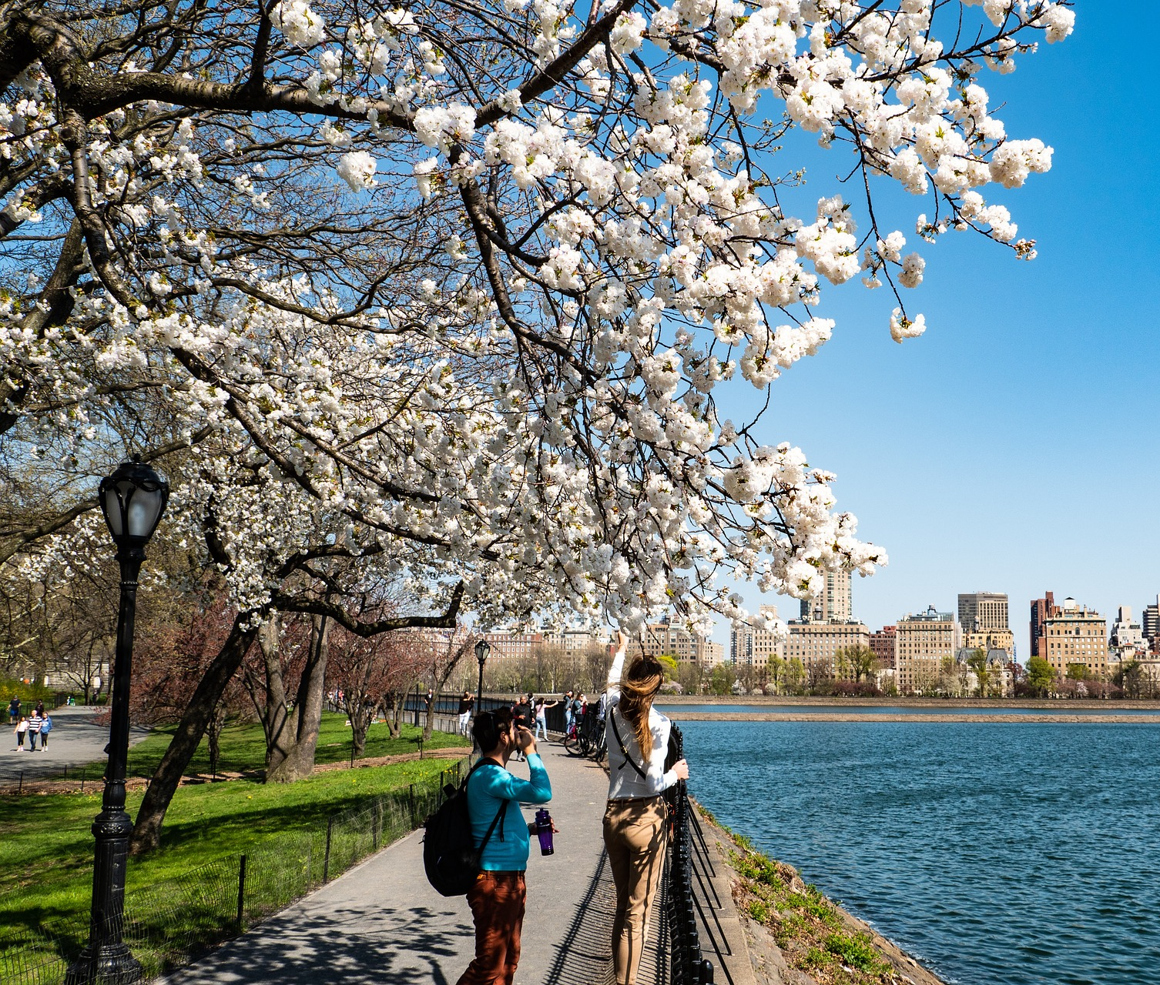
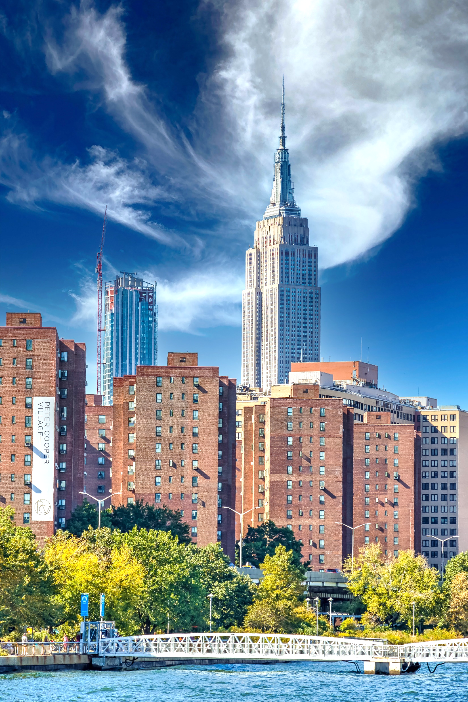
Session 2
Your Natural Neighbors
Where can you find plants in your neighborhood?

Slide 4
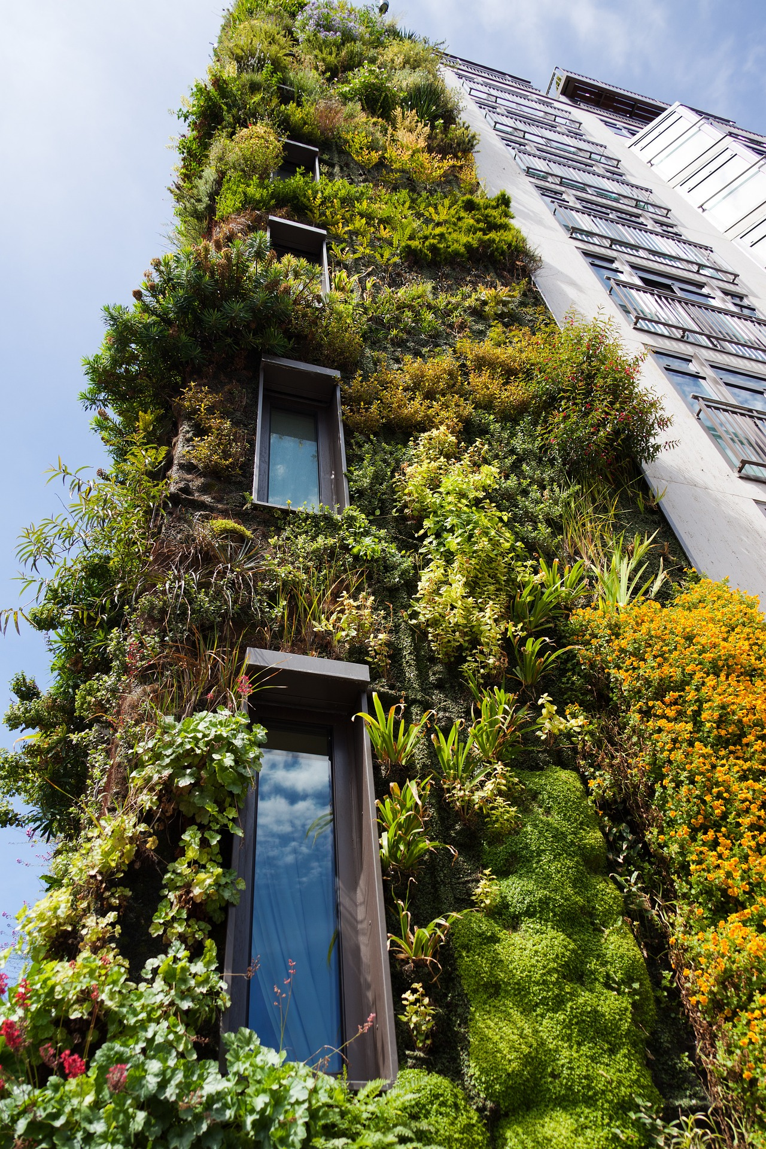
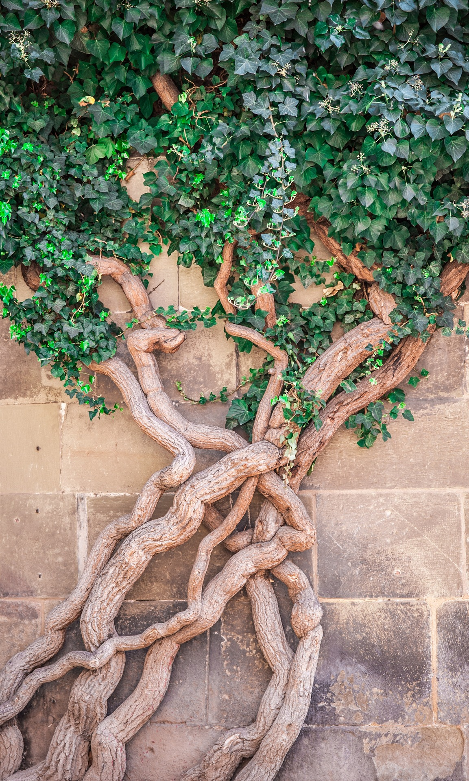
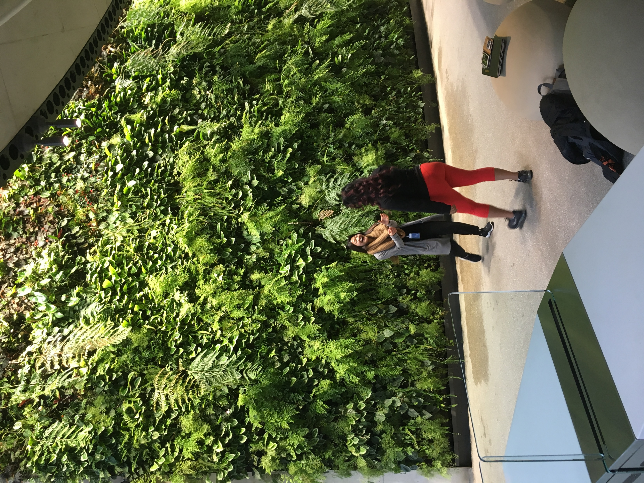
Session 2
Your Natural Neighbors
What about on the walls?

Slide 5
Session 2
Your Natural Neighbors: Living Walls
Inside:
The plants provide a source of fresh oxygen.
The plants naturally absorb sound so people can work, talk, and think.
Many people find the color green relaxing.

Slide 6
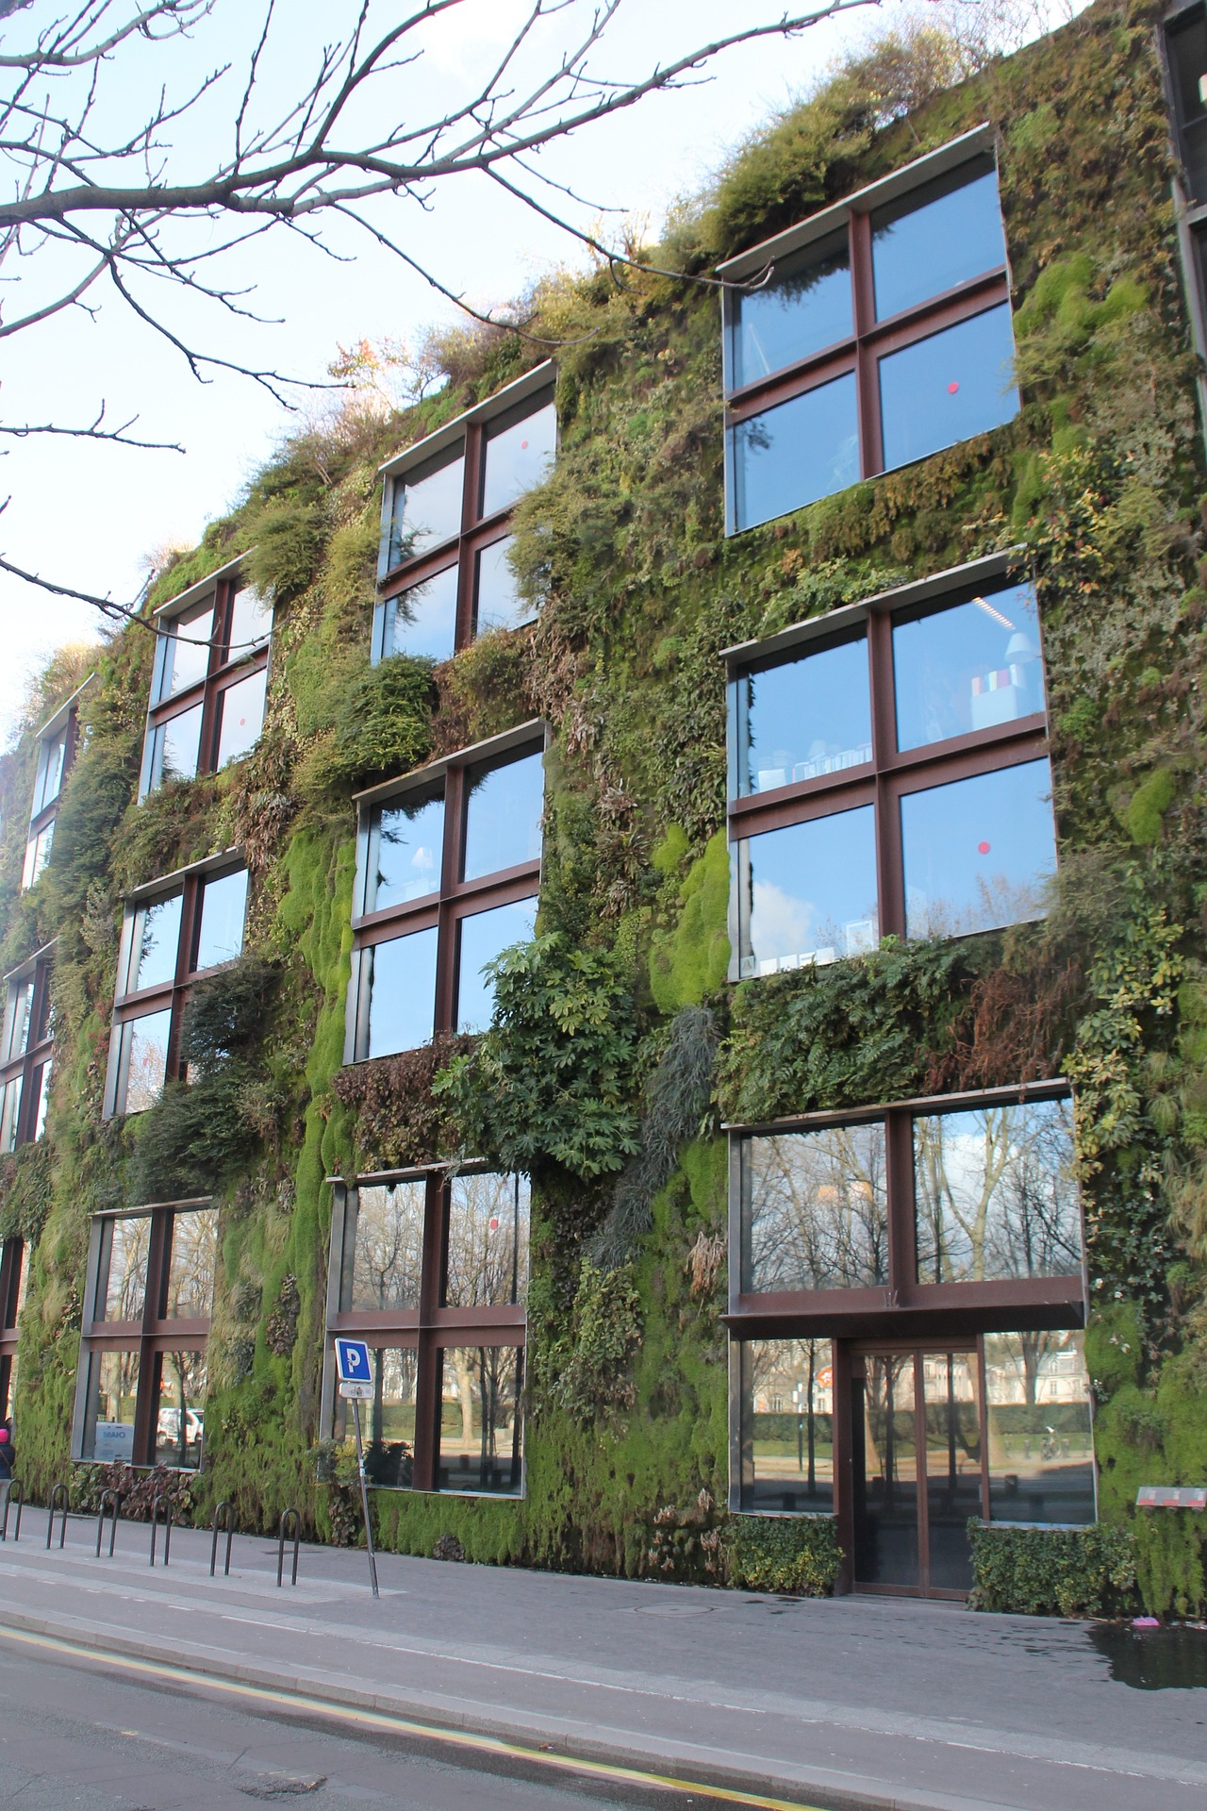
Session 2
Your Natural Neighbors: Living Walls
Outside:
Living walls provide homes and food for small animals, insects, and pollinators.

Slide 7
Session 2
Your Natural Neighbors: Living Walls
What if we used them to grow food?

Slide 8
Session 2
Your Natural Neighbors
“Homemade” living walls

Slide 9
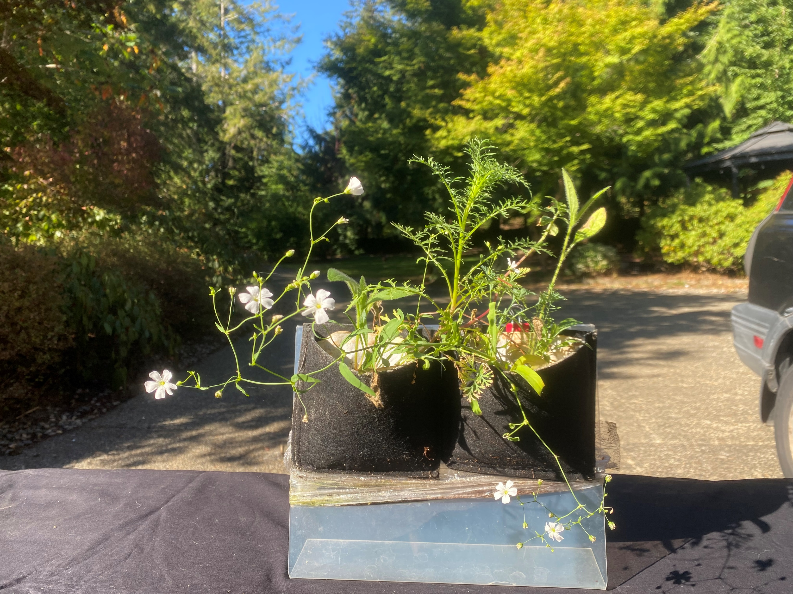
Session 2
Your Natural Neighbors: Living Walls
What you need:
Picture frames
Felt Pockets
Coffee filters
Binder clip
Soil
Seeds
Adhesive dots
Foil
What are your design criteria?

Slide 10
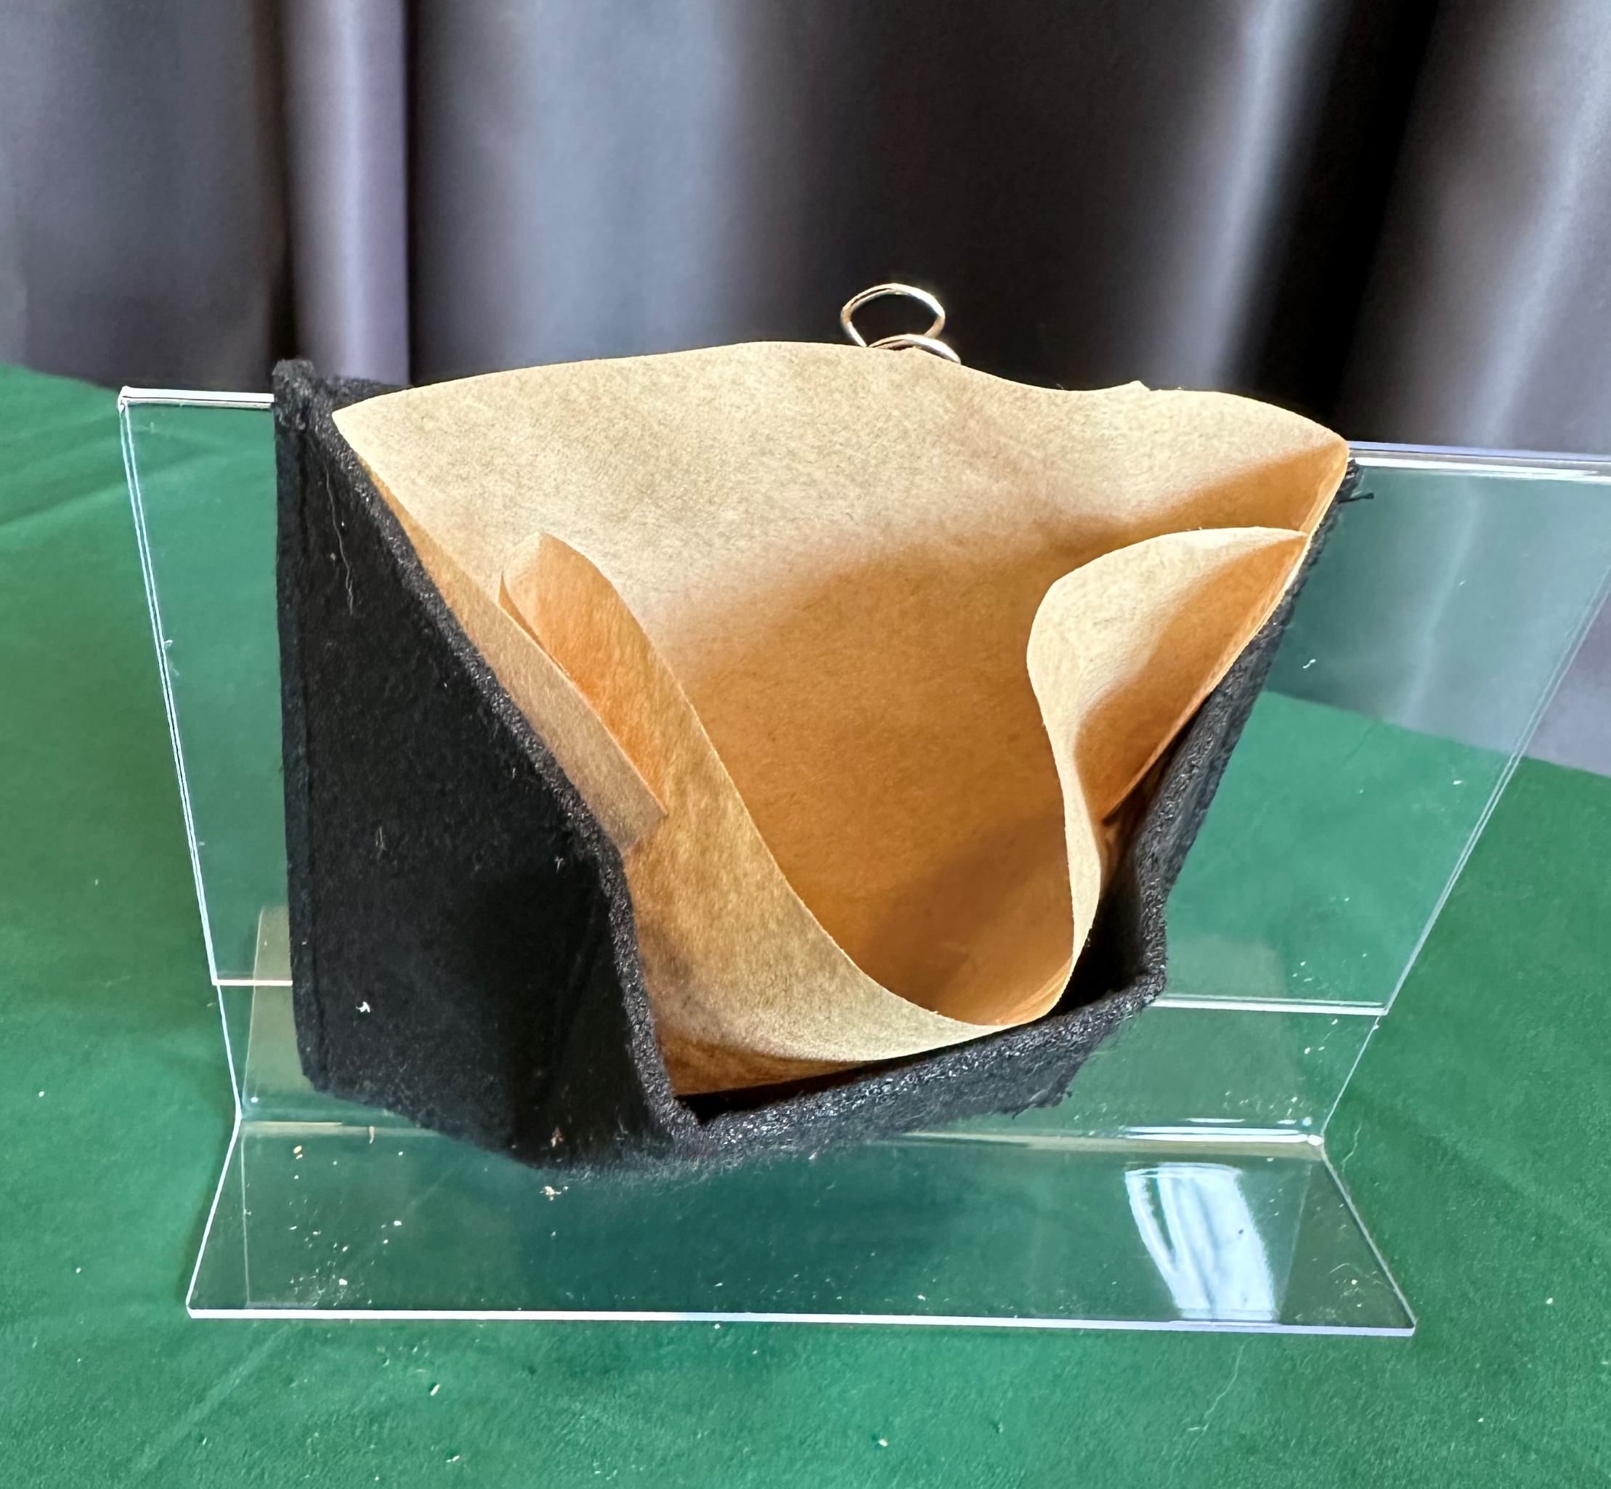
Session 2
Your Natural Neighbors: Living Walls
Step 1:
Clip the felt pocket to the picture frame.
Put the coffee filter into the felt pocket.

Slide 11
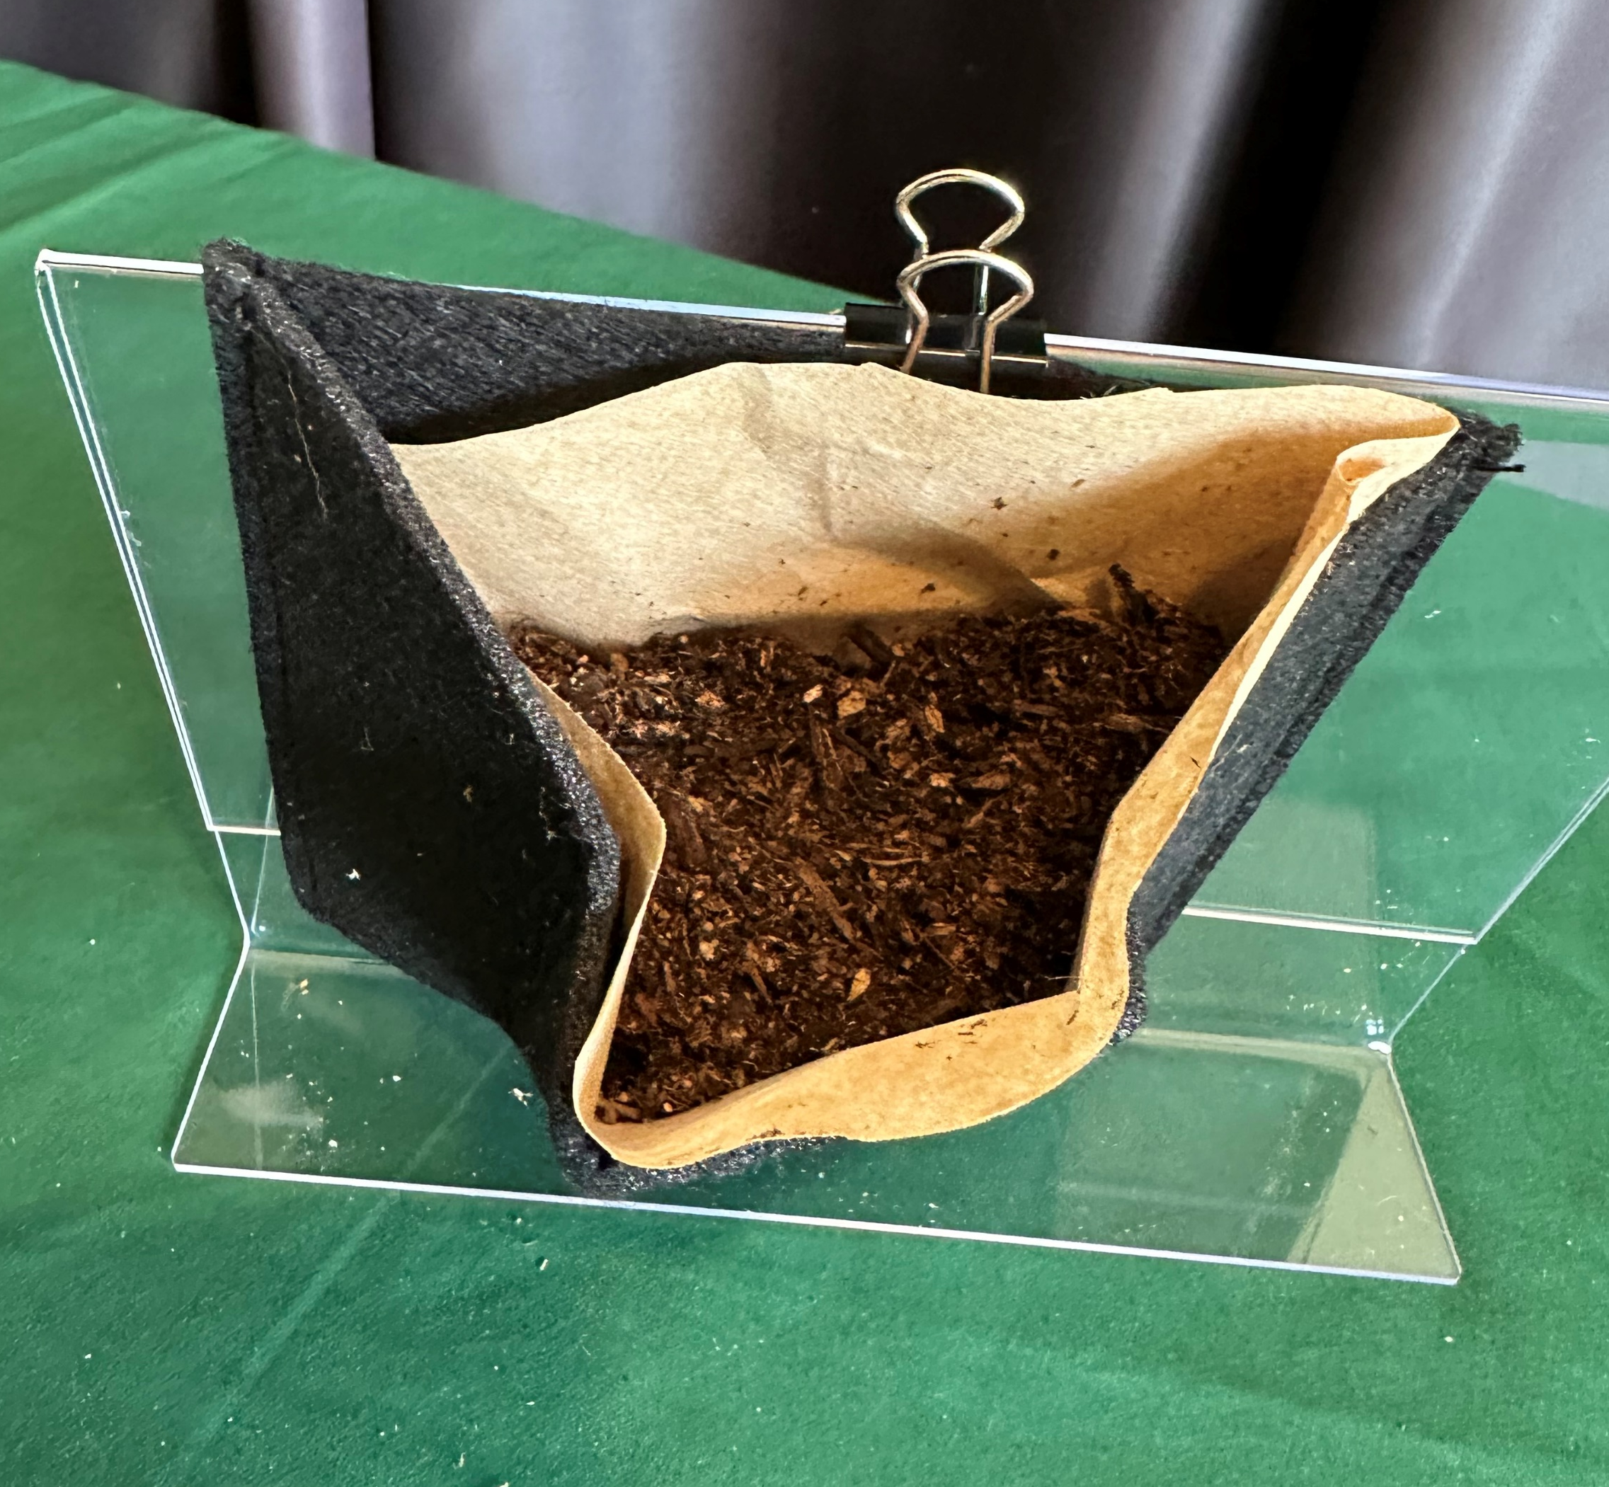
Session 2
Your Natural Neighbors: Living Walls
Step 2:
Fill the pocket half full with soil.

Slide 12
Session 2
Your Natural Neighbors: Living Walls
Discussion on seed choice

Slide 13
Session 2
Your Natural Neighbors: Living Walls
Step 3:
Select the type of seeds you want to add.
Add seeds to pocket and then cover with soil.

Slide 14
Session 2
Your Natural Neighbors: Living Walls
Step 4:
Use the foil as a tray to collect water.
Lightly water your plant.
Optional extension –
Figure out how to secure the wall to tray.
Notes:
Optional extension – Figure out how to secure the wall to tray.

Slide 15
Session 2
Final Reflection
If you could put a living wall somewhere,
where would you put it and what would you plant in it?

