Slide 1
Collaborative Communities
Presented by

Slide 2
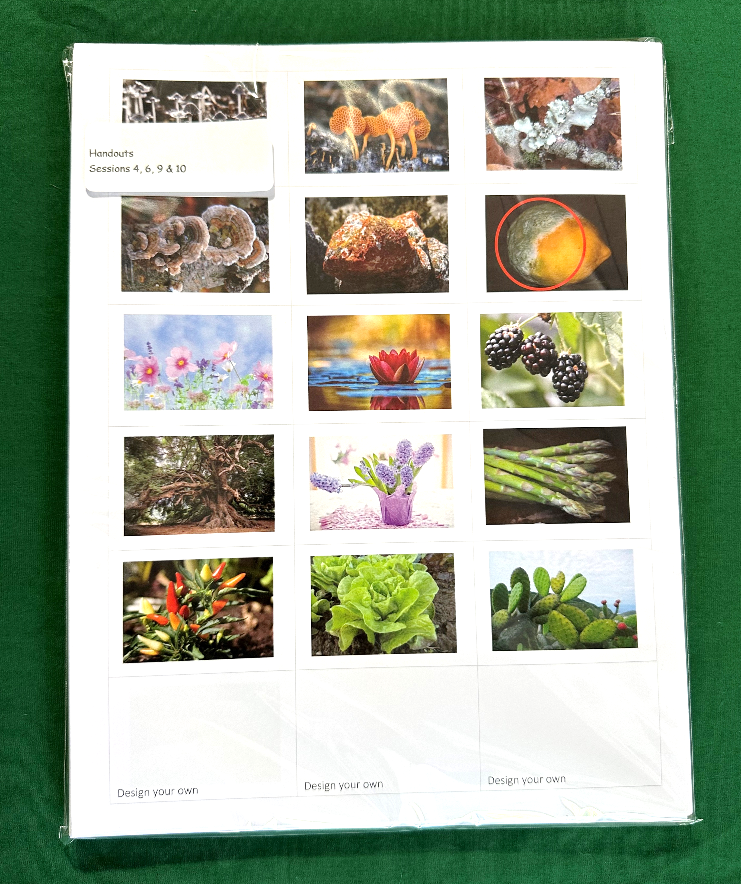
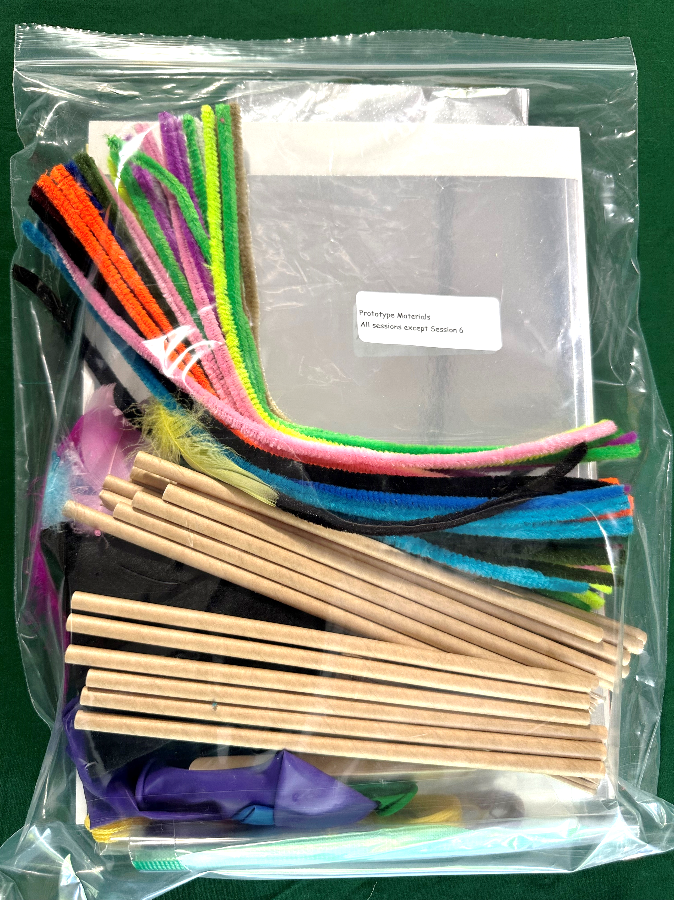
Session 4
Harnessing Nature: Traits and Characteristics
What you need
Participant notebook Sorting cards Prototype supplies: Craft sticks, pipe cleaners, feathers, cardstock Additional Supplies Needed Pens/pencil Scissors Tape
Session Flow | Session Flow
10 min | Welcome. Topic introduction via discussion prompt
10 min | Traits sorting activity (group)
10 min | Reflection, discussion
20 min | Superhero design (group)
Remaining time | Wrap up and share
Session 4 Materials
Participant Notebook

Slide 3
Session 4
Harnessing Nature: Traits and Characteristics
What makes you unique?
Notes:
What are some things about you that make you unique – or different than everyone else

Slide 4
Session 4
Harnessing Nature: Traits and Characteristics
A characteristic, or character, is a feature, inherited by offspring from their parents, that varies among individuals. It may help to think of a character as describing the “category of features.” Some examples include hair color, flower color, and having fingers or toes.
A trait is a variant of a given character, in other words, the versions or examples that would show up in the category. Example traits for hair color would be brown, blond, and black. Example traits for flower color might be red, purple, and white.
Notes:
Begin the session with a general discussion on organization and why we put things in certain places. You can use a relevant example such as the classroom, the library, or the grocery store to help illustrate the point and then ask the participants if they can think of their own examples. After discussing the what, move on to chat about the why. Why do we organize things and how do we choose to organize them? There are many possible answers, but make sure the discussion also includes the concept of similarities and patterns (both of how things look and how we use them) between different objects as a reason why things are often grouped together. From this discussion you can introduce the concepts of characteristics and traits as a way to organize things.
An example introduction is outlined below.
Look in the cupboards in your kitchen—how are things organized? Probably the plates and bowls are in one place; cups in another; and knives, forks, and spoons in a drawer. People often like to organize their “stuff” based on its shape, size, and function. This helps us remember what we have and where to look when we need something.
A similar thing can be said about how scientists keep track of living creatures. They like to group them together based on their similarities: how they look, what they are made of (their DNA), and how they behave. This activity of classification is called taxonomy.
Taxonomy helps us keep track of all the organisms in the world and also helps us to understand where they came from, what they need to survive, and how
they can be helpful (or harmful) to humans.
For the following investigation you’ll be organizing the cards in a number of different ways. Each time we organize them we’ll spend some time discussing WHY you decided to organize the cards that way.

Slide 5
Session 4
Harnessing Nature: Traits and Characteristics
Sorting game
Notes:
Have participants take the cards and organize based on which ever reason they think is most interesting or relevant.
Then use just the animals and organize in the following ways:
How do they move? (e.g., swim, fly, walk)?
How many legs do they have (0,2,3,6,8, more)?
What covers their body (hair, fur, feathers, scales, others)
How do they breathe (lungs, gills)
How are their young produced (live, eggs (hard shell or in water)?
Where do they live?

Slide 6
Session 4
Harnessing Nature: Cool Plant and Animal Traits
Do you remember some of the cool traits of the insects that we discussed in the first session?
Notes:
Ants – can lift 10-50x their weight
Bees – 5 eyes and can fly 20 mph
Cockroaches - A cockroach can live almost a month without food, two weeks without water, and hold their breath for 40 minutes

Slide 7
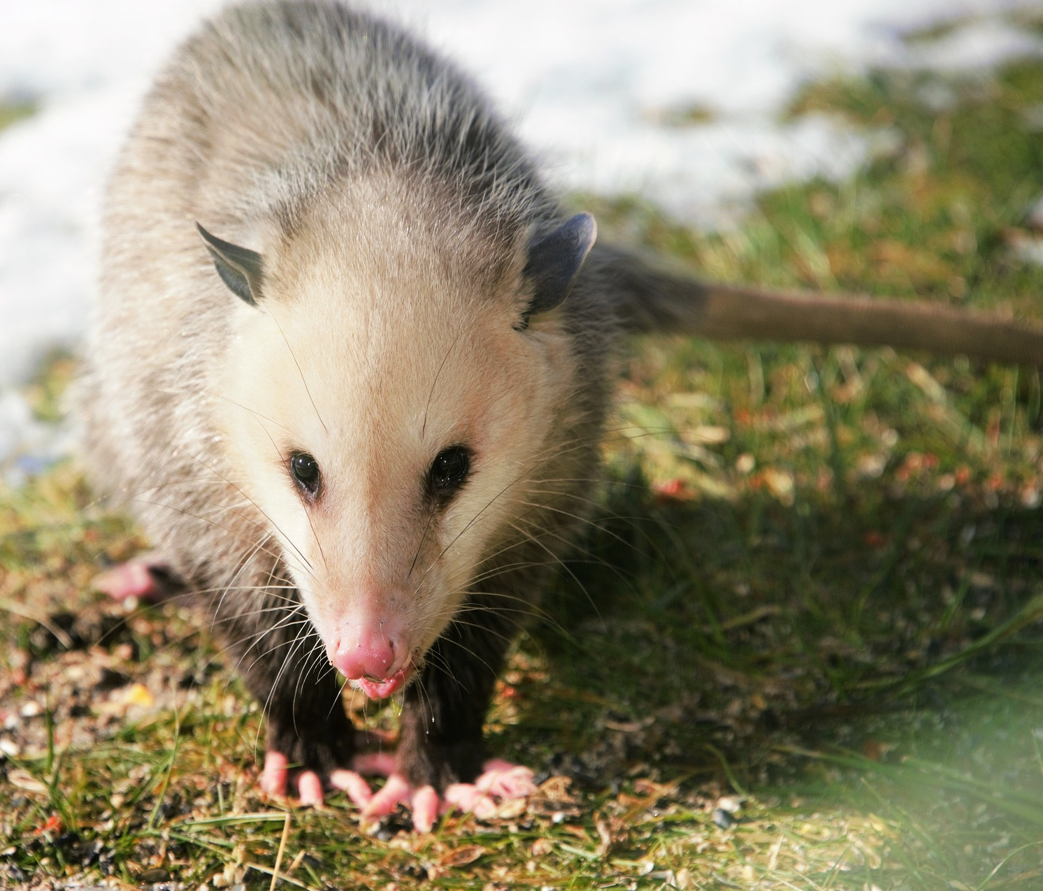
Session 4
Harnessing Nature: Cool Plant and Animal Traits
Opossums are immune to snake venom
They can be bit by almost 200 rattlesnakes without getting sick.

Slide 8
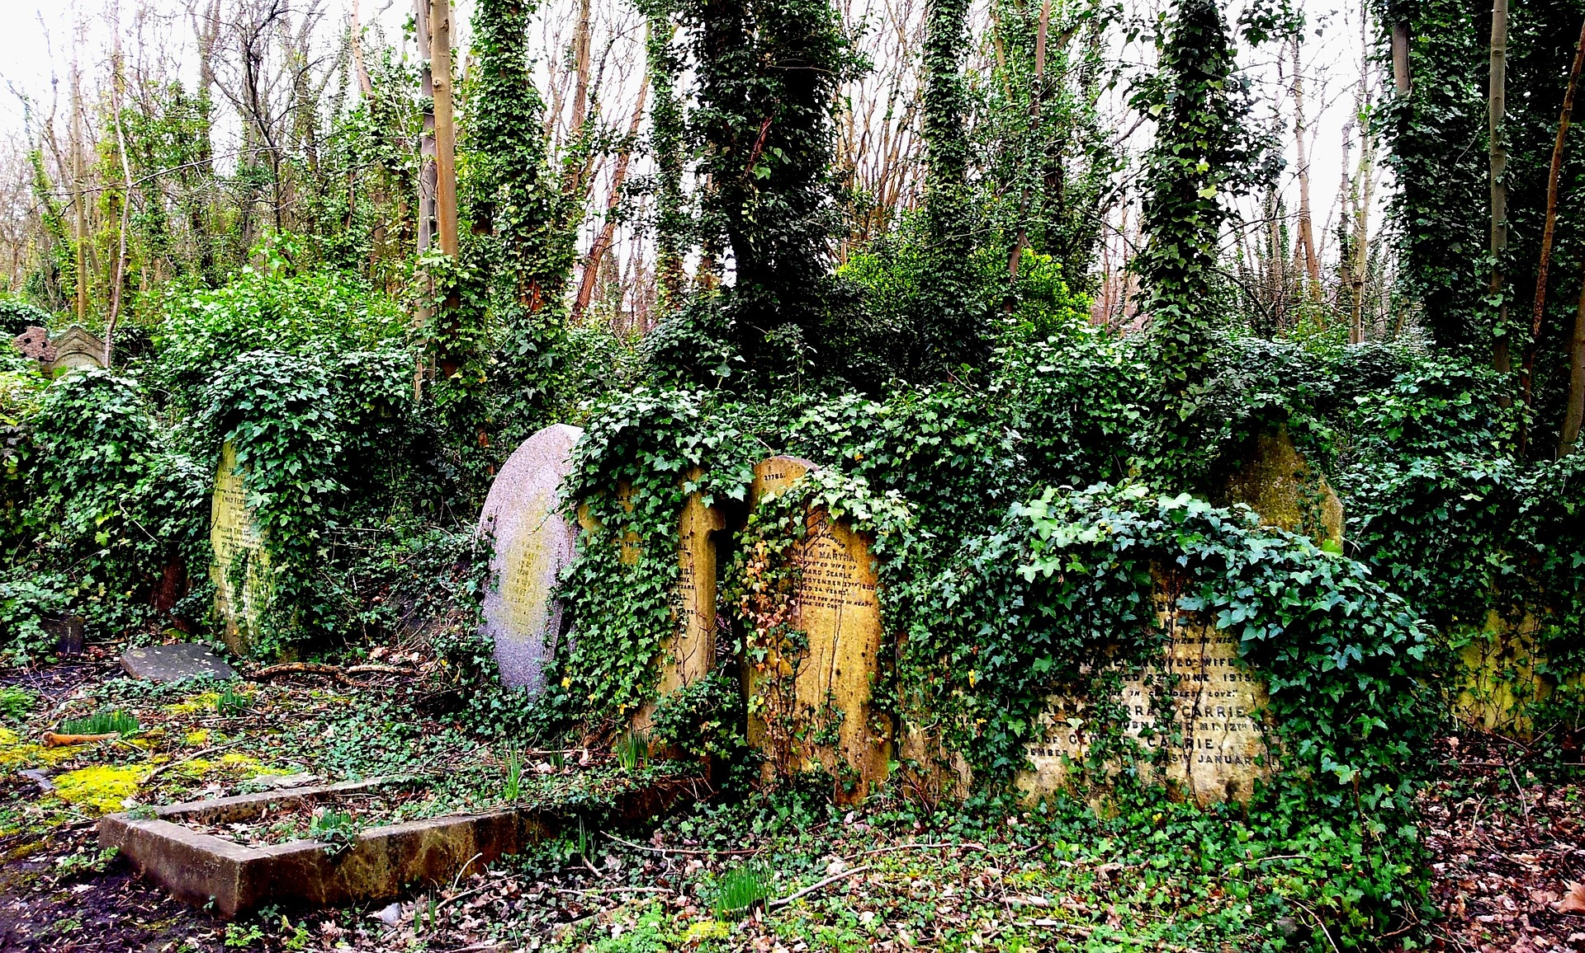
Session 4
Harnessing Nature: Traits and Characteristics
English ivy can grow almost everywhere – it can trail along the ground or grow vertically up trees, fences, walls and hillsides.
When growing on trees and other plants it often sucks the life out of that tree or plant.

Slide 9
Session 4
Harnessing Nature: Traits and Characteristics
What other cool plant or animal traits can you share?

Slide 10
Session 4
Harnessing Nature: Traits and Characteristics
Elephants can smell water up to three miles away
Hummingbirds have wings that beat up to 200 times a second. They are also the only birds able to hover, and they can fly backwards and even upside down!
Dogs have a sense of smell ranging from 100,000 to 1,000,000 times more sensitive than a human’s; 100 million times greater in bloodhounds.
Cows have almost total 360-degree panoramic vision. They also have an excellent sense of smell and are able to detect odors 5-6 miles away. They can also hear both high and low frequency sounds beyond human capability.
A butterfly’s sense of taste is 200 times stronger than ours!
Rabbits can see behind themselves without turning their head.
Chickens have a complex language all of their own, with over 30 different types of alarm calls depending on the type of threat. They also have great memories and can differentiate between over 100 different faces (of their fellow chickens).
Goldfish are the only animals that can see in both infrared and ultraviolet light.
Electric eels can transmit a shock between 600 and 800 Volts
Mountain Stone Wetas freeze, but remain alive
Jaguars have killer jaws
Owls can twist their heads 270 degrees
Welwitschia Mirabilis: The stem of this plant, which consists of two leaves, a strong stem and a root, both gets longer and wider and reaches a height of two meters and a width of eight meters. This plant, which draws even the slightest moisture inside it through this stem, can live for five years with no rain.
The Selaginella lepidophylla also known as “Erica’s rose” is also a desert plant. The interesting thing about this plant is that it can live with almost no water. This plant completely dries during times of drought and turns into a ball by tucking in its branches and leaves. However, when rains begin, it revives again by opening its branches and leaves and starts all of its vital functions again.
Venus fly trap - You might wonder how the trap is triggered. Well, with trigger hairs. When two hairs are touched within 20 seconds of each other or, if a single hair is touched twice, the trap snaps shut. Healthier Venus Flytraps close quicker. Scientists are unsure about the mechanism (it has to do with neighboring cells sending chemical messages to each other).
The strangler fig is the biggest mooch of the plant kingdom. Not only does it mooch, it kills. There are many different species of strangler fig, but they all are basically the same thing: that roommate who steals all of your food, the guy at a party who steals all of your beer, or that guy in class who copied your homework and got a better grade. They are usually dispersed by hitch-hiking on birds and being dropped on the canopy of trees of a dense forest. They are wacky because they will grow up and down. They grow down so that their roots can rob the living tree of all its nutrients. It grows upwards to absorb sunlight. They often outlive the host tree by years.
Bear's-Head Tooth Mushroom This amazing mushroom fights cancer, stimulates nerve growth, and helps kill roundworms. How do we know? Well, some really brave soul found out it was edible.
Notes:
This is a list of plant and animal traits that you can put on the board to help the groups brainstorm.

Slide 11
Session 4
Harnessing Nature: Traits and Characteristics
Working alone or in small groups, design your own superhero (or super villain), with as many cool traits as you want. Be sure to determine the back story of your superhero (or super villain) that describes where and how they got their super-powers.

