Slide 1
Collaborative Communities
Presented by

Slide 2
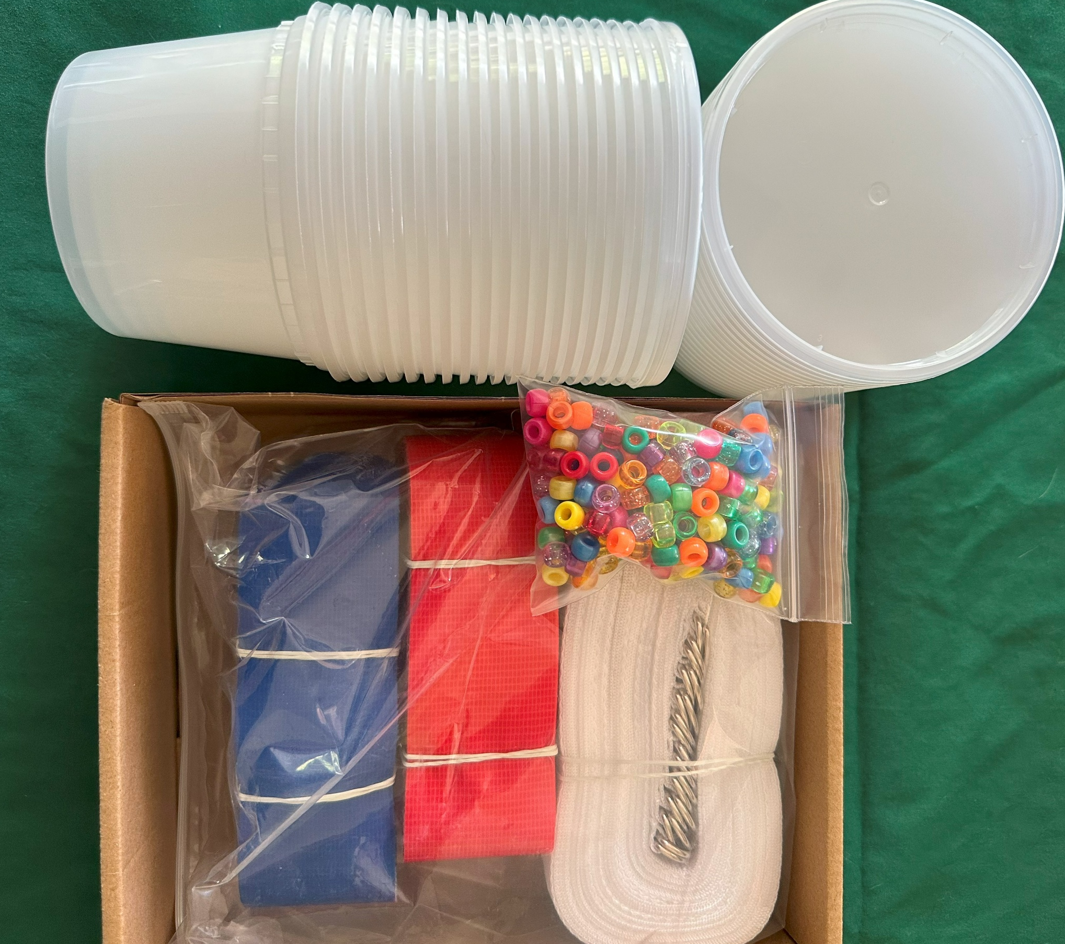
Session 5
Harnessing Nature: Microbes
What you need
Participant notebook Per Participant: 1 container Shared Prototyping Resources (mentees can pull from them to make their composter) Puffballs test compost mixing (4 – 7 each) Prototyping supplies (fabric, pipe cleaners, wire, paper straws, craft sticks) ½ cup scoop (to hand out soil at the end) To be handed out at the end: ▪ ½ scoop soil (save 2 scoops for session 8) Additional Supplies Needed Pens/pencil Scissors Tape or glue Coloring Supplies (optional)
Session Flow | Session Flow
10 min | Welcome. Topic introduction via discussion prompt and microbe match
5 - 15 min | Microbe Battle Royale (optional)
5 - 10 min | Composting lesson
10 - 15 min | Design your own composter
Remaining time | Wrap up and cleanup
Session 5 Materials
Participant Notebook

Slide 3
Session 5
Harnessing Nature: Microbes
What do you know about microorganisms?
What is the smallest living organism you can describe?

Slide 4
Session 5
Harnessing Nature: Microbes
What is a Microbe?
Microorganisms (or microbes) are VERY small creatures that we can only see with special equipment.
The size of the organism—not what it is made of—determines if it is a microbe. Many types of organisms can be microbes including bacteria, fungi, and algae.

Slide 5
Session 5
Harnessing Nature: Microbes
What is a Microbe?
Some microorganisms are helpful—like antibodies, yeasts, and geobacters—that help our immune systems, make our food taste good, and even produce energy.
Some microorganisms are harmful—like germs and viruses—and these can make us sick.

Slide 6
Session 5
Harnessing Nature: Microbes
Microbes in our food
Do you like yogurt? How about sauerkraut, kimchi, or bread?
Originally, using microbes for fermentation was used as a method to preserve food. Today scientists, chefs, and entrepreneurs are taking it a
step further and turning the practical into a delicious treat.
Bread – fungus (yeast) (Saccharomyces cerevisiae)
Yogurt – bacteria (Lactobacillus bulgaricus and Streptococcus thermophilus)
Kimchi – bacteria (Leuconostoc, Weissella, and Lactobacillus)
Notes:
Bread yeast is actually part of the fungus kingdom

Slide 7
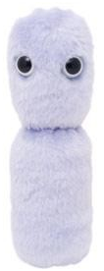
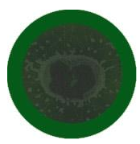
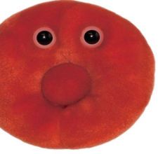
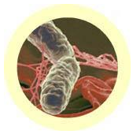
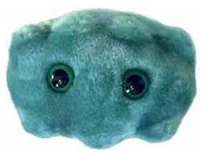
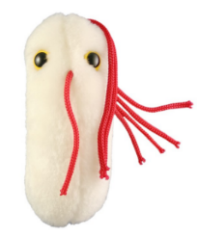
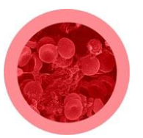
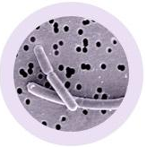
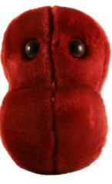
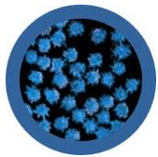
Session 5
A
1
Bad Breath
Porphyromonas Gingivalis
This white food has lots of bacteria that are good for your tummy.
Harnessing Nature: Microbe Match
This cell carries oxygen to all parts of your body
B
2
Salmonella
Salmonella Typhimurium
Work with a friend to see if you can connect the toy microbes on the left to the actual picture on the right.
Look at the shape and color of the microbe in addition to reading the description.
Always remember to brush and floss your teeth to keep this guy away.
C
3
Sore Throat
Streptococcus
This bacteria can make you sick if you don’t clean up the counter after you prepare chicken
D
4
Red Blood Cell
Erythrocyte
E
5
Lots of people catch this virus in the winter. Don’t forget the Kleenex
Yogurt
Lactobacillus bulgaricus
Sometimes when you have this you can stay home from school and eat ice cream
F
6
Common Cold
Rhinovirus

Slide 8
Session 5
Harnessing Nature: Microbes
Microbe-based energy generation and storage
Microbial fuel cells use bacteria to digest food waste and sewage to create electrical energy and clean water. This technology is used today in many applications, including cleaning up the water used in wastewater treatment plants and breweries.
This ability comes from a special group of microbes who don’t need oxygen to live—they are called Anaerobic Microbes.

Slide 9
Session 5
Harnessing Nature: Microbes
Aerobic vs. Anaerobic
Aerobic microbes need oxygen to help breakdown food and pull energy out it.
Anaerobic microbes are able to get energy from food without the help of oxygen.
Where would you explore if you didn’t need oxygen to survive?

Slide 10
Session 5
Harnessing Nature: Microbes
Microbe Battle Royale
(optional)
Anaerobes vs. Aerobes
Notes:
This is an optional game that you can play with your group if you think they would benefit from a bit of moving around. It is a microbial take on a classic prey/predator population game.
Divide the group into three teams. Teams will rotate through being the anaerobes, aerobes and “food” (“food” is both food and oxygen). Every player receives a flag football belt but only the “food” team wears flags. It is suggested that each member of the food team wear four flags. The flags do not need to be all the same color.
The anaerobe and aerobe teams line up on either end of the field of play. The “food” team places flags on their belts – blue for oxygen, red for food – and stands spread out in the field of play. Once positioned on the field of play, “food” team members do not move.
Participants are reminded that some microbes need food and oxygen (Aerobes) to function while others just need food (Anaerobes).
The line leader on either side starts at the go signal by entering the arena and gathering food and/or oxygen. After returning with the food/oxygen, he/she will tag in the next individual and both will go out and get more food/oxygen and both tag in the next two people, and so on. The game stops when there is no food left. Anaerobes don’t need oxygen to breath, but don’t get as much energy per unit food, so they have to gather two units of food each time (but no oxygen) in order to tag the next person in.
Anaerobes don’t need oxygen to breathe, but don’t get as much energy per unit food, so they must gather two units of food each time (but no oxygen) in order to tag the next person in.
Aerobes need oxygen, but not as much food – so they need one unit of oxygen and one unit of food each time.

Slide 11
Session 5
Harnessing Nature: Microbes
Microbe Battle Royale
(optional)
Scenarios
Suggestion – The number of flags in use should be 4x the number of people on a given team. For example, if each team has 5 people, use 20 flags total
Scenario 1
Stagnant Pond
Use 3x as many food flags as oxygen flags
Scenario 2
Moving Steam
Use 2x as many oxygen flags as food flags
Scenario 3
Compost Bin
Use 4x as many food flags as oxygen flags
Scenario 4
Recently Harvested Field
Use 4x as many oxygen flags as food flags

Slide 12
Session 5
Harnessing Nature: Microbes
Microbes and Waste
Can you think about how microbes might help us manage waste?

Slide 13
Session 5
Harnessing Nature: Composting
What is Composting?
When you compost organic matter, such as leaves and food scraps, decomposes and turns into a nutritional material that can improve soil and feed plants.
To compost you need four basic ingredients:
Browns - This includes materials such as dead leaves, branches, and twigs. These provide the carbon for your compost.
Greens - This includes materials such as grass clippings, vegetable waste, fruit scraps, and coffee grounds. These provide nitrogen for your compost.
Water - Having the right amount of water, greens, and browns is important for compost development. The moisture helps the browns and greens to decompose.
Microbes – Many people add microbes to their compost to help speed up the process.
Notes:
Composting not only helps soil but it also reduces the amount of garbage that is sent to the landfill. Composting helps the planet in many ways!

Slide 14
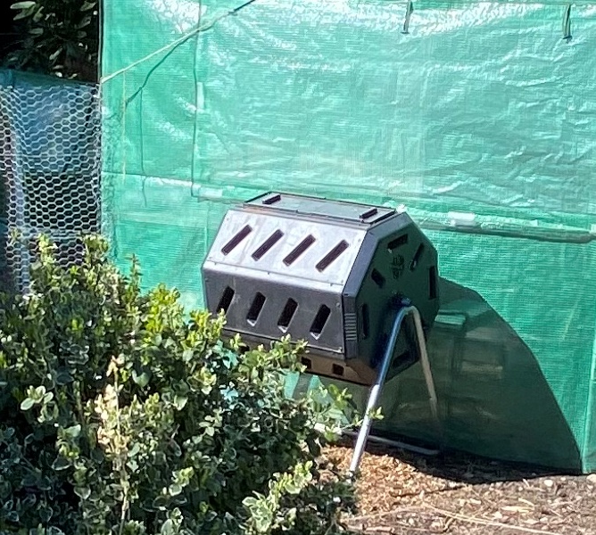
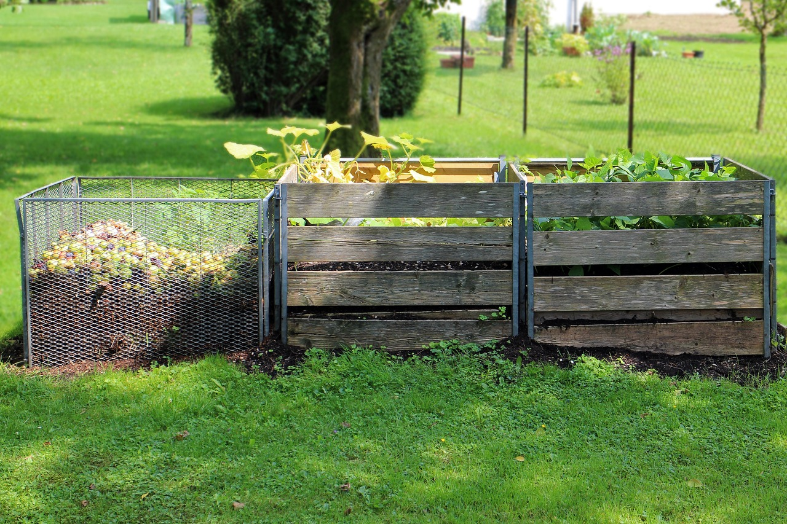
Session 5
Harnessing Nature: Composting
Notes:
Many composters are big and smelly and outside – what if we had an easy in house composter?

Slide 15
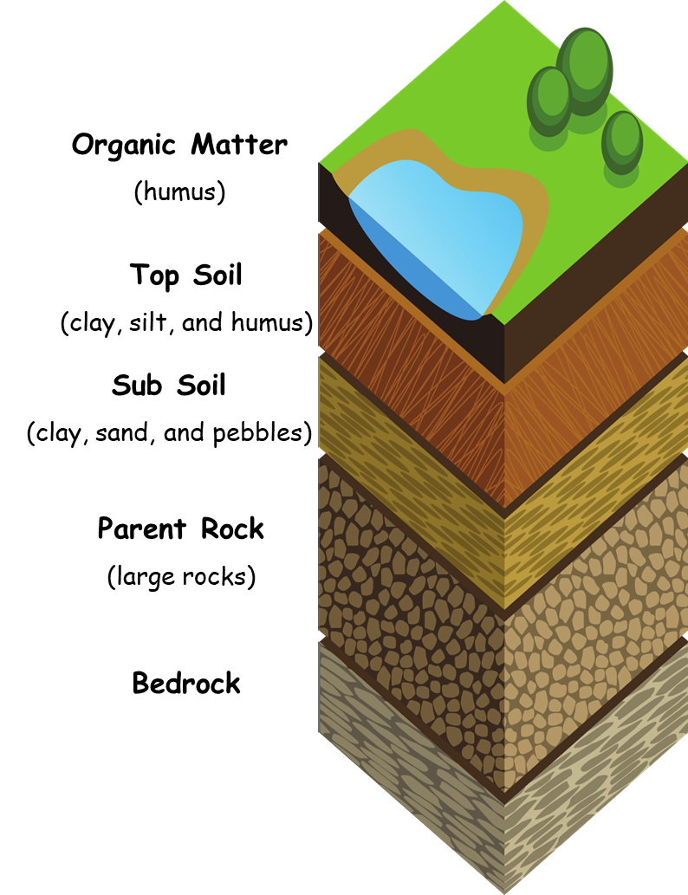
Session 5
Harnessing Nature: Microbes
Soil is more than just dirt
Soil is a mixture that helps balance food and energy between different living organisms.
The soil performs four jobs that are very important to life on Earth.
Soil provides a home and food for plants to grow.
Soil provides a home, or habitat, for many different living creatures (animals, insects, good bacteria).
Soil cleans and stores a lot of Earth’s drinkable water.
Soil interacts with the atmosphere and helps to balance the amounts of different gasses.
Notes:
The soil includes organic matter, minerals, gases, liquids and living creatures. The soil keeps all these parts together by balancing the interactions with the world around it. For example, when plants are growing, they take nutrients (food) and water from the soil. When plants die, they return the nutrients (organic matter and minerals) and water to the soil through decomposition.

Slide 16
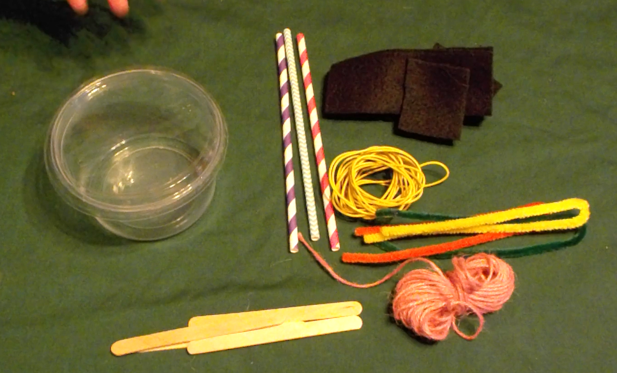
Session 5
Harnessing Nature: Build a Composter
What you need:
Container
Fabric
Scissors
Wire
Craft Sticks
Pipe Cleaners

Slide 17
Session 5
Harnessing Nature: Build a Composter
Discuss what a composter needs for design criteria
Notes:
Needs to be sealed, allow for some air, allow for some water, allow for mixing

Slide 18
Session 5
Harnessing Nature: Build a Composter
Design Criteria:
Must be sealed
Must allow for some air flow
Must be able to add water
Must be able to have some mixing.
Notes:
Needs to be sealed, allow for some air, allow for some water, allow for mixing

Slide 19
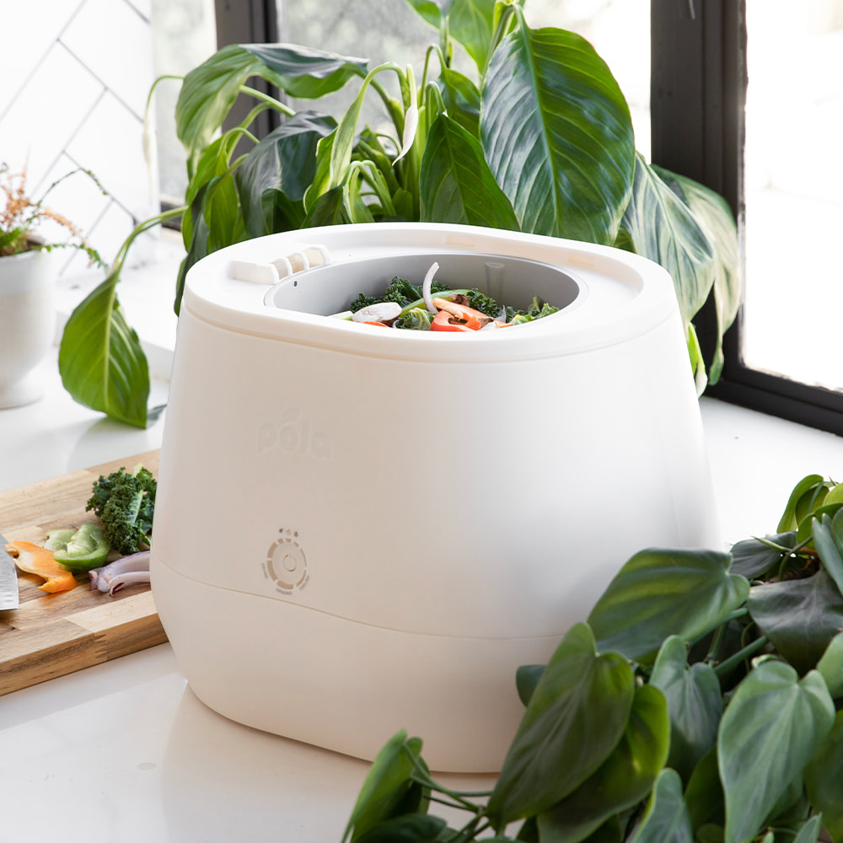
Session 5
Composters and Innovation
JEREMY LANG
From: Saskatchewan, Canada
Age at time of invention: ~ 30
Invention: Jeremy started the company Pela, with the lofty goal to create a waste free future. One of the ways they are working towards this goal is with their new composting product, Lomi. Jeremy’s goal is to make composting fast and easy so more waste stays out of our landfills.
Notes:
This is a great 1 minute video on the power of composting innovation. https://youtu.be/HYv6d6U0E2s

Slide 20
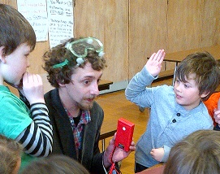
Session 5
Microbial Fuel Cell Inventors
BRENT SOLINA
From: Buffalo, NY
Age at time of invention: ~ 20
Invention: Brent has been working on a new microbial fuel cell system for the past 10 years! He is trying to find the best microbe – electrode combination. His company, MIRCOrganics technology has pilot trials running in Upstate New York.

Slide 21
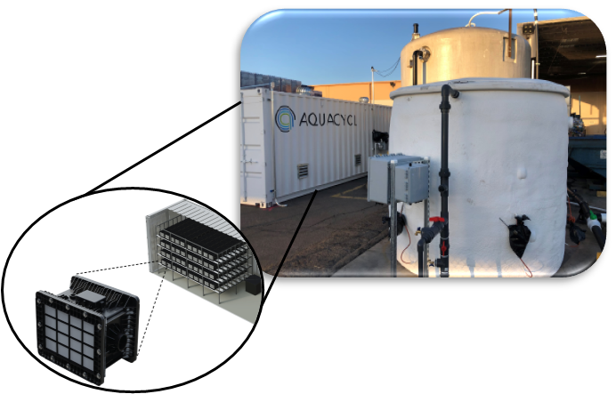
Session 5
Microbial Fuel Cell Inventors
ORIANNA BRETSCHGER & SOFIA BABANOVA
From: San Diego, CA
Age at time of invention: ~ 27
Invention: Orianna and Sofia founded Aquacycl in 2016 but started working on the technology almost 15 years earlier when Orianne was in graduate school. Acuacycl focuses on developing systems that can be used in underserved and developing communities around the world.

