Slide 1
Collaborative Communities
Presented by

Slide 2
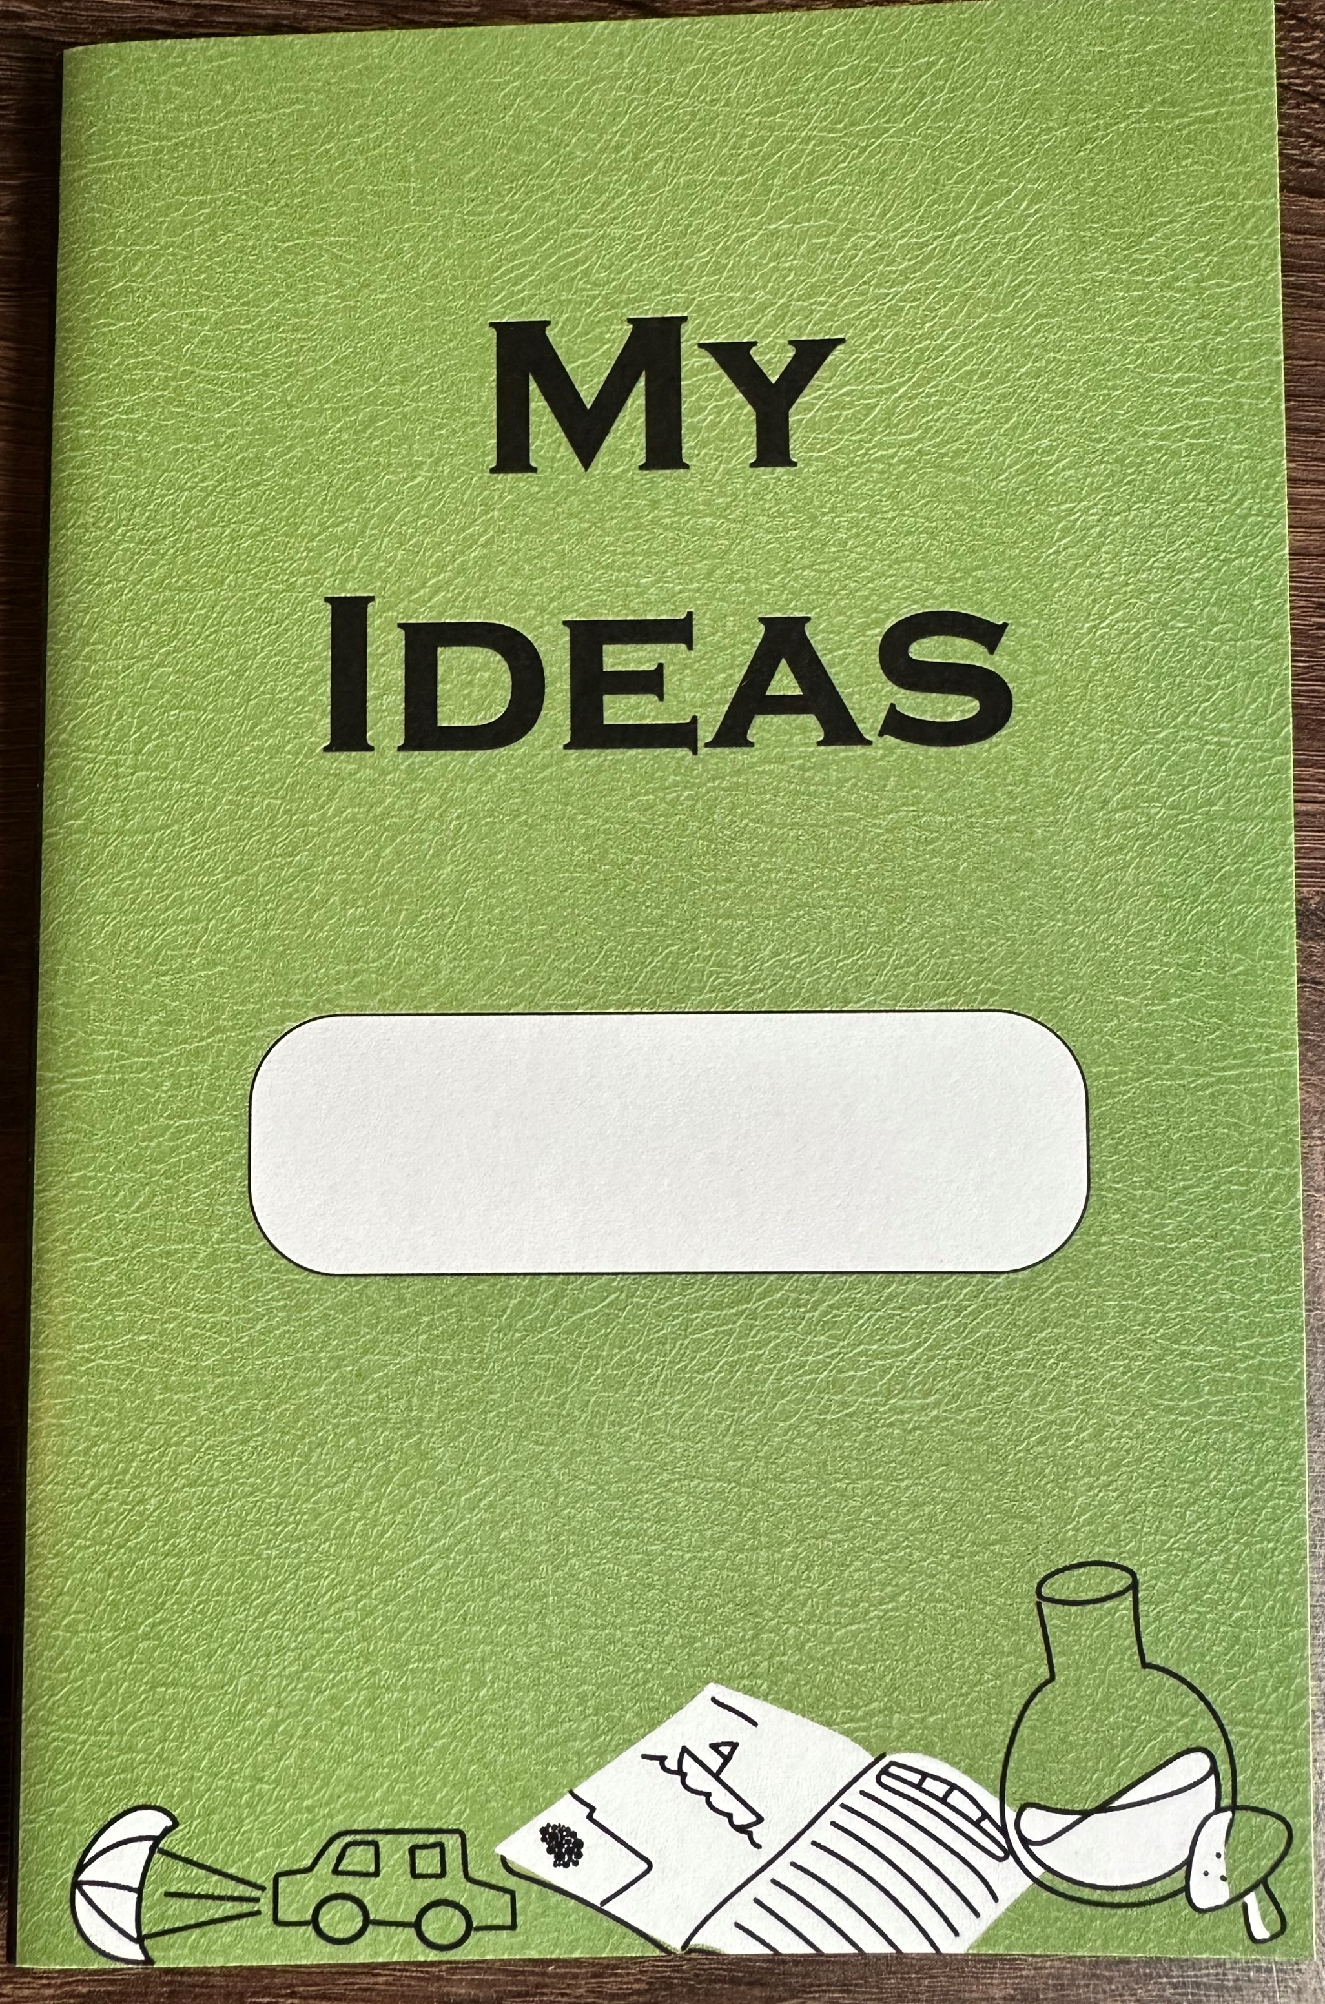
Session 6
Harnessing Nature: Biomimicry
What you need
Participant notebook Biomimicry handouts Additional Supplies Needed Pens/pencil Coloring supplies Scissor
Session 6 Materials
Session Flow | Session Flow
10 min | Welcome. Topic introduction via discussion prompt
15 min | Biomimicry matching game and discussion
25 min | Biomimicry redesign
Remaining time | Wrap up and cleanup
Participant Notebook

Slide 3
Session 6
Harnessing Nature: Biomimicry
What can we learn from plants or animals?
Notes:
Ask if anyone has any suggestions on things we can learn from plants or animals?

Slide 4
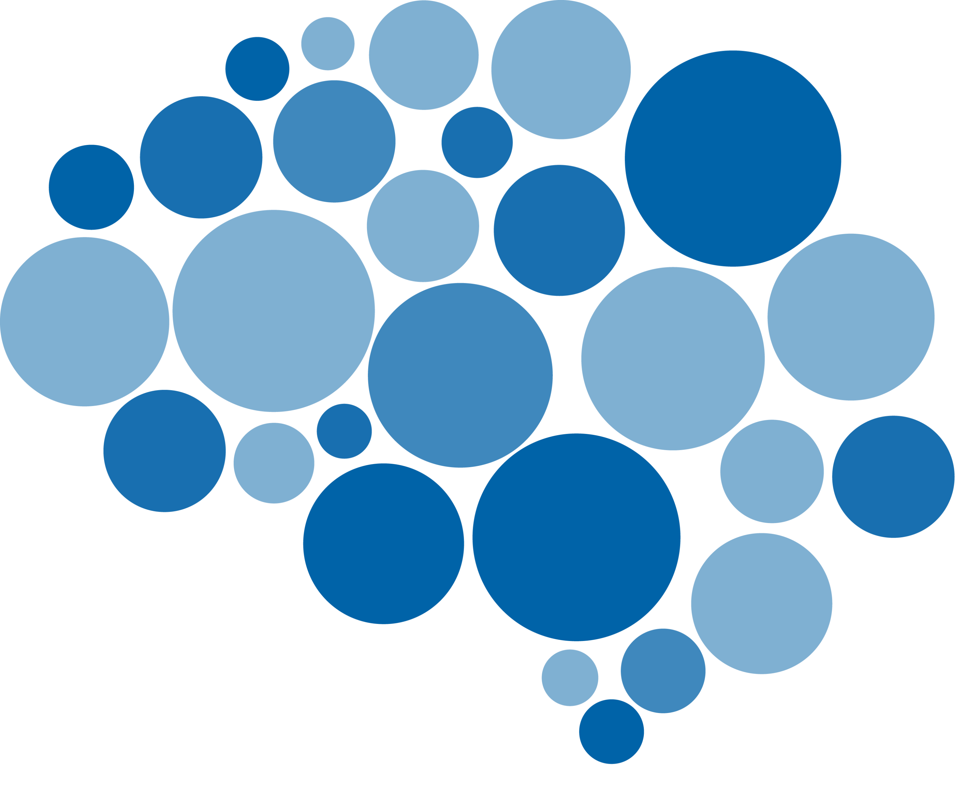
Session 6
Harnessing Nature: Biomimicry
Copying from other organisms is called BIOMIMICRY
Bio means “from nature” and mimic means “to copy” so biomimicry means “to copy nature”.
Notes:
While copying from another student on a test is not a good thing, copying from nature to solve challenges is always welcomed. The Earth is over 3.8 billion years old, so plants and animals have had a long time to learn what works and what doesn’t work. The field of STEM that focuses on learning from nature is called biomimicry. Bio means “from nature” and mimic means “to copy” so biomimicry means “to copy nature”.
Who remembers what the definitions of characteristics and traits are?
A characteristic, or character, is a feature, inherited by offspring from their parents, that varies among individuals. It may help to think of a character as describing the “category of features.” Some examples include hair color, flower color, and having fingers or toes.
A trait is a variant of a given character, in other words, the versions or examples that would show up in the category. Example traits for hair color would be brown, blond, and black. Example traits for flower color might be red, purple, and white.

Slide 5
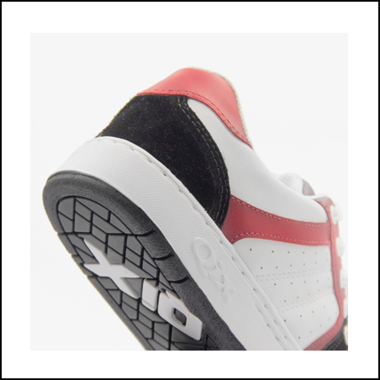
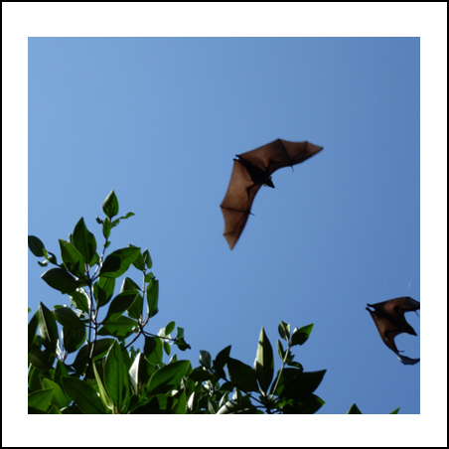
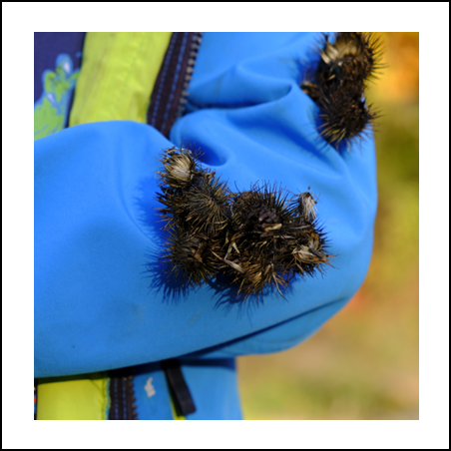
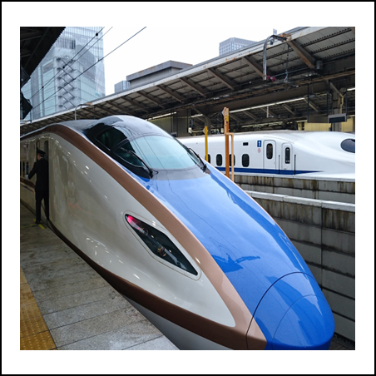
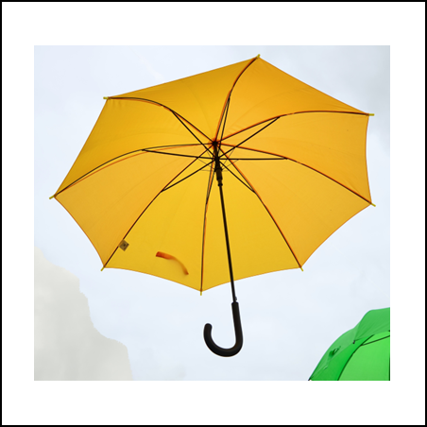
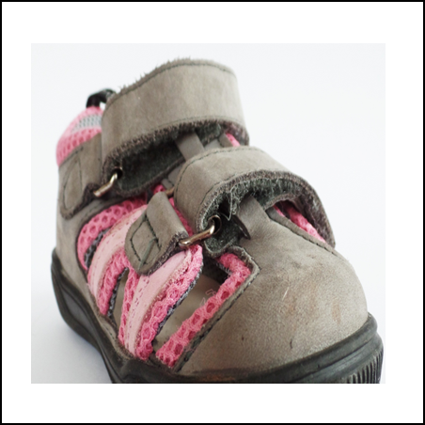
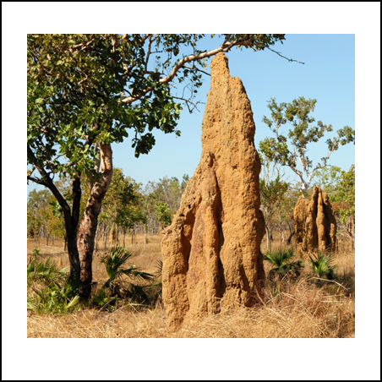
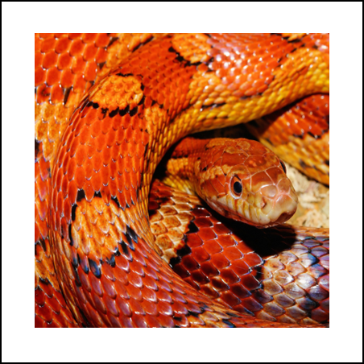
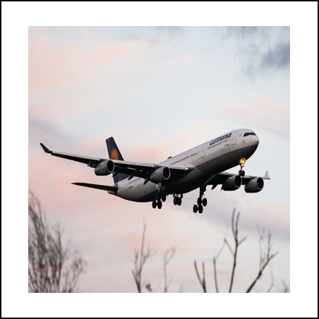
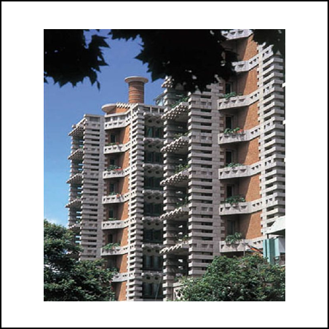
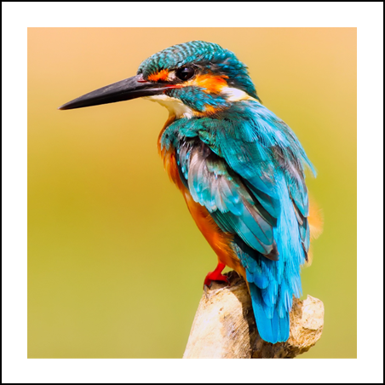
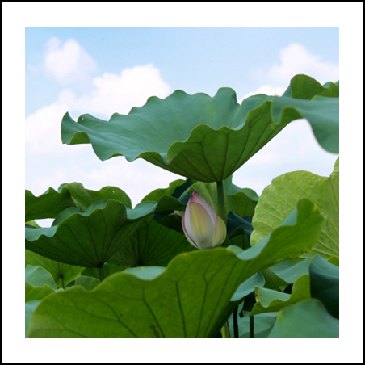
Session 6
Harnessing Nature: Biomimicry
Can you work in teams to match the innovation to its biological inspiration?
Innovation
Inspiration

Slide 6
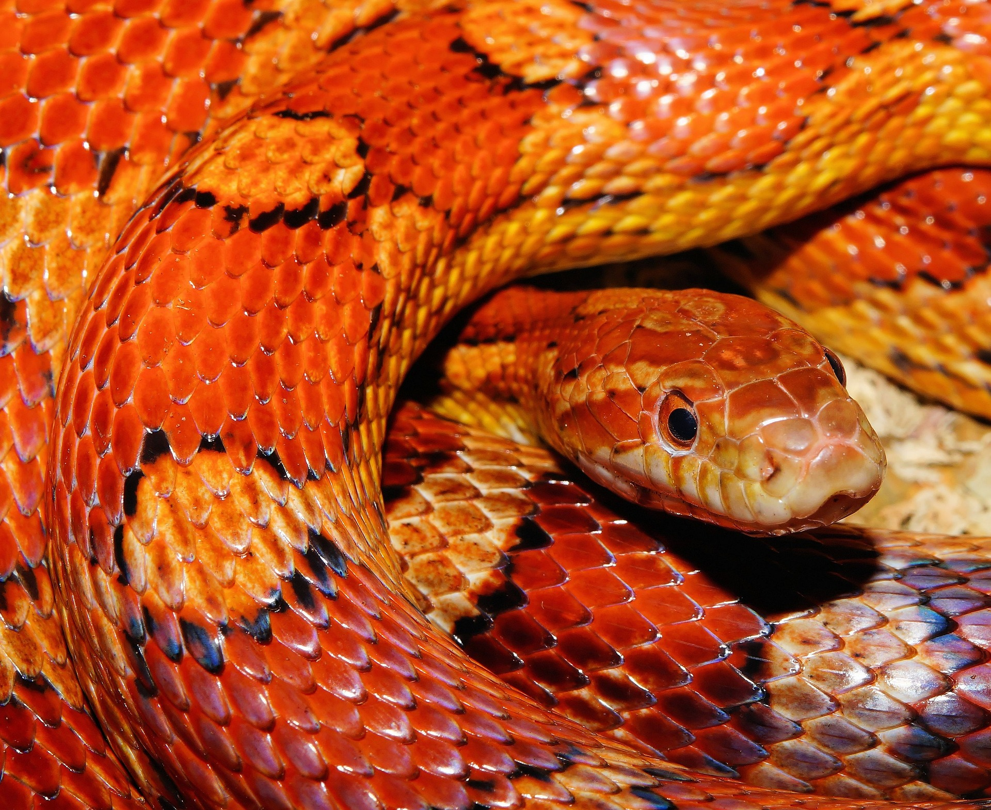
Session 6
Harnessing Nature: Biomimicry
Notes:
Describe the key trait, ask if someone wants to suggest the match.
Next slide, show the match.

Slide 7
Session 6
Harnessing Nature: Biomimicry
The skin of the snake has special properties that allows it to be smooth and lightweight but able to grip the ground so that the snake can slither easily.
Notes:
Describe the key trait, ask if someone wants to suggest the match.
Next slide, show the match.

Slide 8
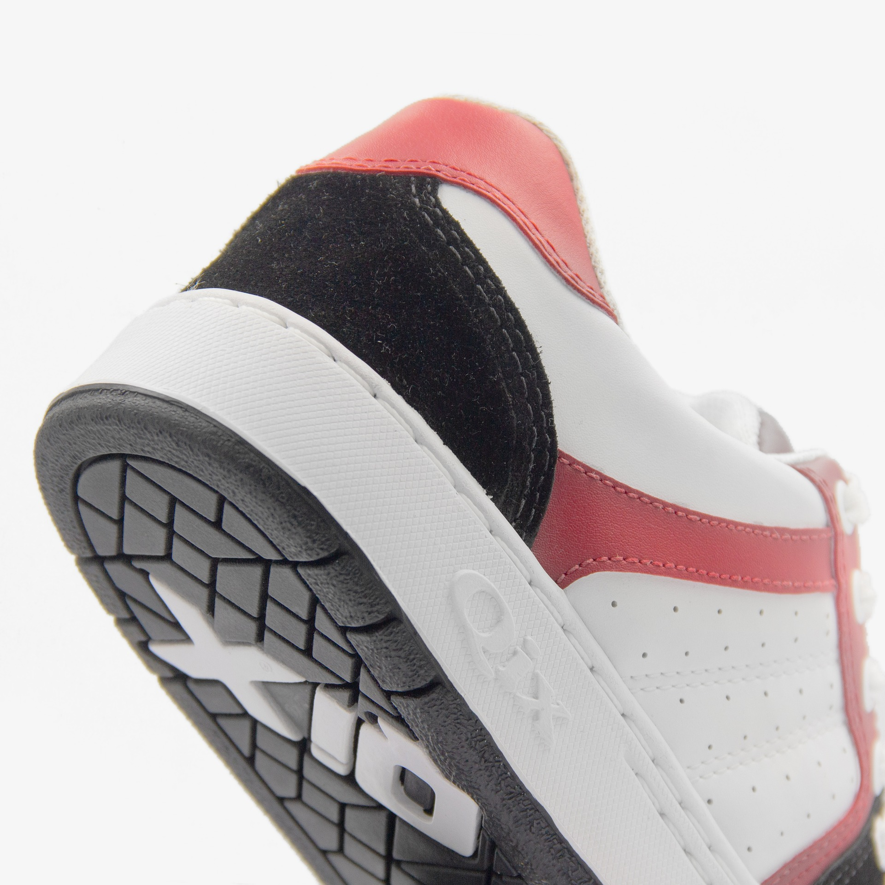
Session 6
Harnessing Nature: Biomimicry
The skin of the snake has special properties that allows it to be smooth and lightweight but able to grip the ground so that the snake can slither easily.
Researchers in Cambridge, Ma have developed an adaptive shoe grip that mimics the scale in snakeskin. The sole is cut using a Japanese technique (Kirigami) and when it stretches small spikes pop out and grip the ground.
Notes:
Describe the key trait, ask if someone wants to suggest the match.
Next slide, show the match. Describe it, and then ask if someone wants to guess type of biomimicry.

Slide 9
Session 6
Harnessing Nature: Biomimicry
Notes:
Describe the key trait, ask if someone wants to suggest the match.
Next slide, show the match.

Slide 10
Session 6
Harnessing Nature: Biomimicry
In some places the leaf of the lotus flower can grow quite large. It is flexible and lightweight.
Notes:
Describe the key trait, ask if someone wants to suggest the match.
Next slide, show the match.

Slide 11
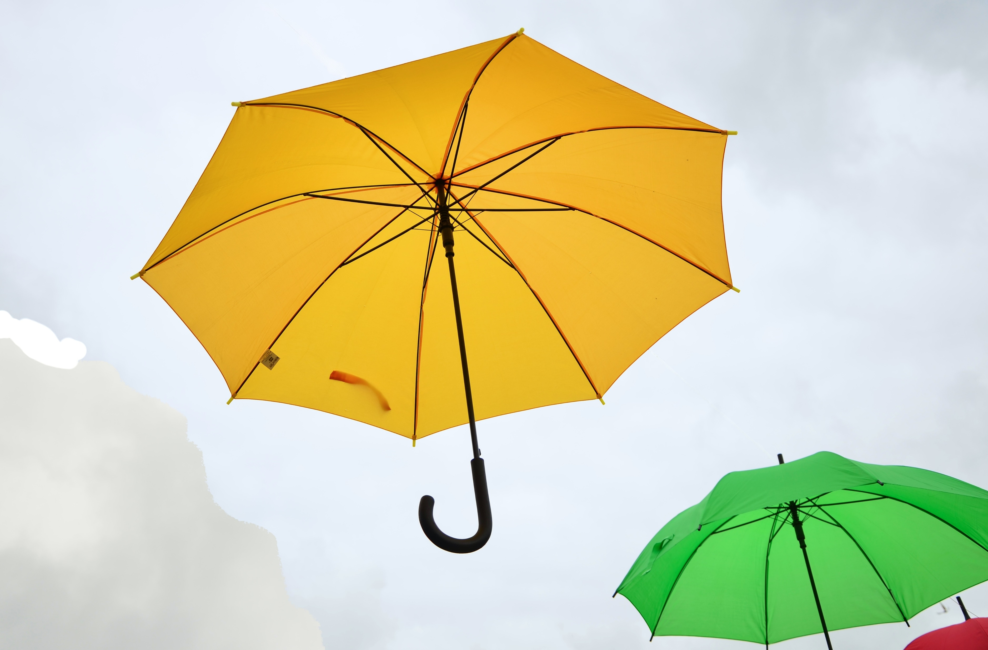
Session 6
Harnessing Nature: Biomimicry
In some places the leaf of the lotus flower can grow quite large. It is flexible and lightweight.
Over 2000 years ago, Lu Ban noticed a group of children shielding themselves from the rain with lotus leaves. He used silk and bamboo to recreate the leaf and developed the first umbrella.
Notes:
Describe the key trait, ask if someone wants to suggest the match.
Next slide, show the match. Describe it, and then ask if someone wants to guess type of biomimicry.

Slide 12
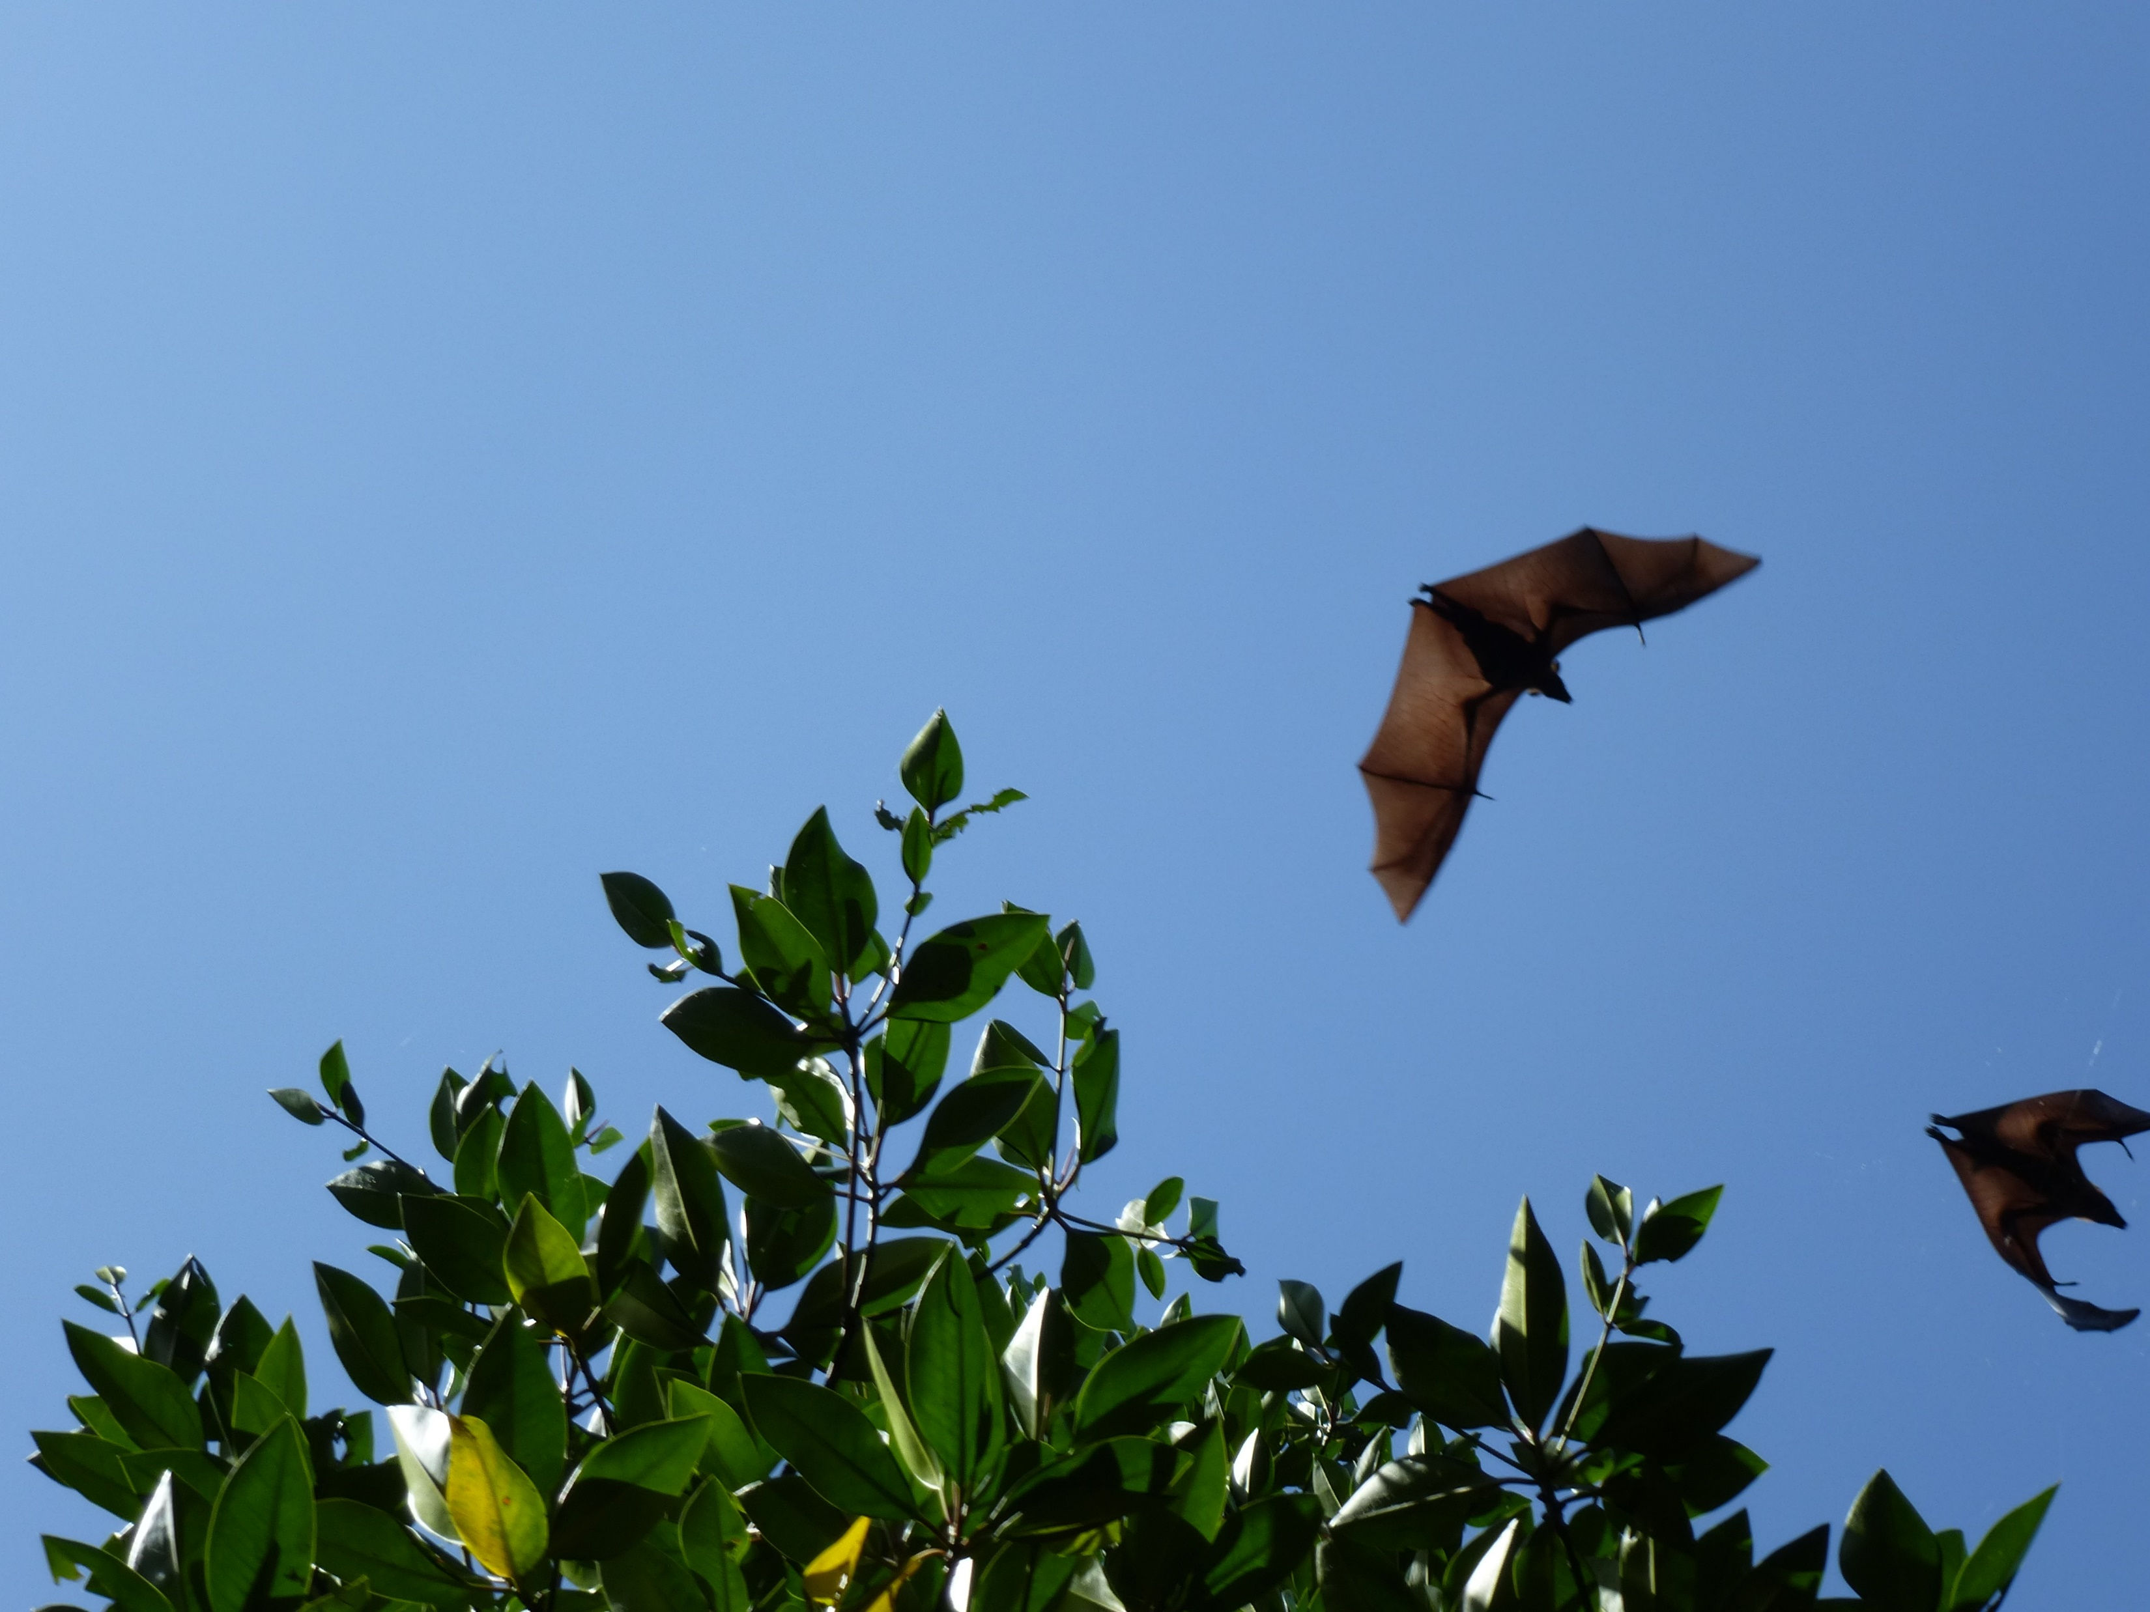
Session 6
Harnessing Nature: Biomimicry
Notes:
Describe the key trait, ask if someone wants to suggest the match.
Next slide, show the match.

Slide 13
Session 6
Harnessing Nature: Biomimicry
The bone structure in the wings of bats and many birds enable them to fly across the sky.
Notes:
Describe the key trait, ask if someone wants to suggest the match.
Next slide, show the match.

Slide 14
Session 6
Harnessing Nature: Biomimicry
The bone structure in the wings of bats and many birds enable them to fly across the sky.
This structure inspired both Leonardo da Vinci and the Wright brothers to create the first flying machines, paving the way for air travel as we know it.

Slide 15
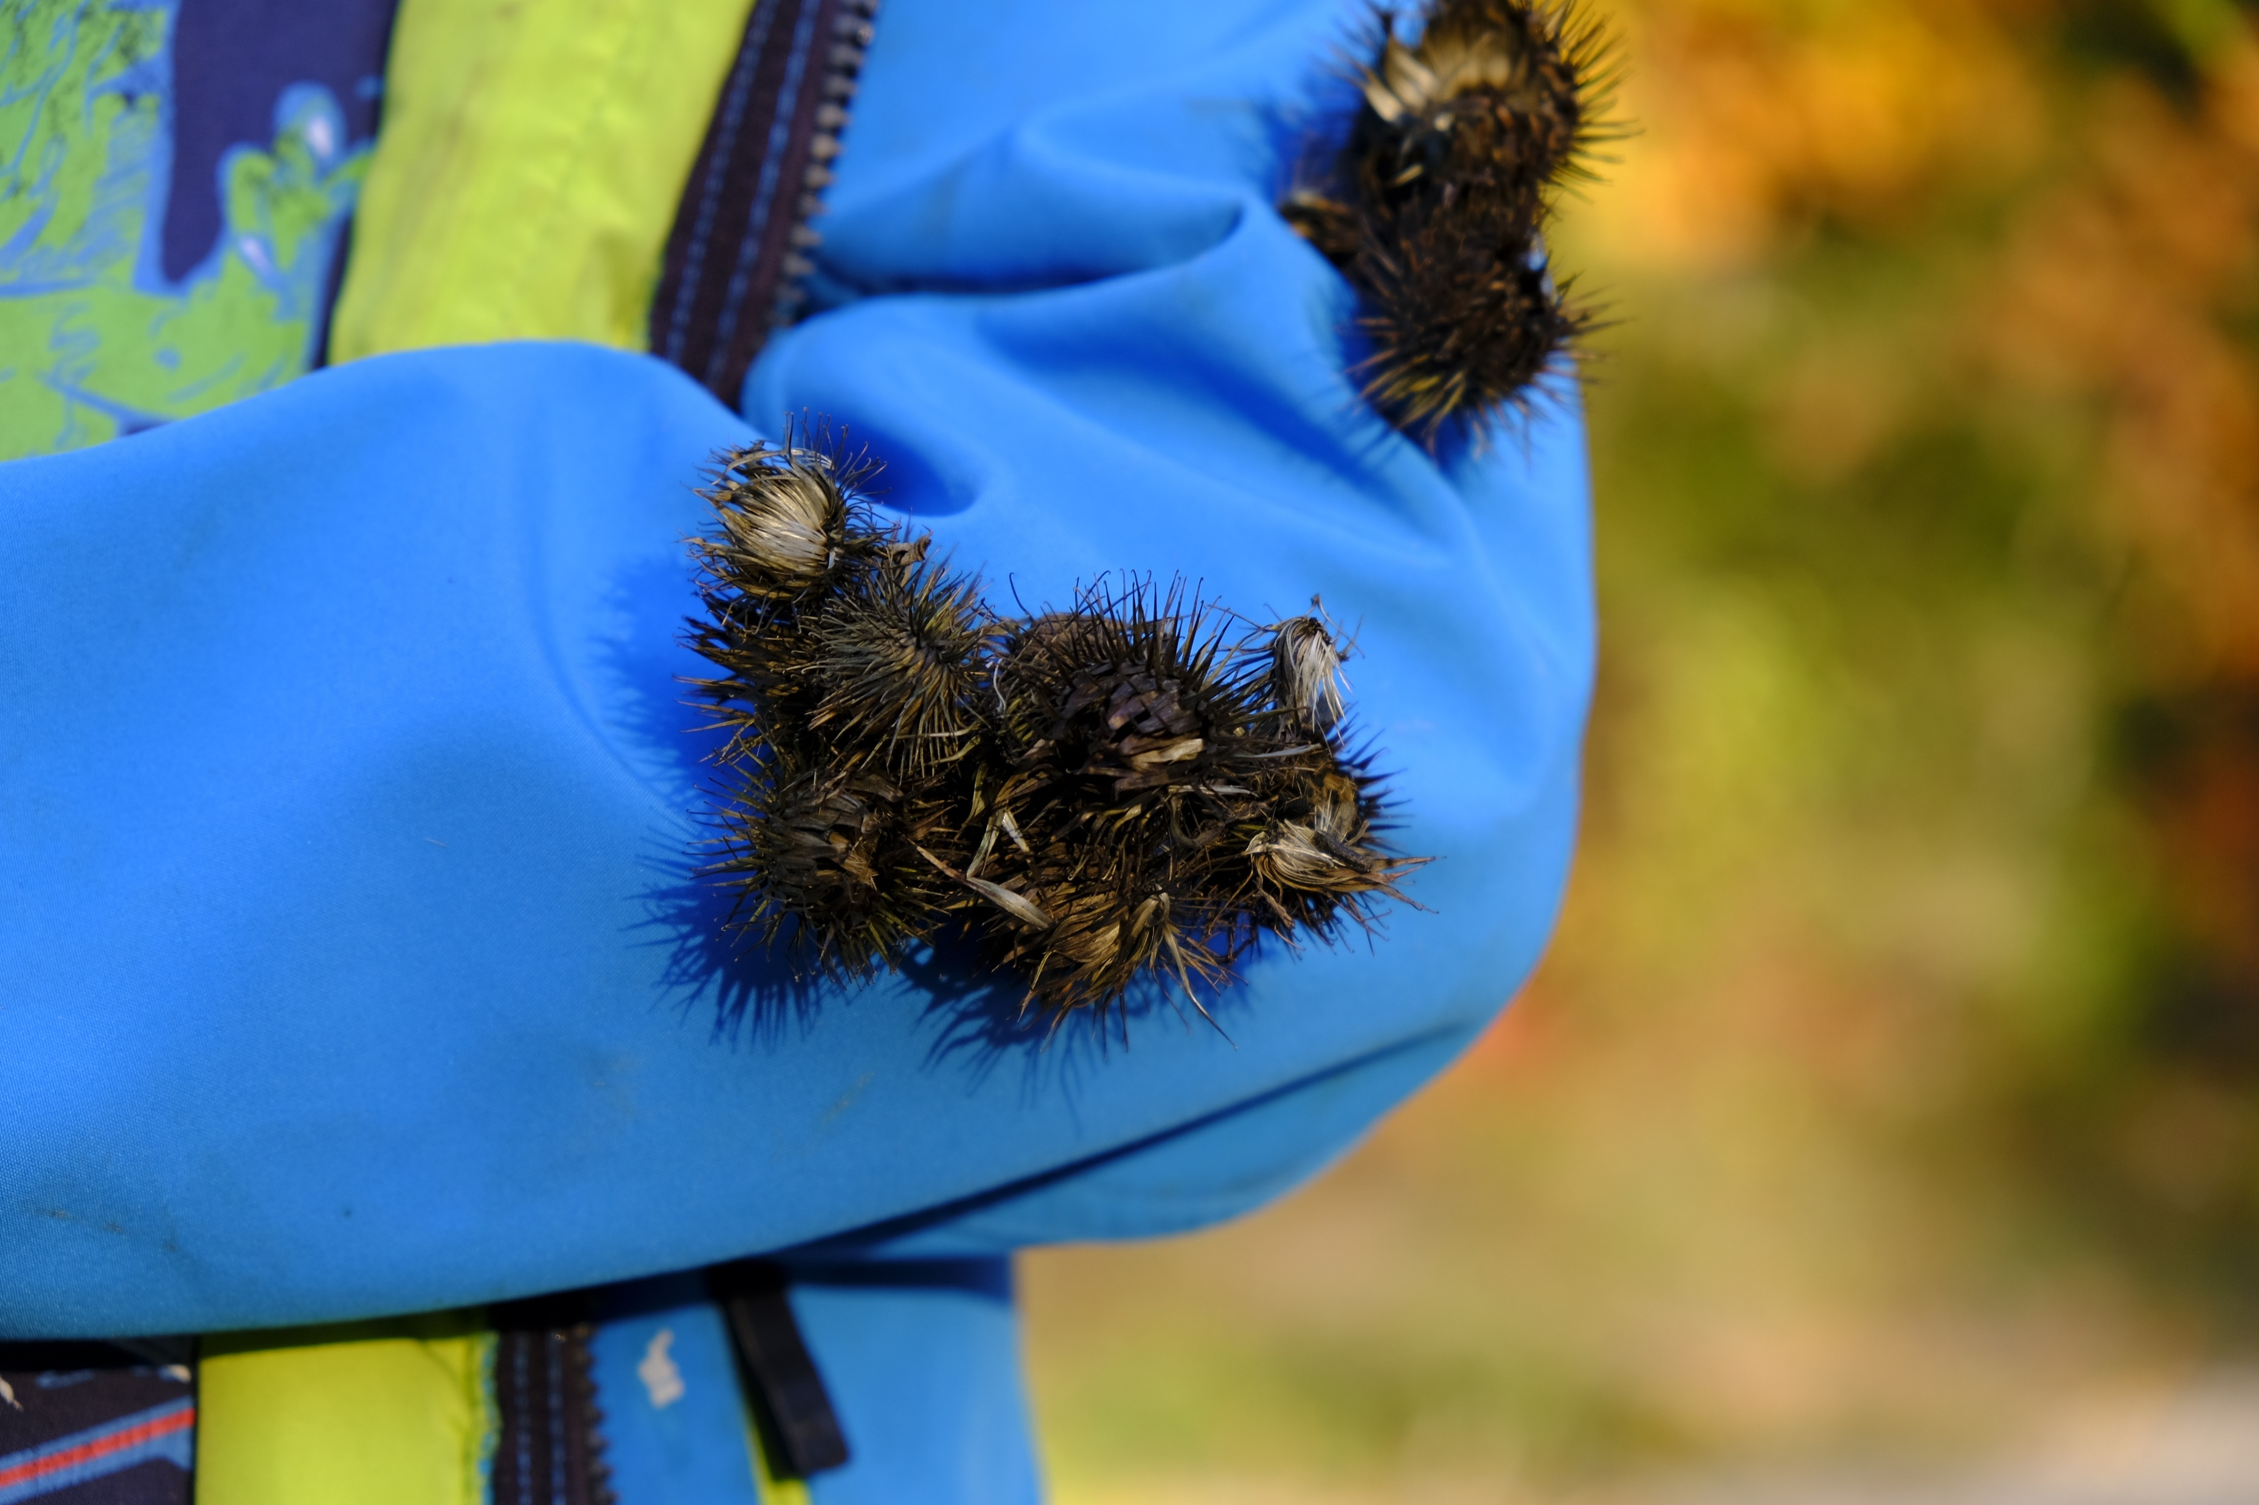
Session 6
Harnessing Nature: Biomimicry
The slim hook structure of the burr enables it to attach to passing by animals (and people) to help spread seeds.
Notes:
Describe the key trait, ask if someone wants to suggest the match.
Next slide, show the match.

Slide 16
Session 6
Harnessing Nature: Biomimicry
Notes:
Describe the key trait, ask if someone wants to suggest the match.
Next slide, show the match.

Slide 17
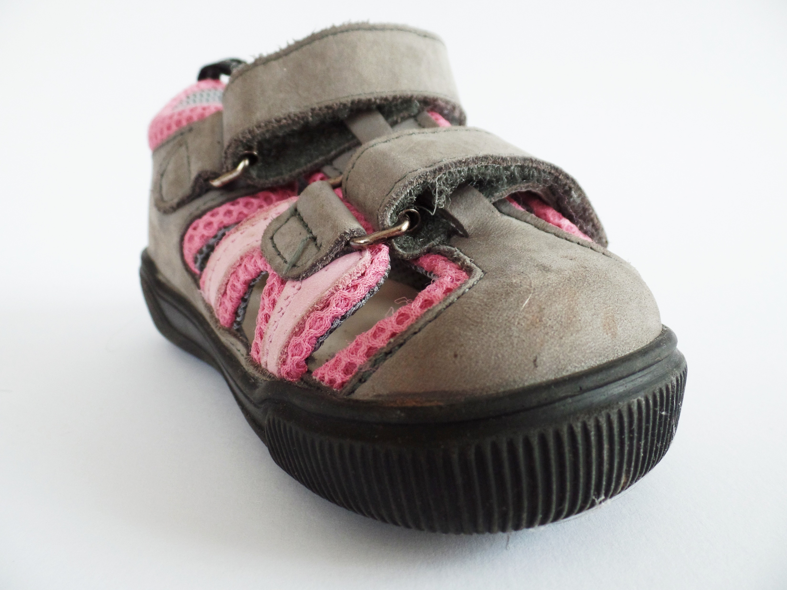
Session 6
Harnessing Nature: Biomimicry
The slim hook structure of the burr enables it to attach to passing by animals (and people) to help spread seeds.
This structure the development of the hook & loop structure of Velcro™.

Slide 18
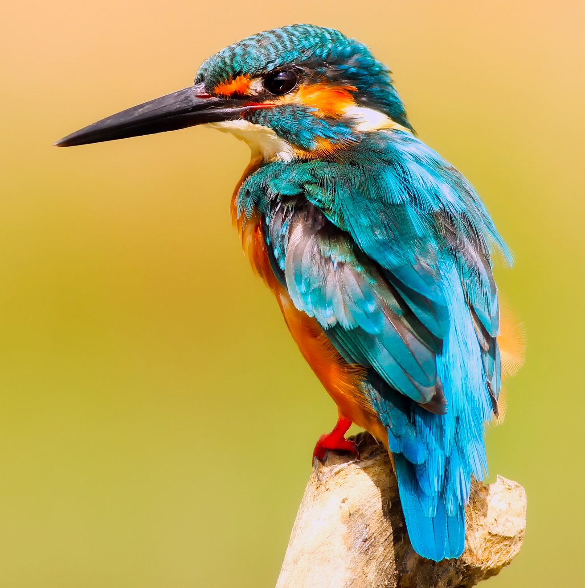
Session 6
Harnessing Nature: Biomimicry
Notes:
Describe the key trait, ask if someone wants to suggest the match.
Next slide, show the match.

Slide 19
Session 6
Harnessing Nature: Biomimicry
The shape of the kingfisher’s head enables it to dive into the water quickly and silently to catch fish.
Notes:
Describe the key trait, ask if someone wants to suggest the match.
Next slide, show the match.

Slide 20
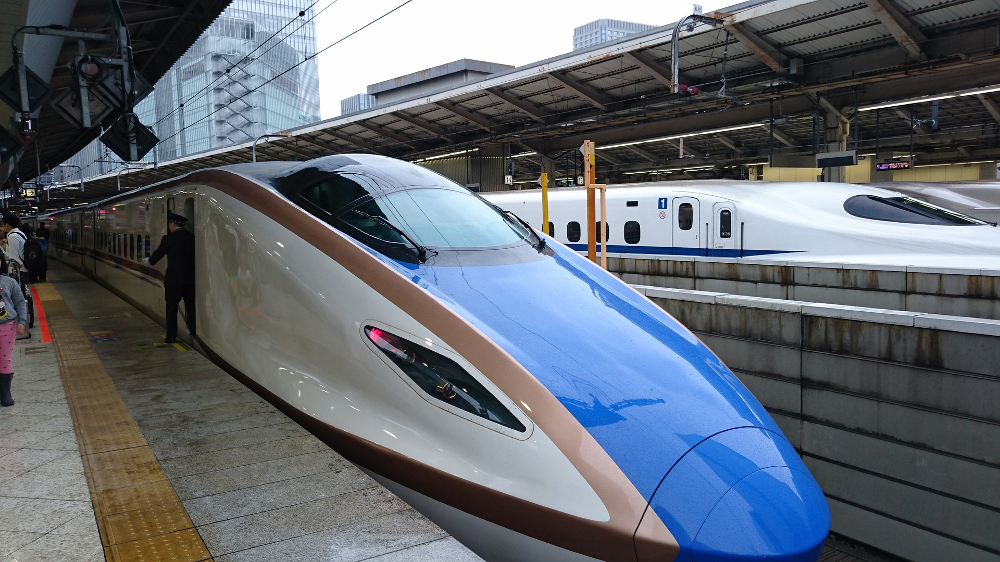
Session 6
Harnessing Nature: Biomimicry
The shape of the kingfisher’s head enables it to dive into the water quickly and silently to catch fish.
The bullet train in Japan is super fast. The first design made a loud boom as it exited tunnels sure to the pressure buildup in the tunnel. When the front of the train was redesigned to look like the kingfisher head, this problem stopped!

Slide 21
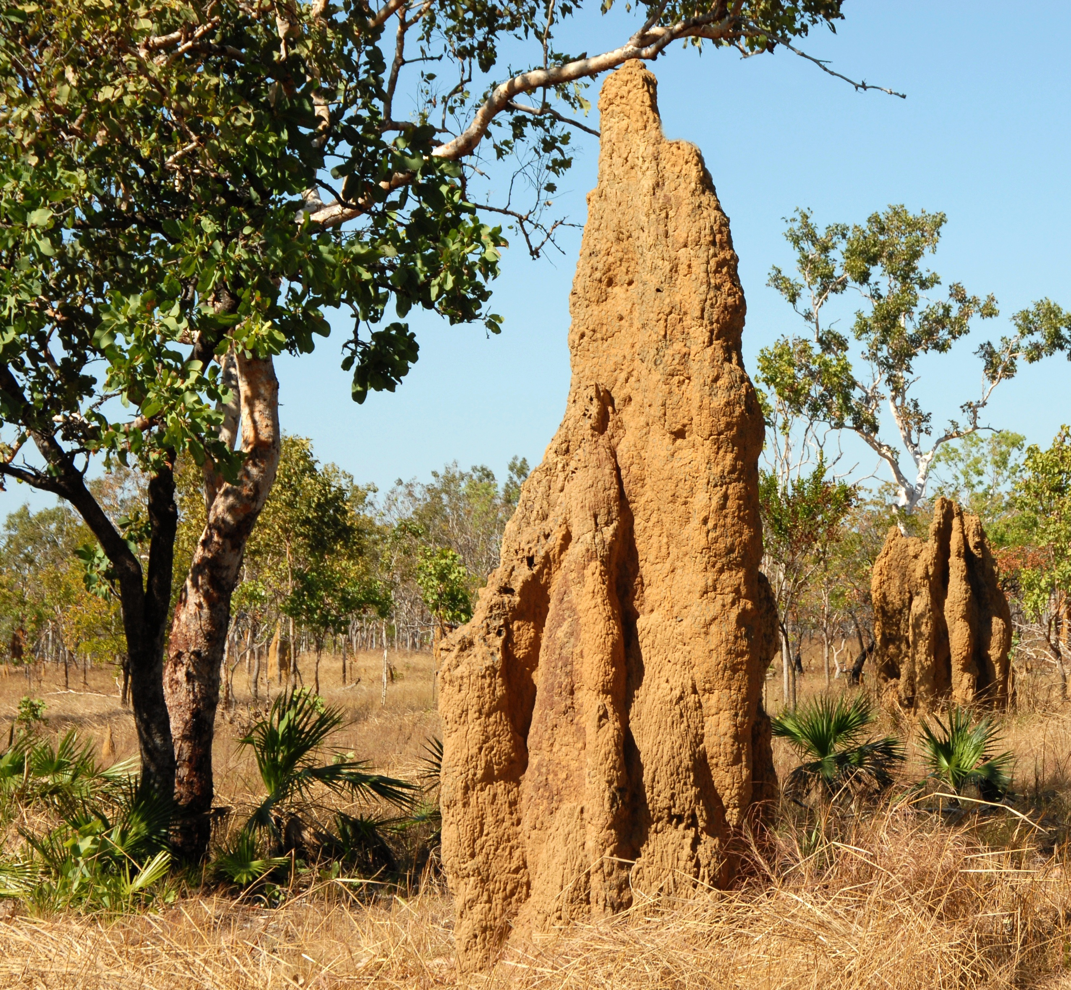
Session 6
Harnessing Nature: Biomimicry
https://www.mickpearce.com/Eastgate.html
Notes:
Describe the key trait, ask if someone wants to suggest the match.
Next slide, show the match.

Slide 22
Session 6
Harnessing Nature: Biomimicry
Termite mounds are full of “windows” and tunnels that let CO2 out and oxygen in, allowing for fresh airflow.
https://www.mickpearce.com/Eastgate.html
Notes:
Describe the key trait, ask if someone wants to suggest the match.
Next slide, show the match.

Slide 23
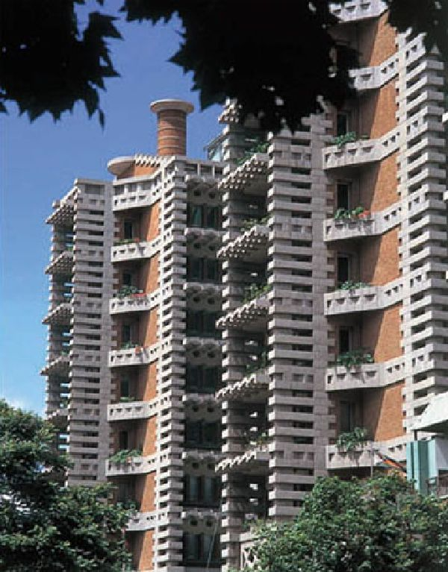
Session 6
Harnessing Nature: Biomimicry
Termite mounds are full of “windows” and tunnels that let CO2 out and oxygen in, allowing for fresh airflow.
Engineers in Zimbabwe have built a shopping mall with a similar structure that also encourages airflow. The building uses 10% less energy for cooling the building mimicking the termite mounds.
https://www.mickpearce.com/Eastgate.html

Slide 24
Session 6
Harnessing Nature: Biomimicry
Copying from other organisms is called BIOMIMICRY
Bio means “from nature” and mimic means “to copy” so biomimicry means “to copy nature”.
People normally group types of biomimicry into three categories:
Form → copying shape
Process → copying how something is done
Ecosystem → Copying how different living things interact
Notes:
People normally group types of biomimicry into three categories:
Form → copying shape
Process → copying how something is done
Ecosystem → Copying how different living things interact

Slide 25
Session 6
Harnessing Nature: Biomimicry
Bio-Inspired Redesign
Heat Island Reduction Concrete buildings, reflective windows, and asphalt streets make urban environments hotter. Pick a design element or two you could incorporate in your neighborhood to make it cooler in the summer. | Smart Water Usage All the rain in NYC goes down the storm drains and into the water treatment plant. Pick a park or a building in your neighborhood, and design a bio inspired way to use some of that rainwater.
Building Energy Buildings take a lot of energy to heat, cool, and to power things like light and computers. Pick a bio inspired way to make your school, home, or corner grocery store more energy efficient. | Ground Stabilization New York City has a lot of coastlines and beaches that can be damaged in storms both from waves and from rain. Upgrade your favorite waterfront park or beach with some bio inspired features to protect the coastline and the people using it.
Notes:
Now it is time for participants to choose one place or building for which they can do a mini-bio inspired redesign. They don’t need to completely redesign the space, but more suggest and describe an upgrade. They can pick from the list above or else suggest their own location.

Slide 26
Session 6
Harnessing Nature: Biomimicry In Architecture
Construction and Materials
Mushrooms-Mycelium The root structure of mushrooms (called mycelium) is an extensive network that binds soil in the wild. Developers can use just the roots (not the fruit) to bind lightweight insulating material (like straw) and make a biodegradable material that can be used for packaging or insulation. | Leaves, rivers, flower petals Curves surfaces are found throughout nature and are both pleasing to the eye and low energy ways for air and water flow. Curved buildings are not only pleasant to look at but also support better airflow inside.
Spider Webs Spiders don’t want birds crashing through their webs so they have a special UV reflective materials in their silk to deter birds. Some glass manufactures are trying to replicate this with their window glass. | Beehive Honeycomb The honeycomb structure used in beehives is very strong but uses the minimum amount of material for the volume. Lightweight building can use this technique to build a strong structure with the least amount of material.

Slide 27
Session 6
Harnessing Nature: Biomimicry In Architecture
Energy Efficiency
Sunflowers Sunflowers naturally track the sun to maximize exposure. Solar cell manufactures have mimicked this behavior to help design systems that capture the most sunlight. | Sedona Cactus These giant cacti have ridges in their truck. These ridges provide built in shade to help keep the cactus cool in the hot sun. Some construction companies have employed similar strategies to help keep buildings cool.
Slime Molds Are a fugus that is very good at mapping the most efficient route to get to its food. City planners are using it to plan the fastest ways to move around, and between, complex and highly populated cities. | Termite Mound The small holes and tunnel network force air circulation in termite mounds. Similar

Slide 28
Session 6
Harnessing Nature: Biomimicry In Architecture
Water Usage & Ground Stabilization
Plant Respiration One-way plants help keep neighborhoods cool is because of water evaporation from the surface of their leaves. Building off this concept, some buildings and public spaces have created artificial mini waterfalls that use recirculated collected rain-water to keep the area cooler through evaporation. | Tall Vetiver Grass This grass is known for its very long root system that helps stabilized sandy shores against erosion. Using a similar design, engineers often insert 8 ft long steel poles into unstable ground to stabilize it prior to construction.
Forest Ecosystems, Tree Trunks Plants and tree root systems naturally filter water and slow run-off. By plants small greenspaces in sidewalks and parkettes, the amount of rain that enters the sewers and water treatment systems can be decreased. Additionally, the quality of that water improves and puts less strain on the water treatment plants. | Oyster Reefs Oysters extract minerals from the water to make their shells. They also filter toxins out of the water naturally. Many costal towns (including around NYC) are creating breakwaters from oyster shells that help protect the coast and clean the water.

Slide 29
Session 6
Harnessing Nature: Biomimicry In Design
Slime molds → efficient routes between locations (city planning)
Humpback whale fins → wind turbine design
Fog Harvester beetle → atmospheric water capture
Mycelium (mushroom roots) → non-toxic (biodegradable) insulation and packaging
Muscles → non-toxic underwater adhesive
Animal Limbs → Earthquake resistant bridges
Plant stems and tree trunks → water filtration
Underwater plants (kelp) and wave motion → energy generation
Maple and sycamore seed pods → ceiling fan design
Octopus limbs → soft, flexible robotics
Forest system → water purification
Spider webs → UV reflective additives to prevent birds from hitting windows.

