Slide 1
Collaborative Communities
Presented by

Slide 2
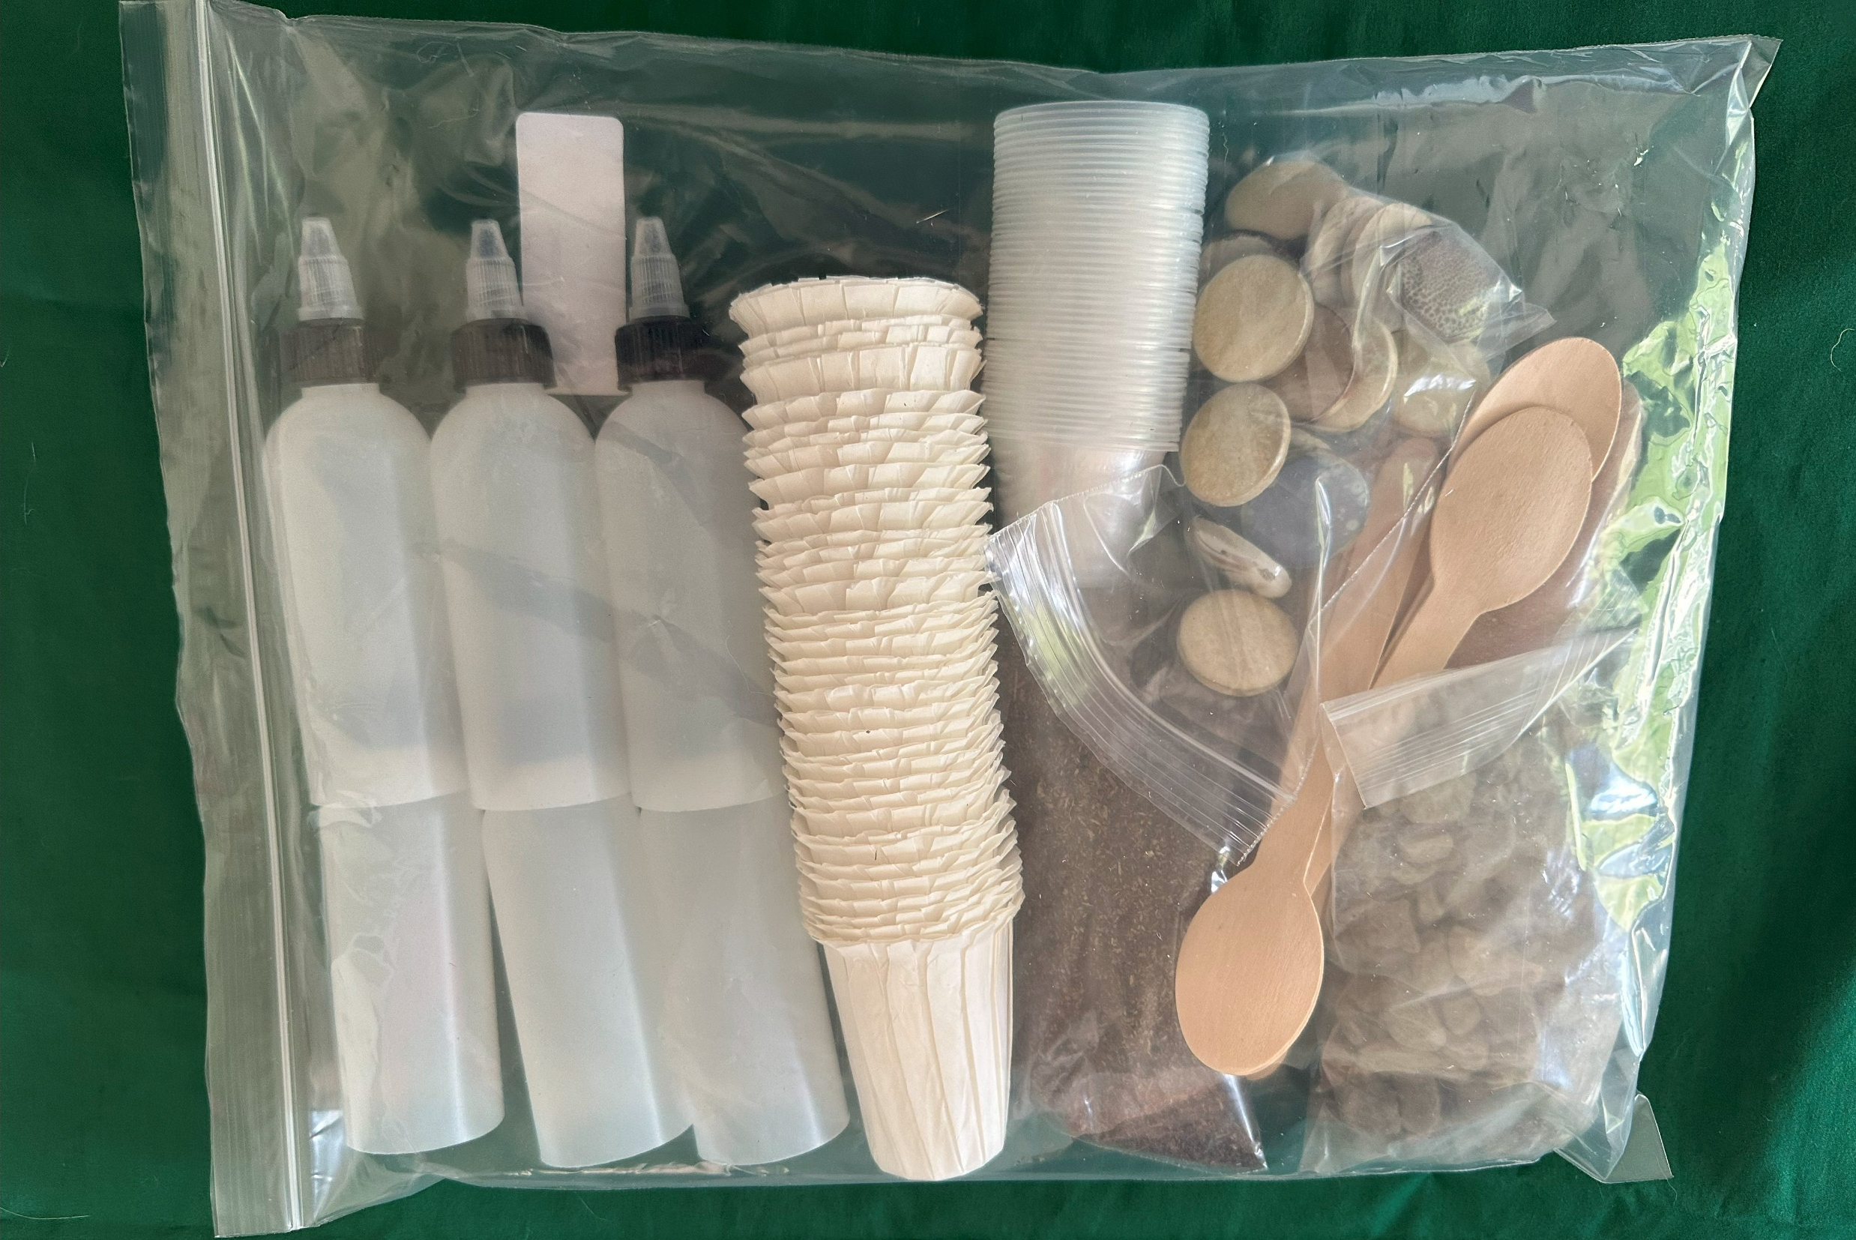
Session 8
Sustainable Materials: Concrete Alternatives
What you need
Participant notebook Ground water investigation – Participants will work in groups of 4 Each group receives: Filter container 4 – 6 filter cups Foil sheet teaspoon Shared resources Soil Clay Rocks Water Push pins Additional Supplies Needed Cup Water Paper towels Pens/pencil
Session Flow | Session Flow
10 min | Welcome. Topic introduction via discussion prompt
10-15 min | Ground water experiment round 1 with discussion
15 min | Science lesson, technology discussion
10 min | Round 2 time permitting
Remaining time | Wrap up and cleanup
Session 8 Materials
Participant Notebook

Slide 3
Session 8
Concrete
What do you know about concrete?
Notes:
Allow kids to brainstorm a bit

Slide 4
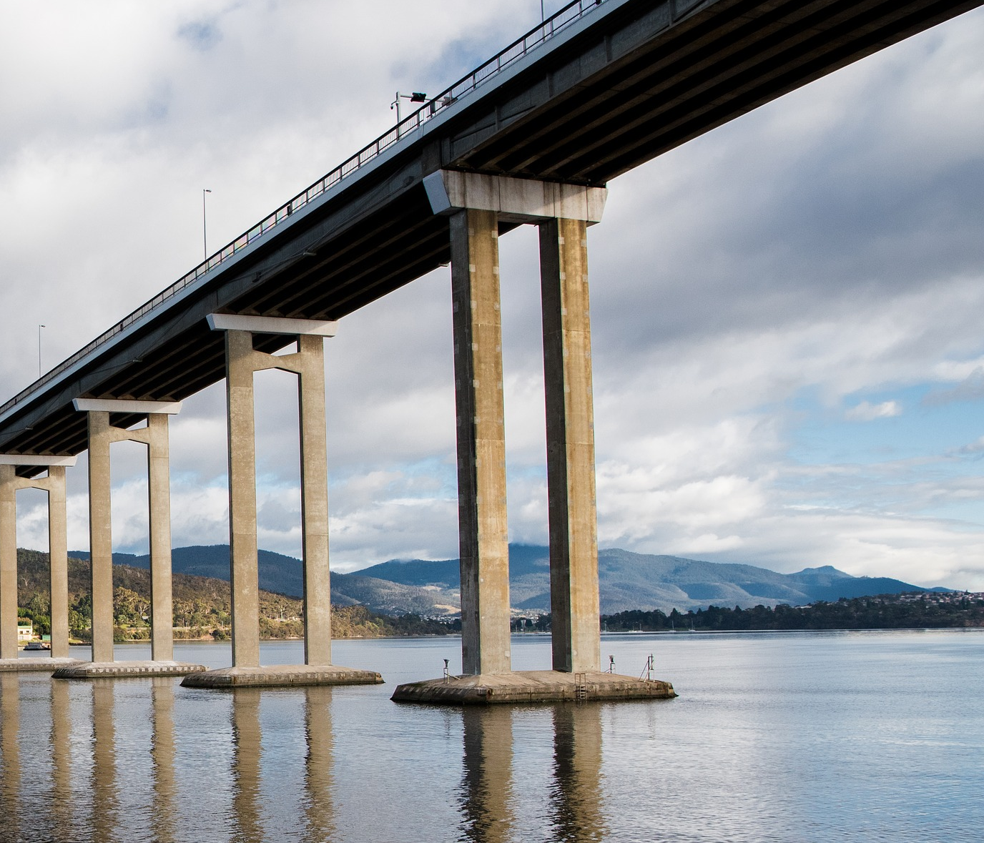
Session 8
Concrete Alternatives
Concrete
Concrete is used in many places throughout construction. It is a mixture of cement, water, sand, and rocks (called aggregate).

Slide 5
Session 8
Concrete
Let’s list out all the ways we can think of to use concrete.
Notes:
Allow participants a chance to brainstorm a bit about all the ways that we use concrete.

Slide 6
Session 8
Concrete
Let’s think about some Pros and Cons of concrete
Pro | Con
Notes:
Allow participants to brainstorm a bit about all the ways that we use concrete. After they’ve had some time to discuss and share, spend a little time filling out the table on this slide.
Some examples: Concrete is used in many places throughout construction. Some examples are driveways, walkways, and foundations. It is very strong and durable but requires a lot of energy to make. As well, regular concrete does not provide many benefits for plants and animals.

Slide 7
Session 8
Concrete Alternatives
Concrete
Concrete is used in many places throughout construction. Some examples are driveways, walkways, and foundations. It is very strong and durable but requires a lot of energy to make. As well, regular concrete does not provide many benefits for plants and animals.

Slide 8
Session 8
Concrete Alternatives: Comparing Ground Materials
Let’s examine four different types of ground material and what happens to them in the rain.
Soil
Clay
Rocks
Concrete
What do you think some design criteria are for ground covering?

Slide 9
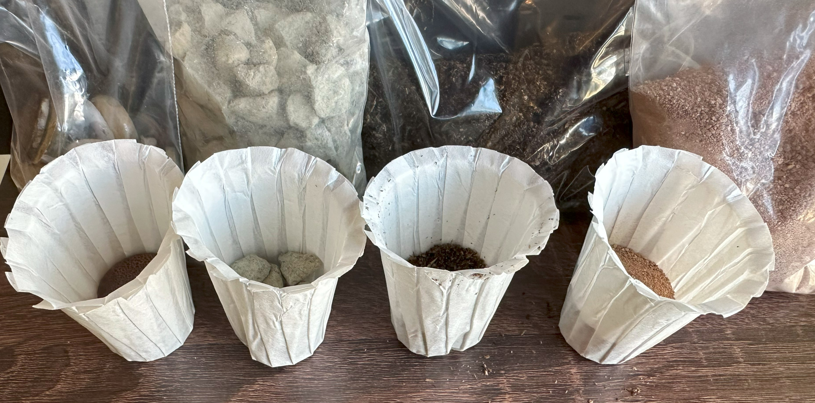
Session 8
Concrete Alternatives: Comparing Ground Materials
What you need:
Condiment container
Paper filter cups
1 oz cups
Foil
Soil
Clay
Tiles
Rocks
Teaspoon

Slide 10
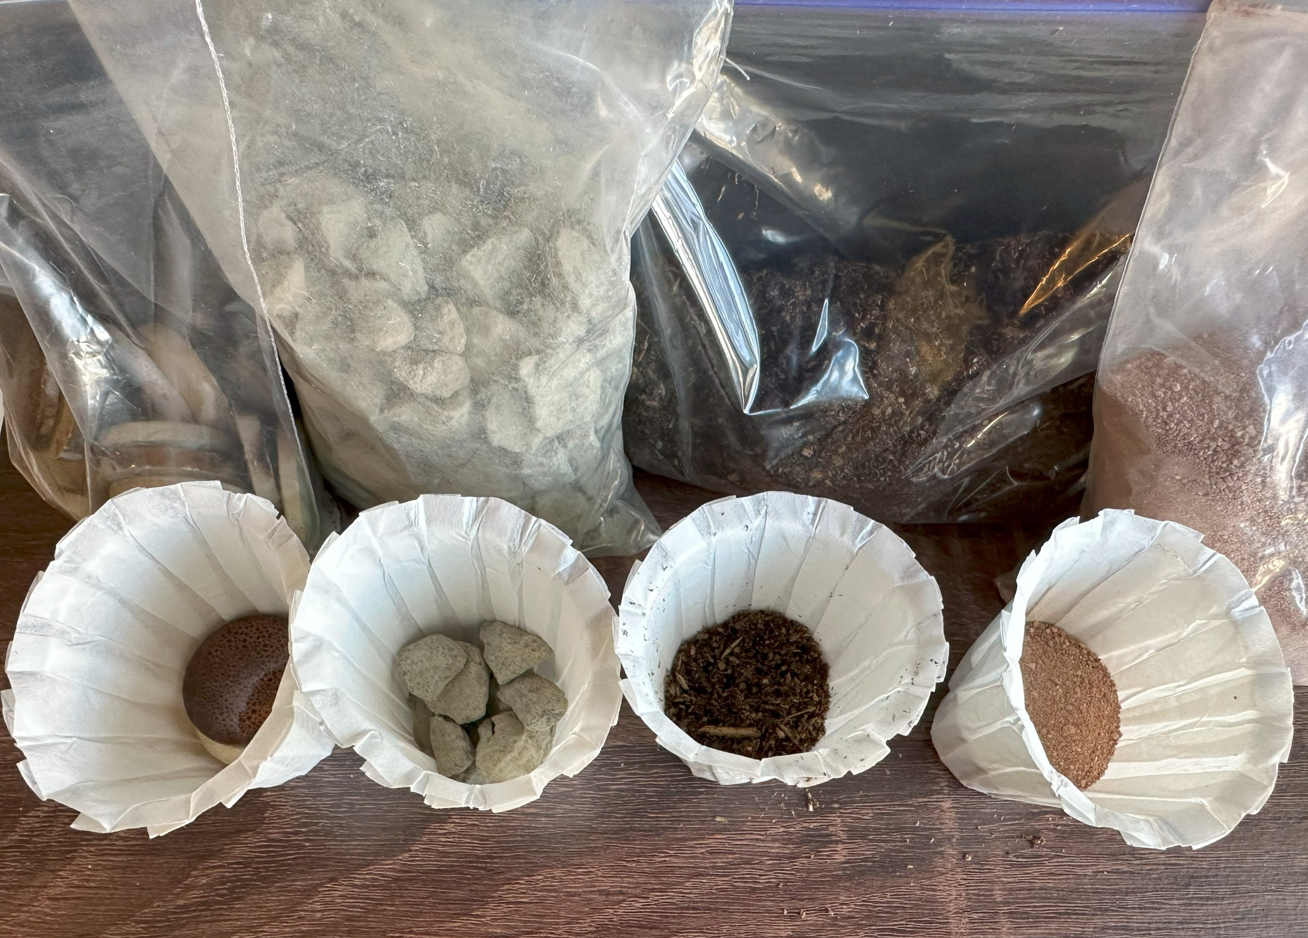
Session 8
Concrete Alternatives: Comparing Ground Materials
Step 1:
Set out four paper filter cups and fill one each with tiles, soil, gravel, and clay respectively. All should be about the same height (~ 1 inch or 4 tiles).
Gather two 1-ounce cups of water

Slide 11
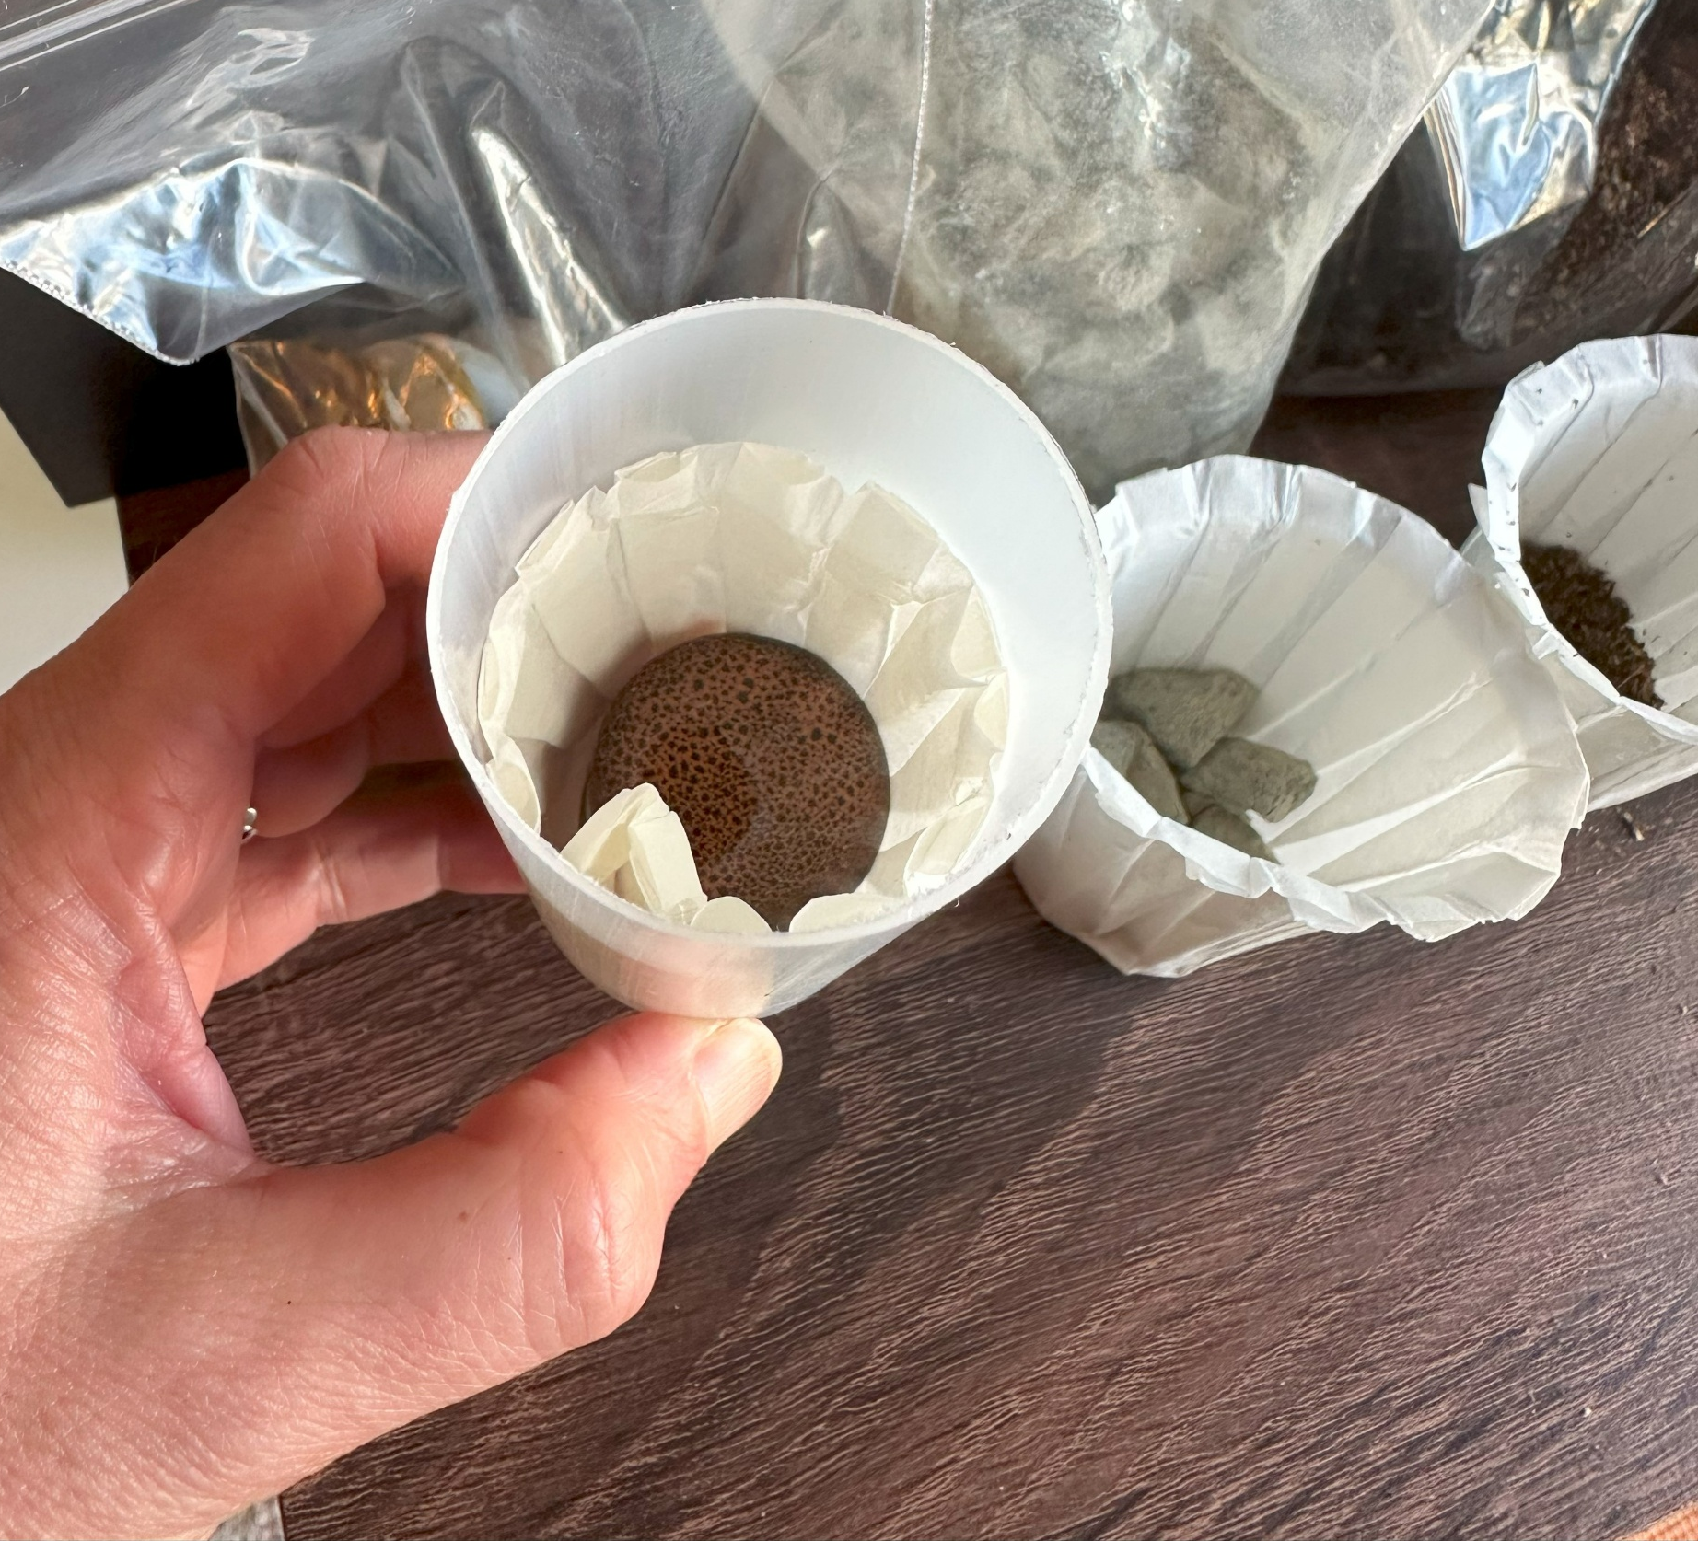
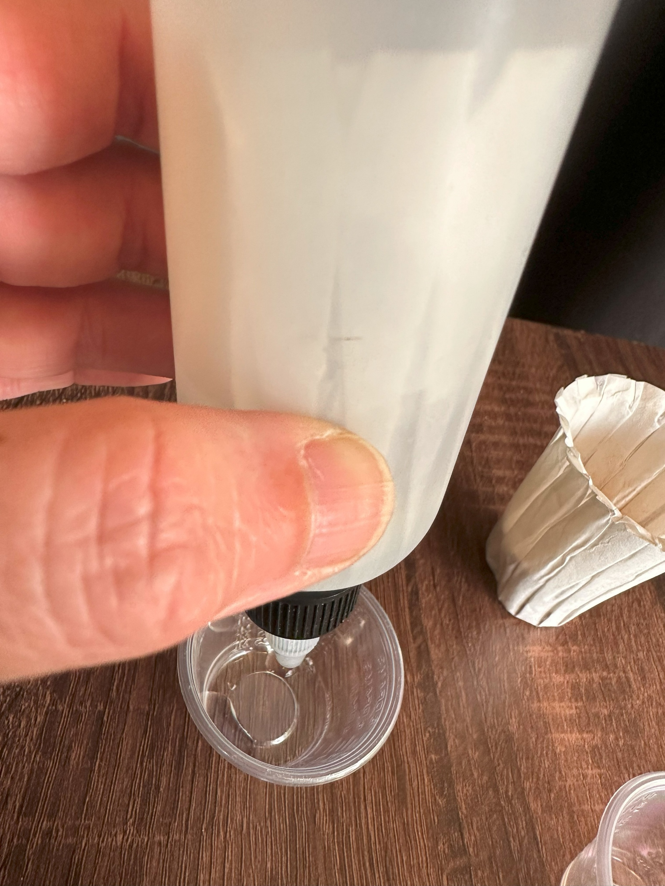
Session 8
Concrete Alternatives: Comparing Ground Materials
Step 2:
Starting with the tiles, place the paper filter cup into the condiment container. Place or hold a 1-ounce cup under it to catch the water that comes through on the next step.
Pour 1-ounce of water on top of the tiles. Wait 1 minute to see how much of the 1-ounce of water makes it through. Describe how fast or the water moved through the system.

Slide 12
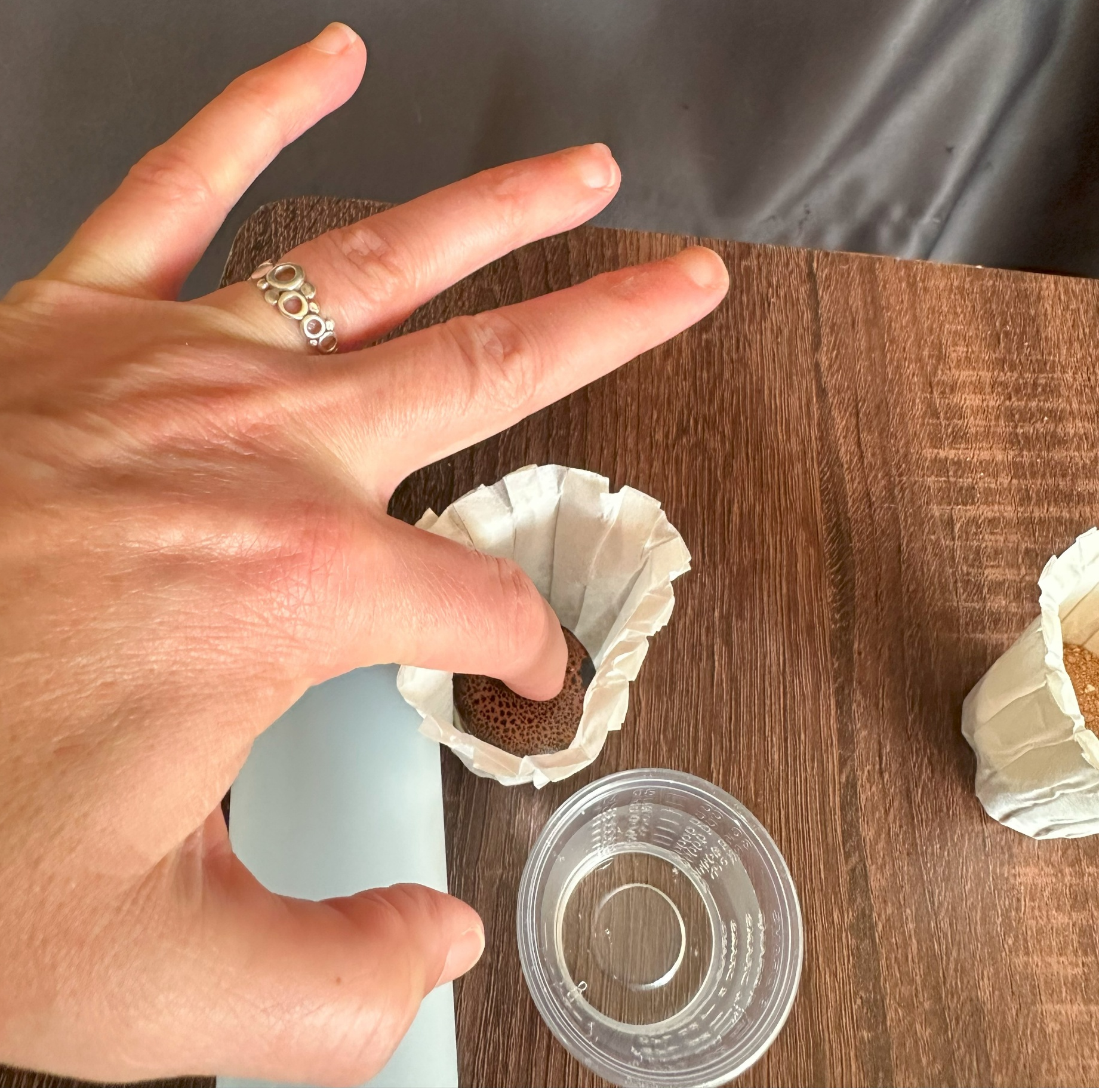
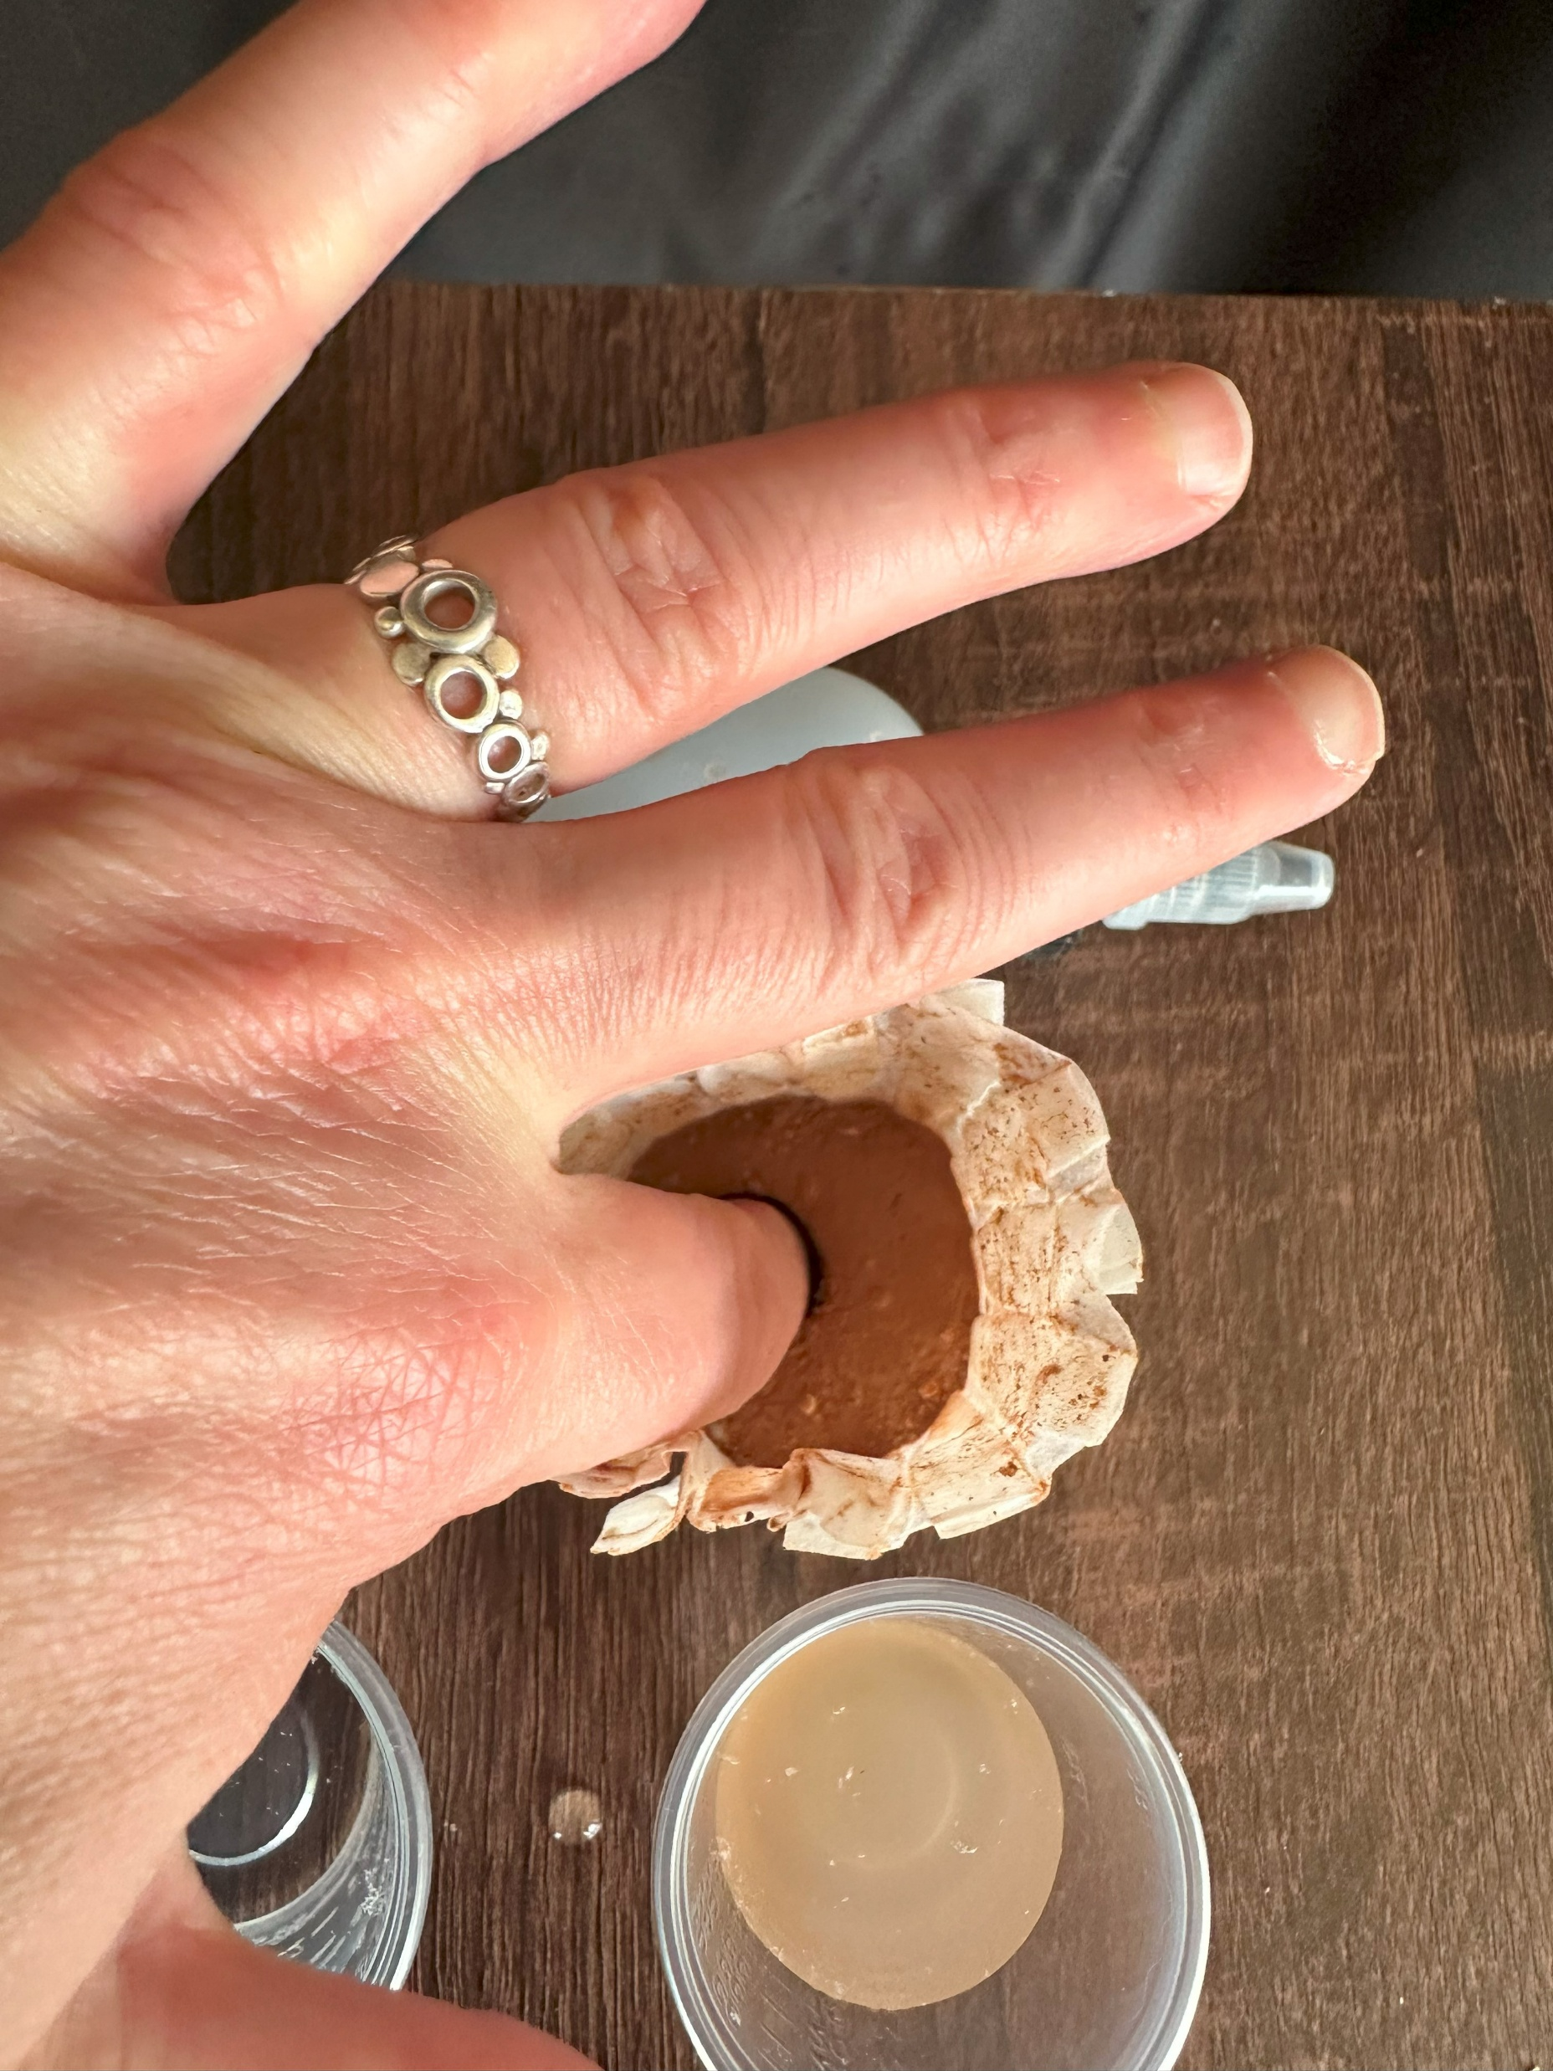
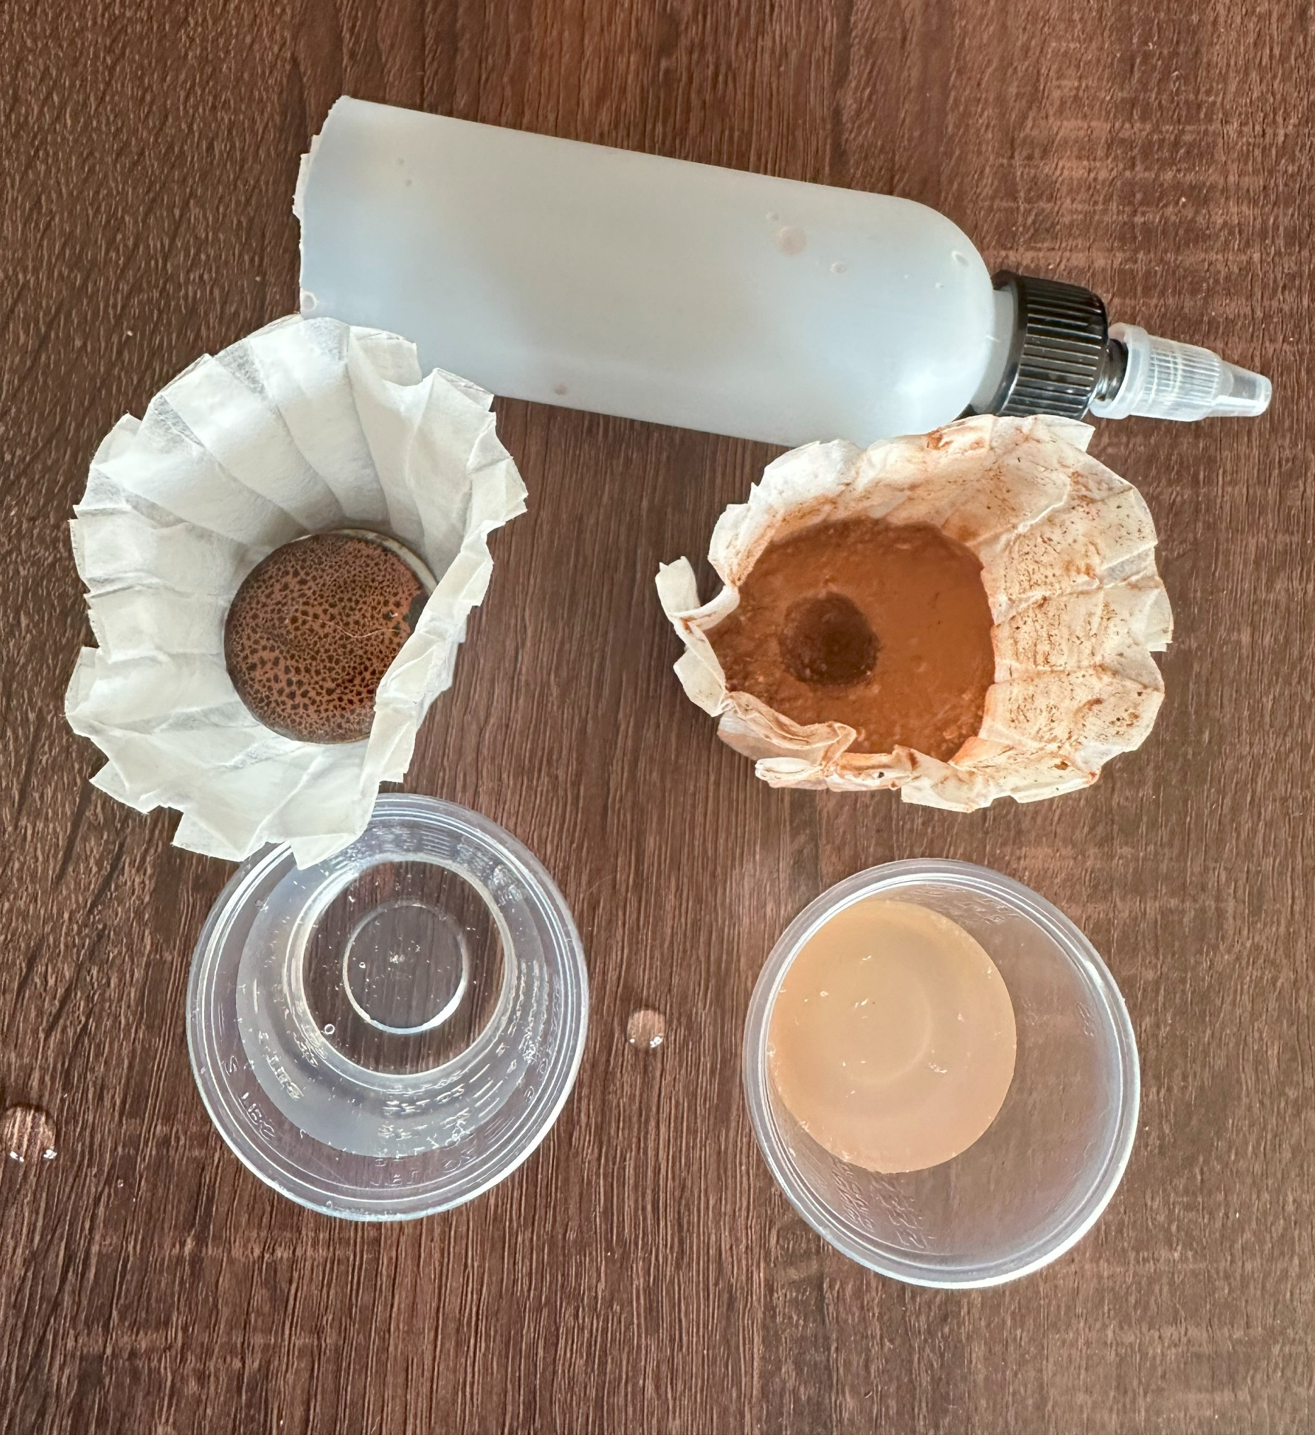
Session 8
Concrete Alternatives: Comparing Ground Materials
Step 2 cont.:
Pour a second 1-ounce cup of water over the tiles. Repeat the observations from step 2b. Gently touch the top of the surface of the tiles and describe what you feel.
Repeat for the other materials comparing how fast the water comes through, how much water comes through and how the material feels to the touch (e.g., solid, soft, etc.).

Slide 13
Session 8
Concrete Alternatives: Comparing Ground Materials
What did you notice about the four different materials?
Clay | Soil | Rocks | Concrete
Notes:
Key observations:
Clay absorbs a lot of water but has no strength or ability to keep its shape
Soil is similar – perhaps a bit stronger but absorbs a bit less water
Rocks – absorb some water (more surface area), but not a lot.
Concrete doesn’t absorb any water and the water runs through it very quickly
Key observations - Concrete has a lot of advantages in the strength department, but it can’t hold any water, which can be an issue when severe rains or coastal storms come. It also doesn’t allow for growth of plant or animal habitat.

Slide 14
Session 8
Concrete Alternatives
Timbercrete
Normal concrete is made by mixing rocks into cement. The final product is very strong but very heavy. With timbercrete sawdust or wood chips are added to the cement mixture instead of rocks. This makes a lighter concrete-product. The lighter weight decrease transportation costs and the material uses parts of wood that would otherwise go to waste.

Slide 15
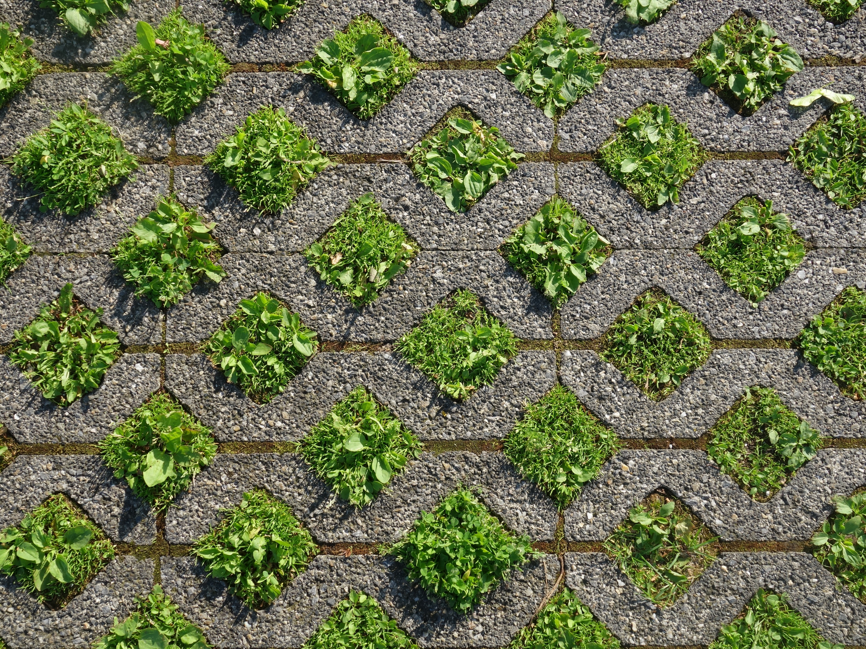
Session 8
Concrete Alternatives
Grasscrete
Grasscrete does not form blocks for building but reduces the amount of concrete required in a walkway or driveway. A cutout pattern is made so grass or plants can grow between pieces while still maintaining a hard surface. Grasscrete increases the ground’s ability to absorb water compared to a space paved over completely. It also allows places for plant life to grow.

Slide 16
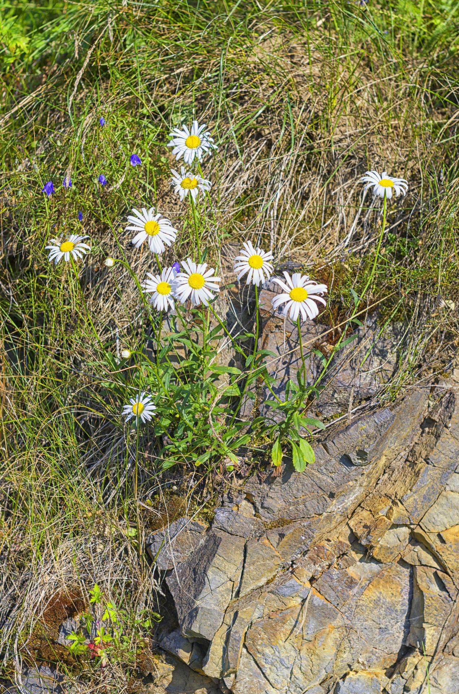
Session 8
Concrete Alternatives
Biocompatible Concrete
A new field of concrete alternatives includes the group of biocompatible concretes. With these materials, a fifth material is added to the concrete blend—in addition to the cement, water, sand, and aggregate—to enable the concrete to actively support living organisms.

Slide 17
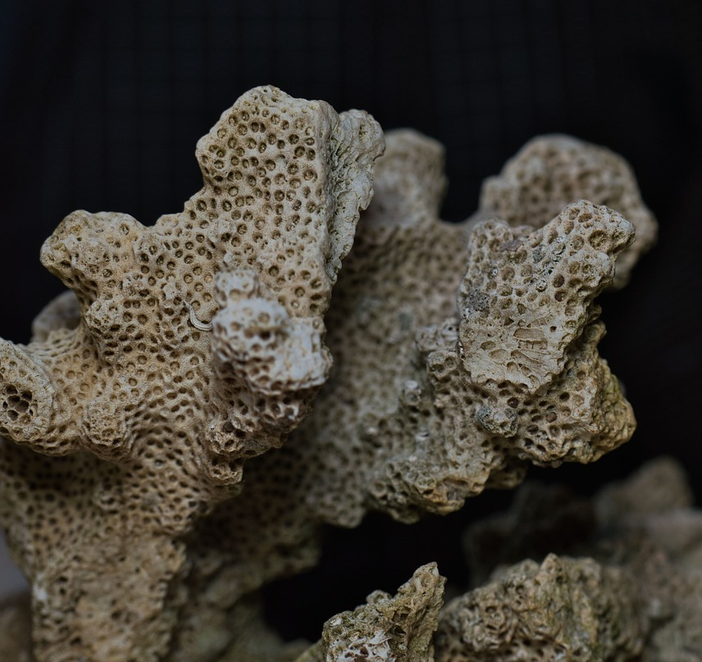
Session 8
Concrete Alternatives
EVELYN TICKLE
From: Charlottesville, VA
Invention: By adding specific chemicals to match the oyster shell composition and producing concrete forms that allow for the integration of living organism, Evelyn was able to develop a product with the strength of concrete but that also supports marine ecosystems.

Slide 18
Session 8
Concrete Alternatives: Comparing Ground Materials
Round 2:
Repeat your previous experiment but now try combinations of materials. Is there a combination that might work better for different applications?

Slide 19
Session 8
Concrete Alternatives: Wrap up
Think about a place in your neighborhood that uses concrete.
Is there something you could replace that concrete with that would still perform the same task but also work with the plants and animals in the neighborhood?

